Slide 1

klasa III
moduł 29
COMMUNITY WORKERS
PI Synergia początkowej nauki języka obcego z edukacją wczesnoszkolną i technologiami informacyjno-komunikacyjnymi.
Projekt współfinansowany przez Europejski Fundusz Społeczny w ramach Programu Operacyjnego Kapitał Ludzki.
Priorytet III Wysoka jakość systemu oświaty, Działanie 3.3 Poprawa jakości kształcenia, Poddziałanie 3.3.4 Modernizacja treści i metod kształcenia – projekty konkursowe.

Slide 2
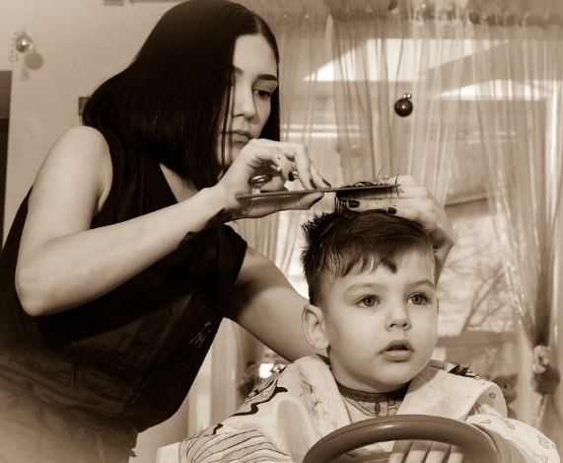
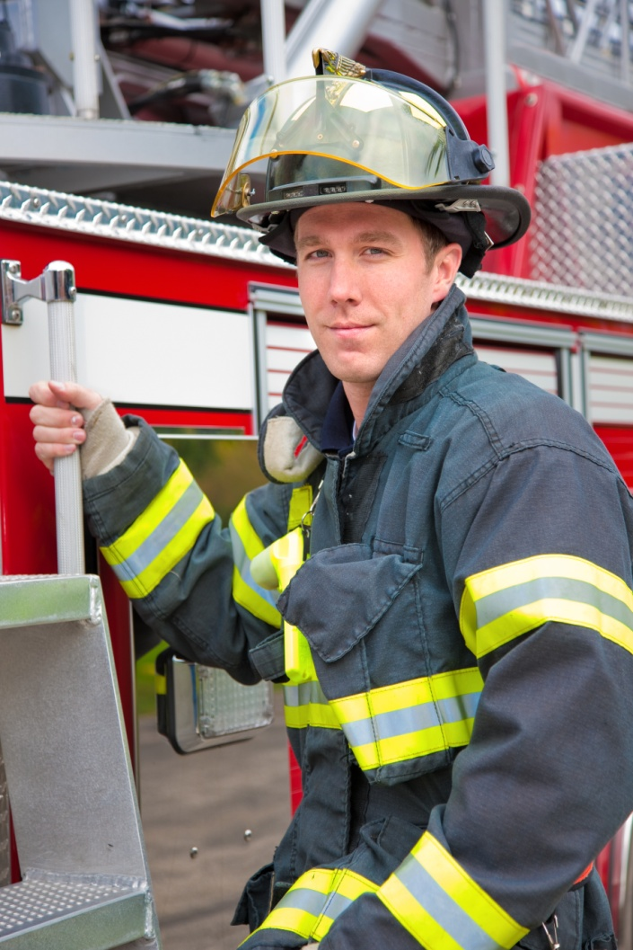
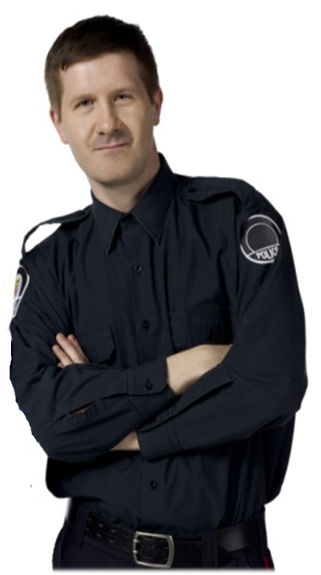
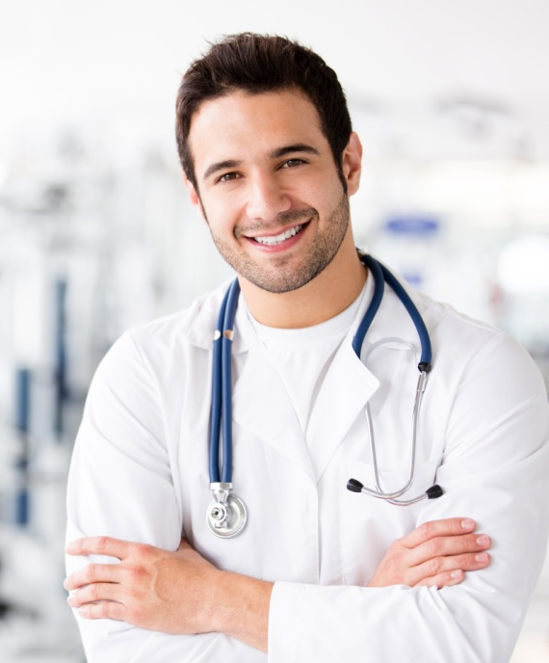
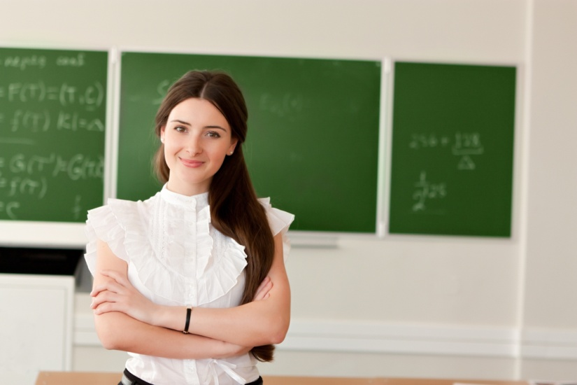
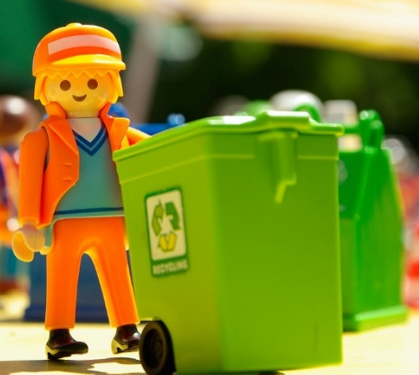
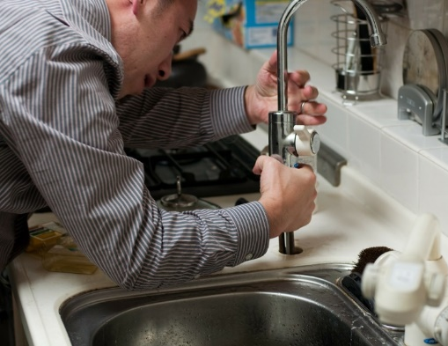
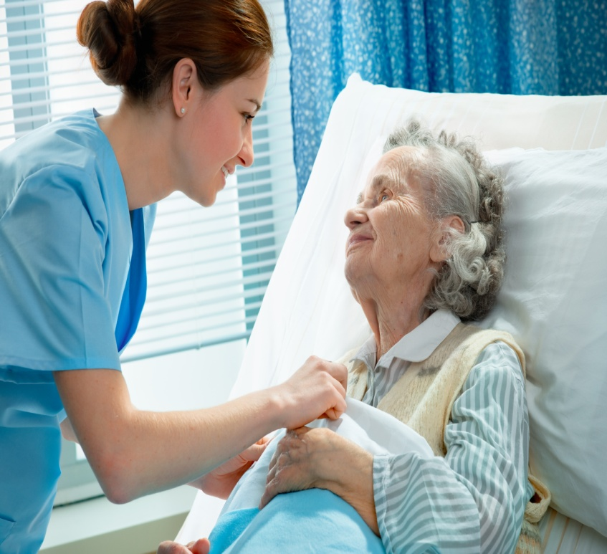
a doctor
a hairdresser
a firefighter
a police officer
a teacher
a garbage
collector
a plumber
a nurse

Slide 3
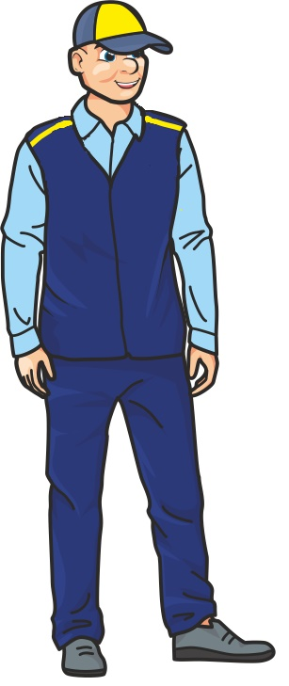
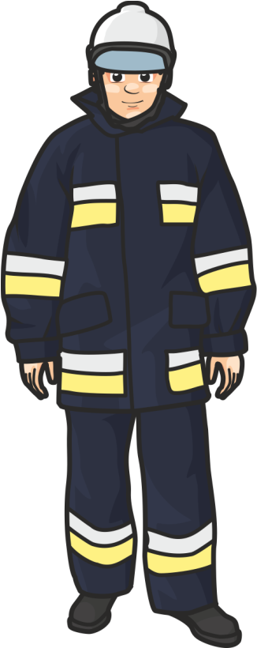
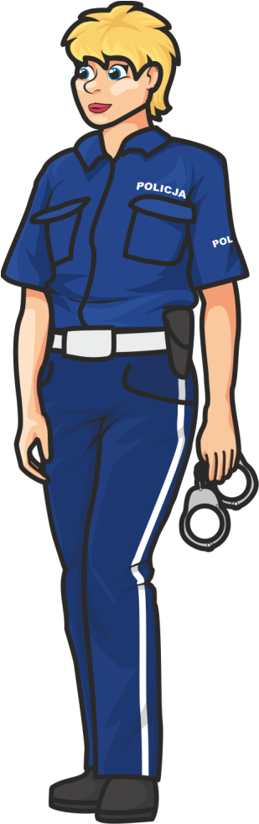
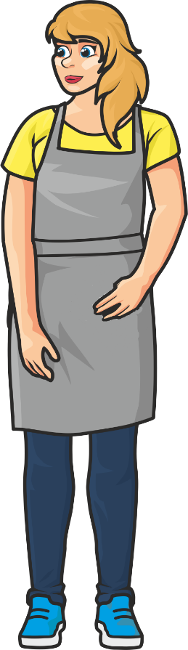
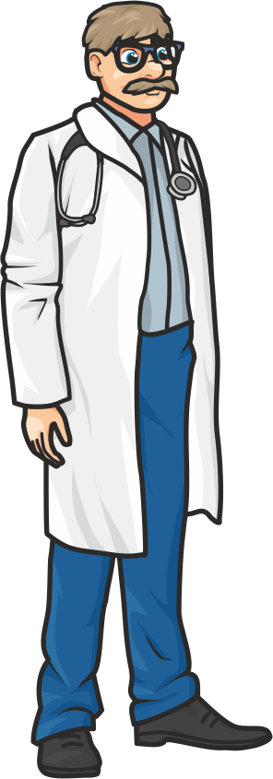
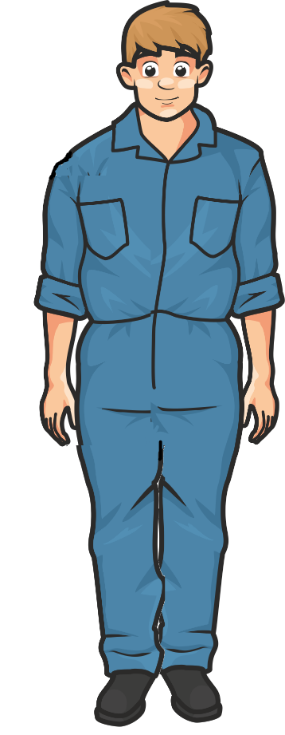
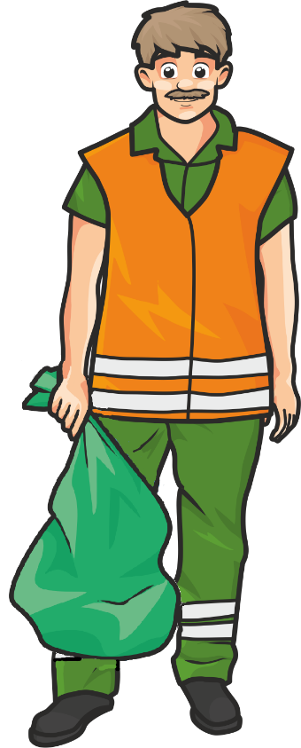
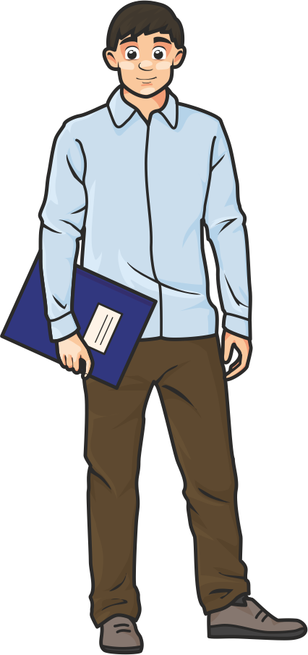


Who are they?
He is a garbage collector.
He is a postman.
She is a police officer.
She is a hairdresser.
He is a plumber.
He is a firefighter.
He is a teacher.
He is a doctor.

Slide 4

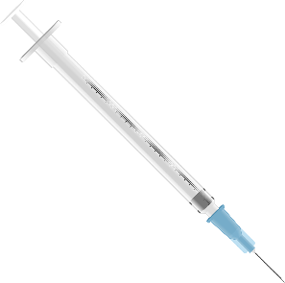


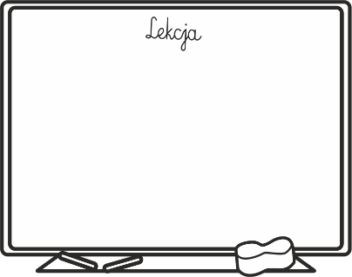

a whiteboard
a plunger
a bin
handcuffs
a stethoscope
a syringe

Slide 5


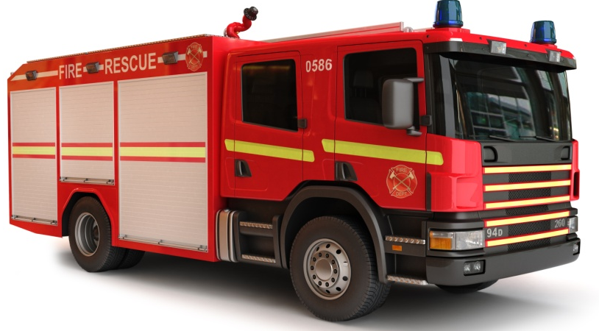









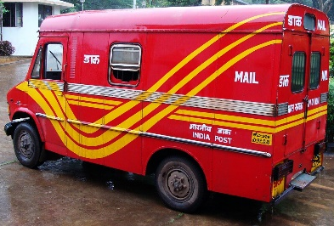

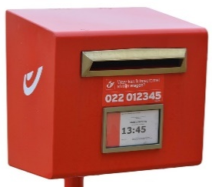

Odd one out
Firefighter
Plumber
Hairdresser
Postman

Slide 6
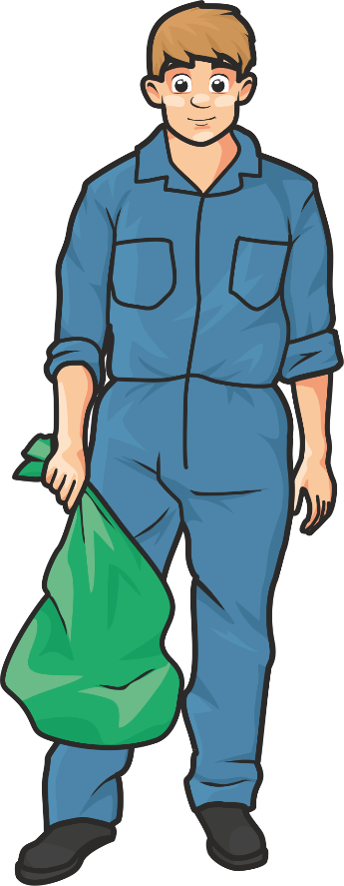
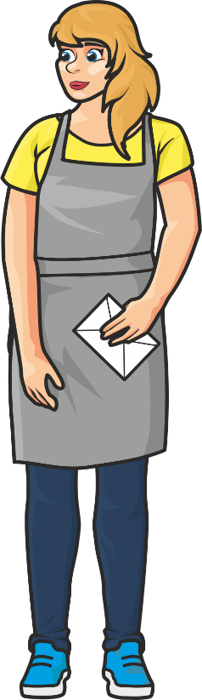
Who needs it?
I’m a plumber but I’ve got a big plastic bag.
Who needs it?
a. a teacher
I’m a hairdresser but I’ve got a letter.
Who needs it?
b. a garbage collector
c. a doctor
a. a plumber
b. a police officer
c. a postman

Slide 7
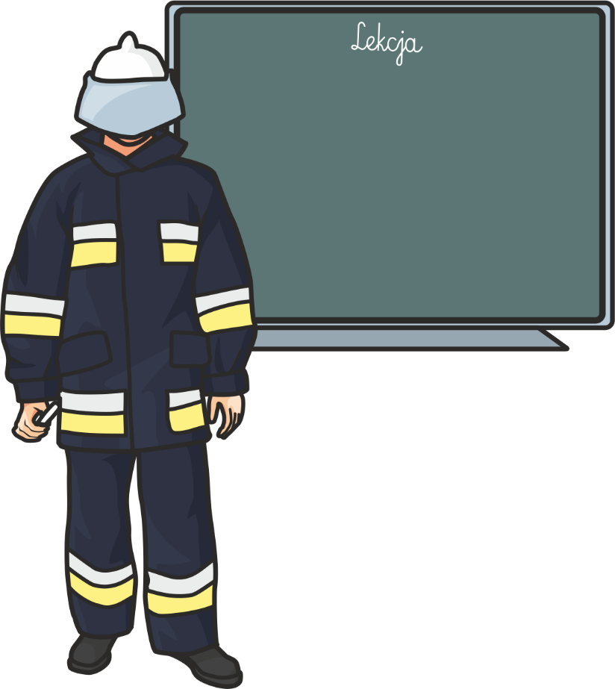
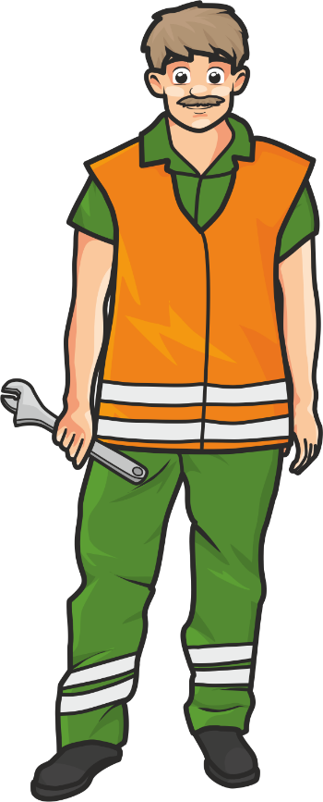
Who needs it?
I’m a firefighter but I’ve got a greenboard.
Who needs it?
a. a teacher
I’m a garbage collector but I’ve got a wrench.
Who needs it?
b. a nurse
c. a postman
a. a firefighter
b. a doctor
c. a plumber

Slide 8
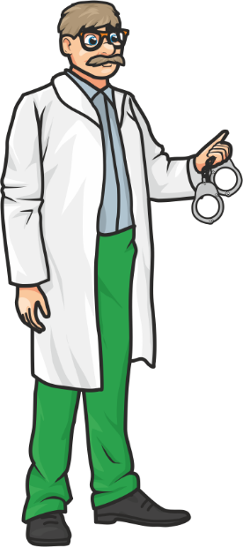
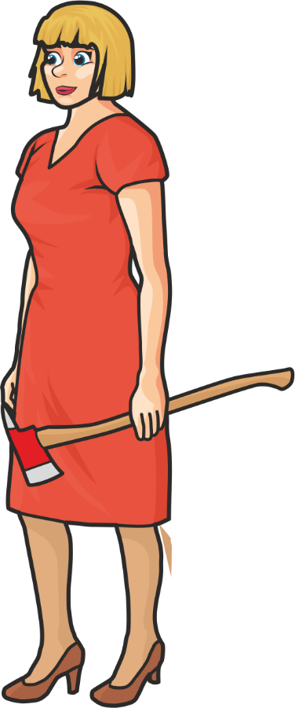
Who needs it?
I’m a doctor but I’ve got handcuffs.
Who needs them?
a. a plumber
I’m a teacher but I’ve got an axe.
Who needs it?
b. a police officer
c. a postman
a. a garbage collector
b. a nurse
c. a firefighter

Slide 9
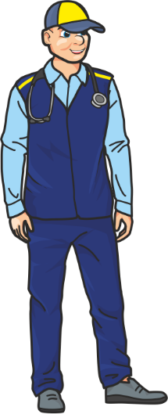
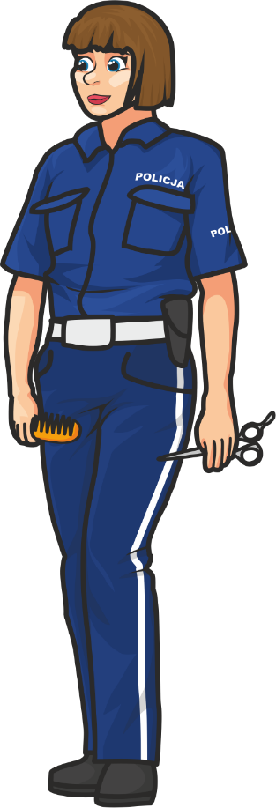
Who needs it?
I’m a postman but I’ve got a stethoscope.
Who needs it?
a. a teacher
I’m a police officer but I’ve got a comb and scissors.
Who needs them?
b. a doctor
c. a police officer
a. a hairdresser
b. a postman
c. a firefighter

Slide 10






I want to be

Slide 11

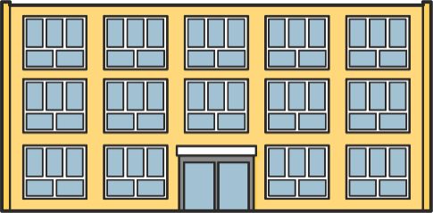


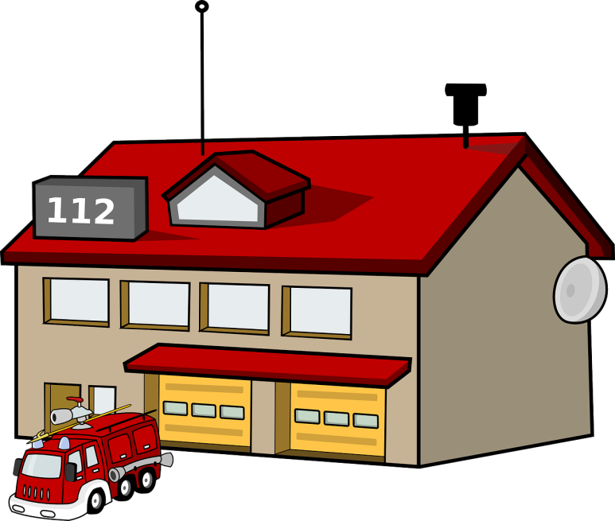
I work at

Slide 12
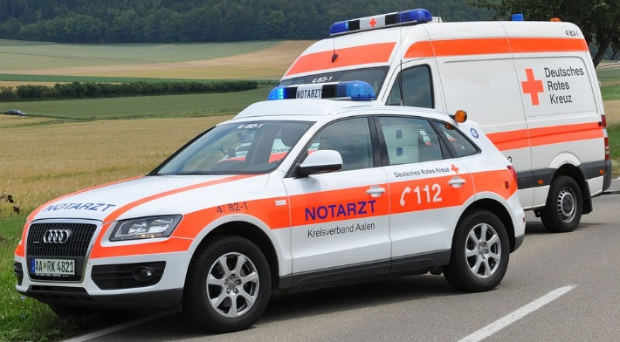
Emergency numbers
999
My mother has got a very high fever. Who should I call?
I see fire in a forest. Who should I call?
997
998
I saw a car accident. Who should I call?

Slide 13
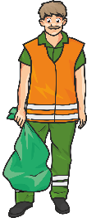





Mark is a . He keeps our city clean.
He drives a ………………..
Jack is a . He delivers letters and parcels.
He works at ………………..
Suzzy is a . She cuts people’s hair.
She works at ………………..
Paul is a . He fixes leaking pipes .
He uses a ………………..

Slide 14
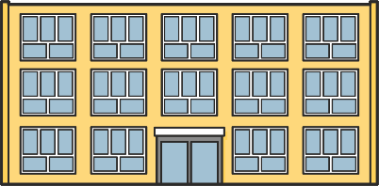

Jenna works at . She helps children learn.
She is a ………………..
Tom works at . He keeps people safe. He wears a uniform.
He is a ………………..
Kate works at . She takes care of people who are sick.
She is a ………………..
David works at . He puts out fires.
He is a ………………..

Slide 15


