Slide 1

klasa III
moduł 14
ARE WE DIFFERENT OR ARE WE THE SAME?
PI Synergia początkowej nauki języka obcego z edukacją wczesnoszkolną i technologiami informacyjno-komunikacyjnymi.
Projekt współfinansowany przez Europejski Fundusz Społeczny w ramach Programu Operacyjnego Kapitał Ludzki.
Priorytet III Wysoka jakość systemu oświaty, Działanie 3.3 Poprawa jakości kształcenia, Poddziałanie 3.3.4 Modernizacja treści i metod kształcenia – projekty konkursowe.

Slide 2


Slide 3
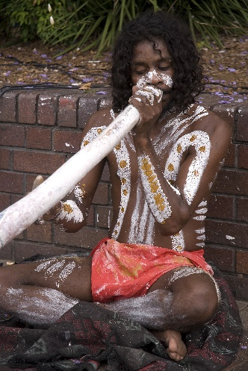
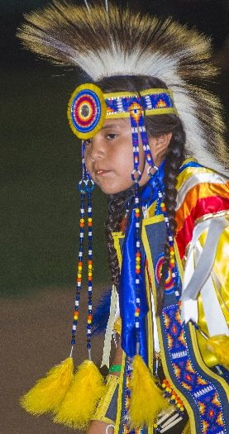
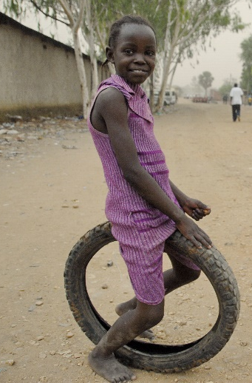
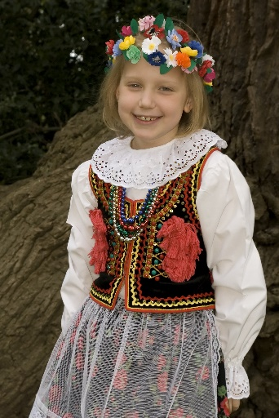
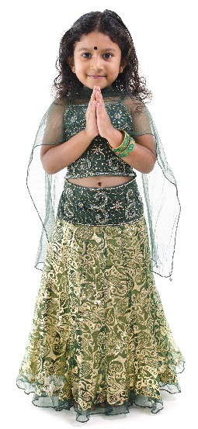
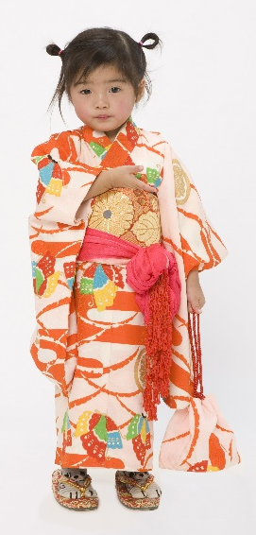
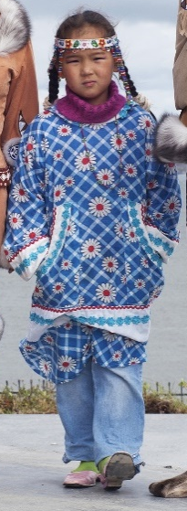
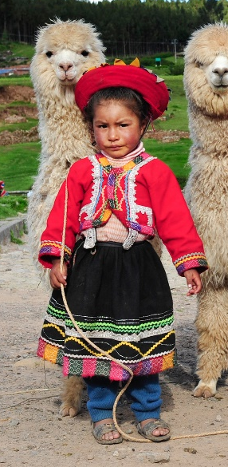
Hello! I’m from Australia.
Totem! I’m from North America.
Salut! I’m from Senegal.
Cześć! I’m from Poland.
Namastē!
I’m from India.
Nĭ hăo!
I’m from China.
ᐊᐃ (Ai)!
I’m from Greenland.
Hola! I’m from Peru.

Slide 4




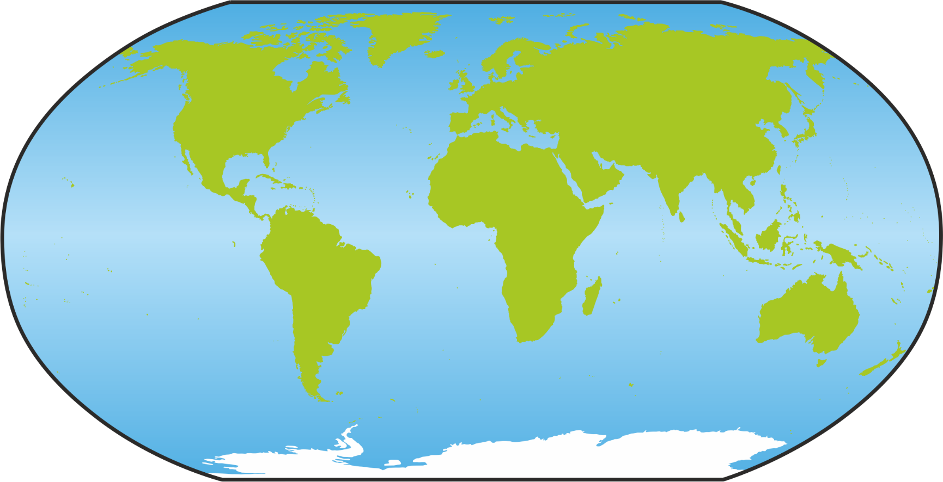

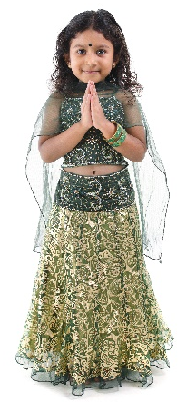


I’m from China.
I’m from Greenland.
I’m from Peru.
I’m from India.
I’m from Poland.
I’m from North America.
I’m from Senegal.
I’m from Australia.

Slide 5
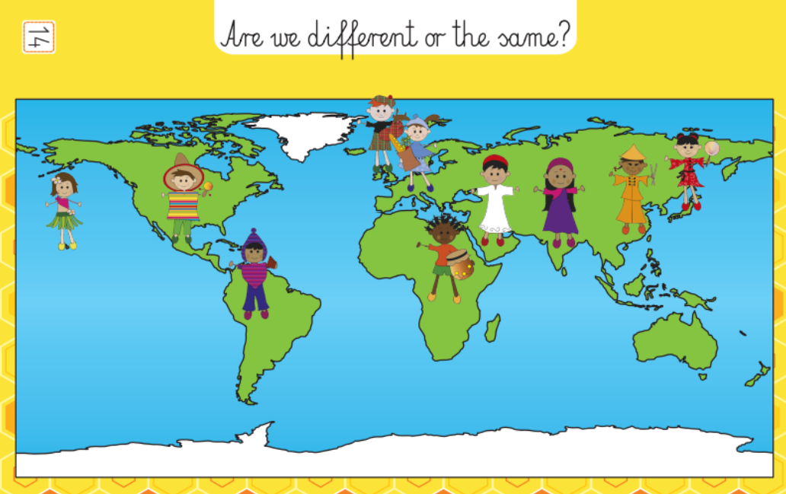
Hawaii
Peru
China
France
India
Mexico
Scotland
Turkey
Congo
Japan

Slide 6


Who am I?
Hello!
I live in Australia. I have got wavy hair and dark skin. My nose is wide.
Who am I?
Hola!
I live in Peru. I speak Spanish. I have got straight black hair. I’m not very tall.
Who am I?
a. Peruvian
b. Aborigine
c. Pole
a. Chinese
b. Inuit
c. Peruvian

Slide 7


Who am I?
Namastē!
I live in India. I have got straight black hair and dark skin. I wear a suri.
Who am I?
Cześć!
I live in Poland. I speak Polish. I have white skin and blond hair.
Who am I?
a. Hindu
b. Aborigine
c. Peruvian
a. Pole
b. Hindu
c. Inuit

Slide 8


Who am I?
Nĭ hăo!
I live in China. I have got straight brown hair and yellow skin. I wear a kimono.
Who am I?
ᐊᐃ (Ai)!
I live in Greenland. I speak Inuktitut. I like to eat fish. I have got dark hair. I live in an igloo.
Who am I?
a. Pole
b. Chinese
c. Peruvian
a. Spanish
b. Chinese
c. Inuit

Slide 9


Who am I?
Salut!
I live in Senegal. I speak French. I have got curly black hair and dark skin.
Who am I?
Totem!
I live in North America in sanctuary (rezerwat). I have got straight dark hair and red skin. I live in teepee.
Who am I?
a. Senegalese
b. Hindu
c. Peruvian
a. Chinese
b. Native American
c. Senegalese

Slide 10
Cześć!
Hola!
Hello!
Nĭ hăo!
Salut!
ᐊᐃ (Ai)!
Namastē!
Totem!.

Slide 11
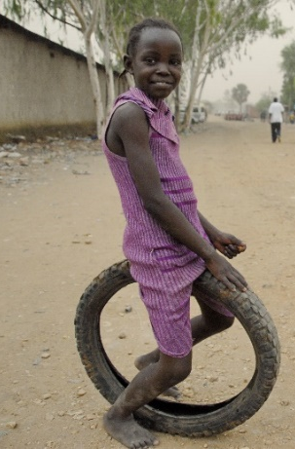


Slide 12
'ele'ele
'ula'ula
melemele
māku'e
negro
rojo
amarillo
marrón
'oma'oma'o
poni
ke'o'ke'o
uliuli
verde
violeta
blanco
azul

Slide 13
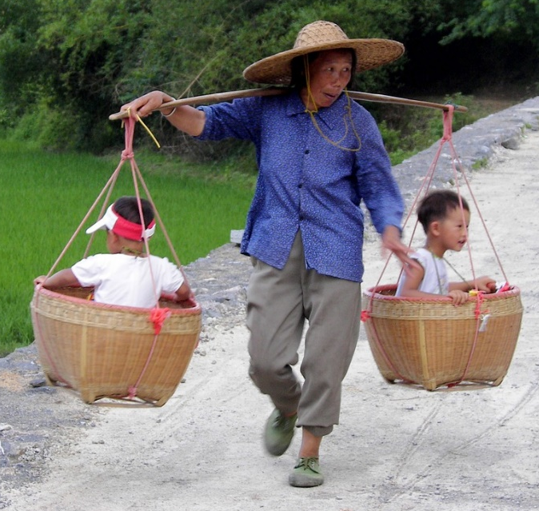
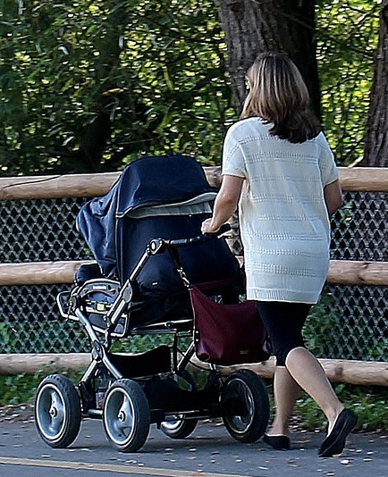
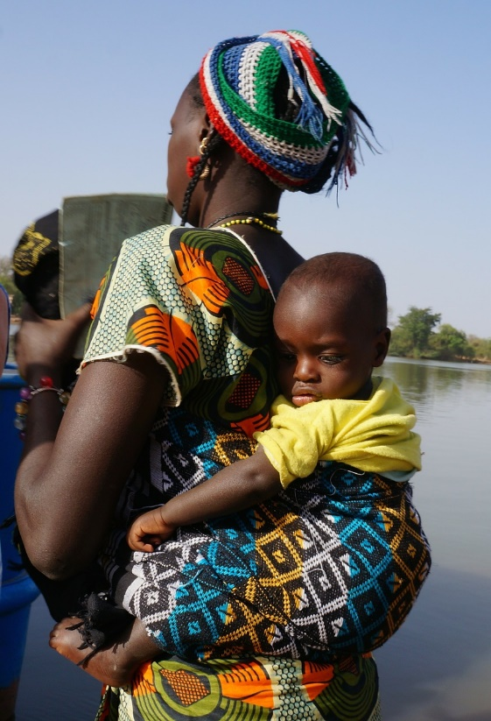
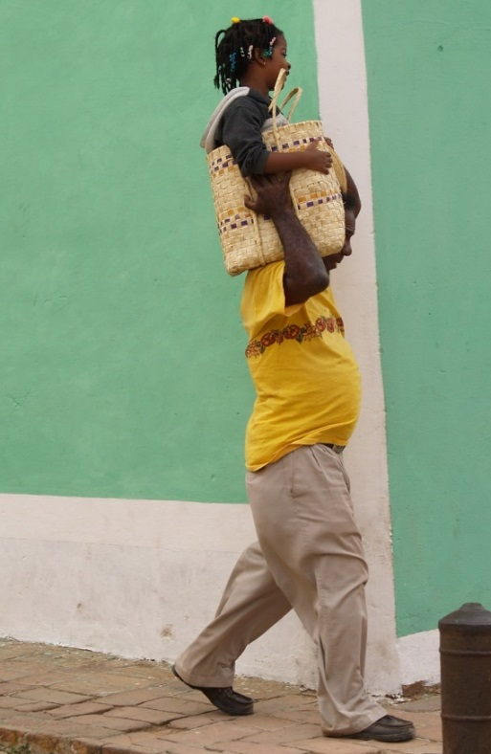
This is how our parents take us for a walk
in a basket
in a pram
in a sling
in a Moses basket

Slide 14
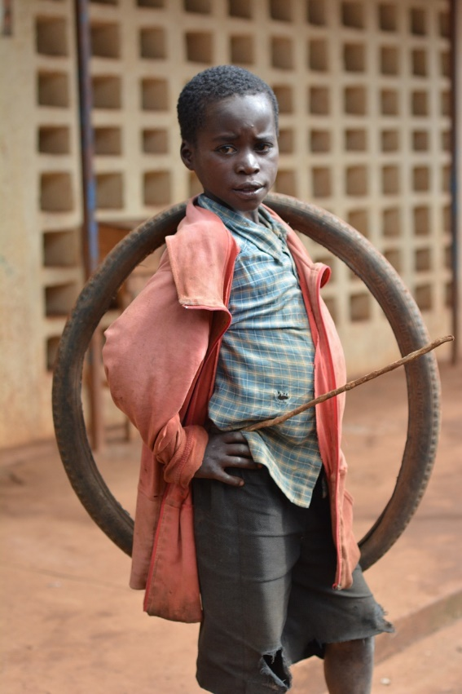
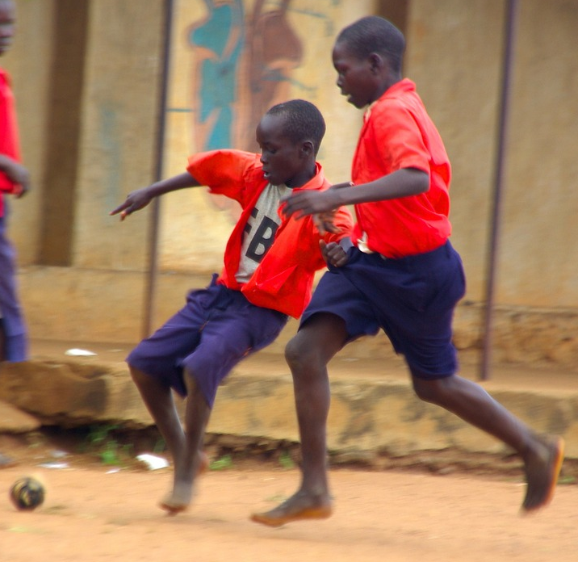
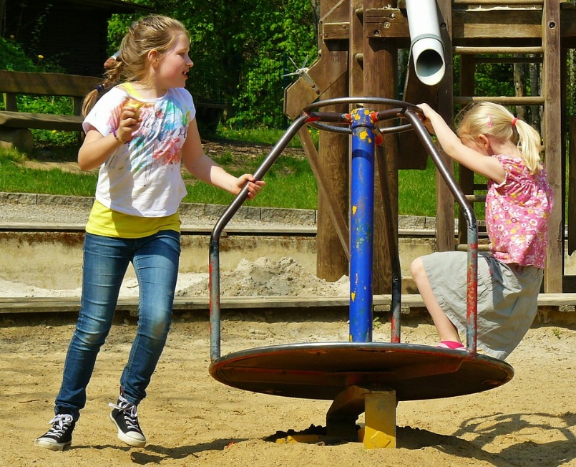
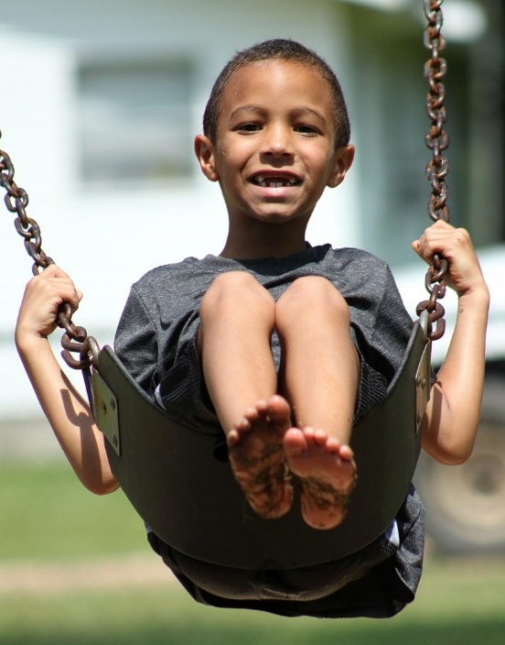
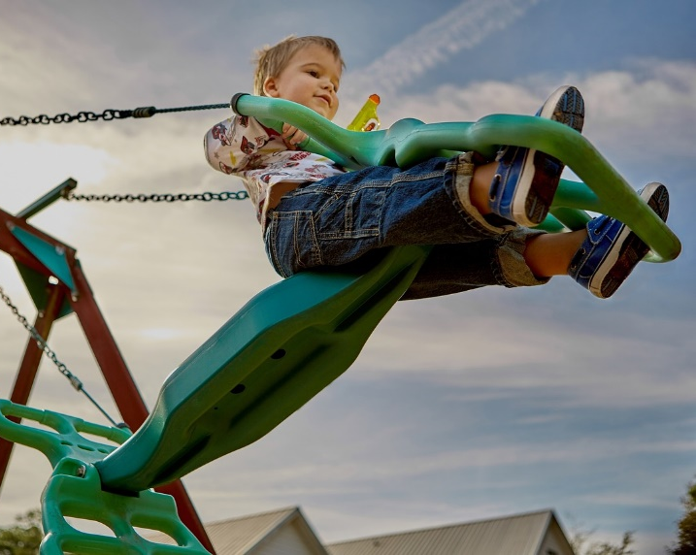
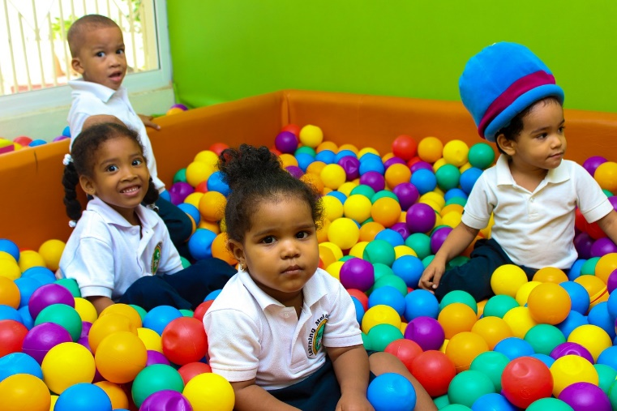
We all love to play

Slide 15
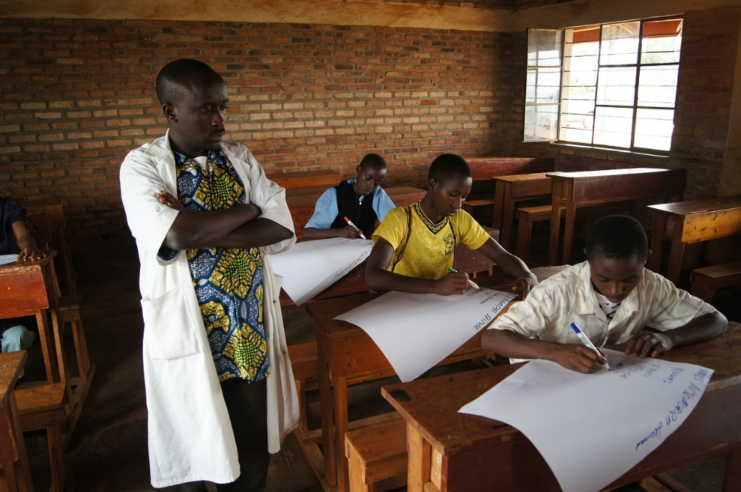
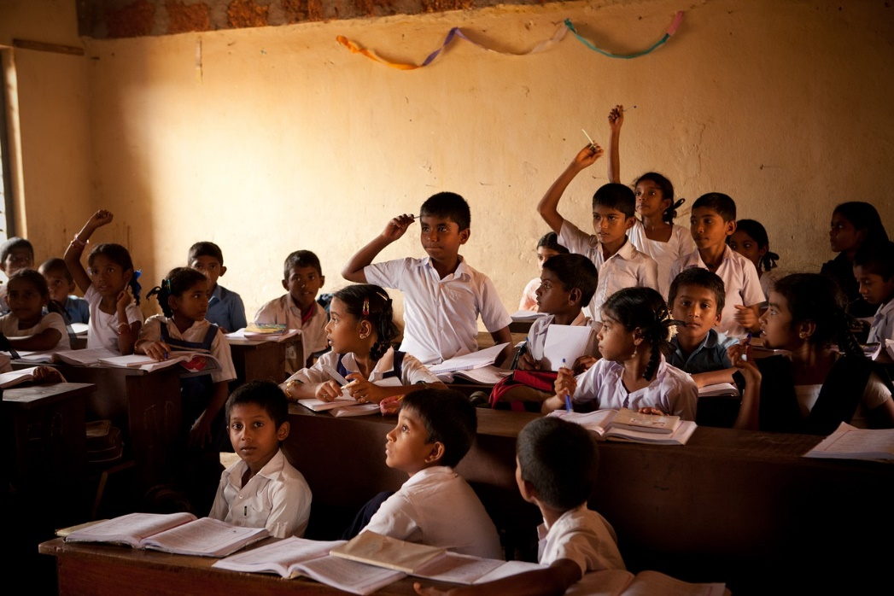
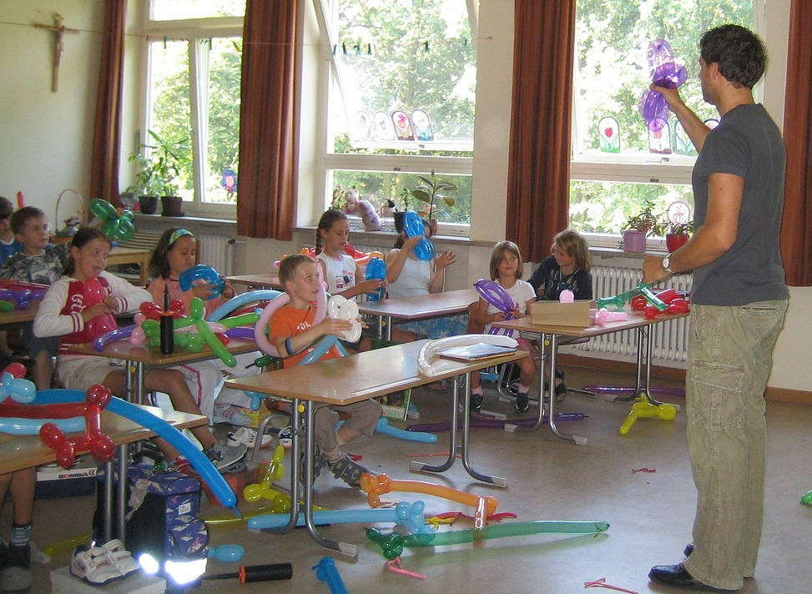
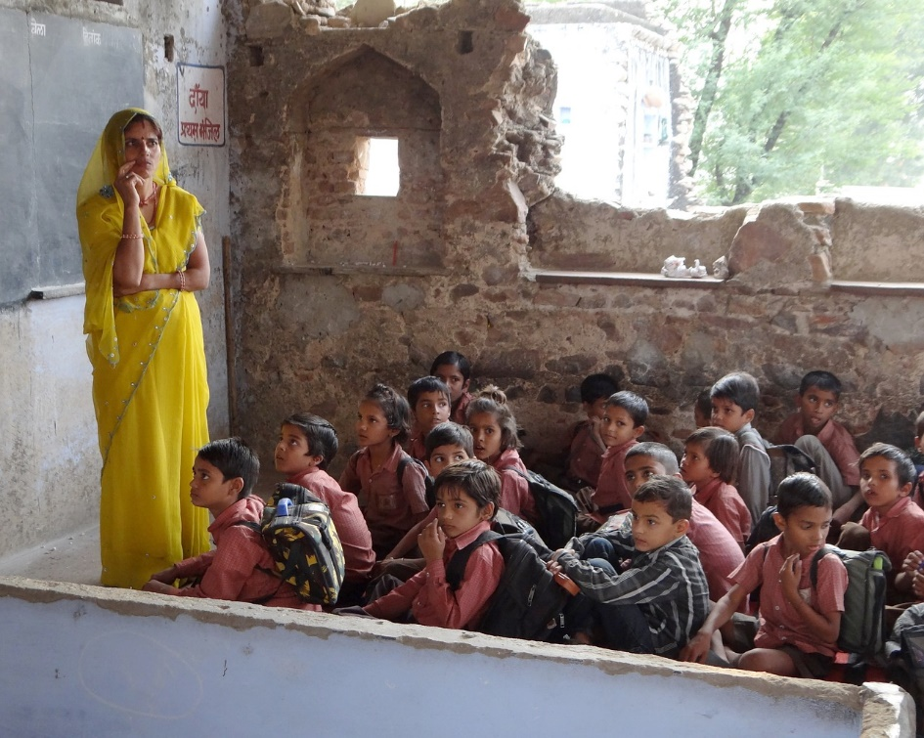
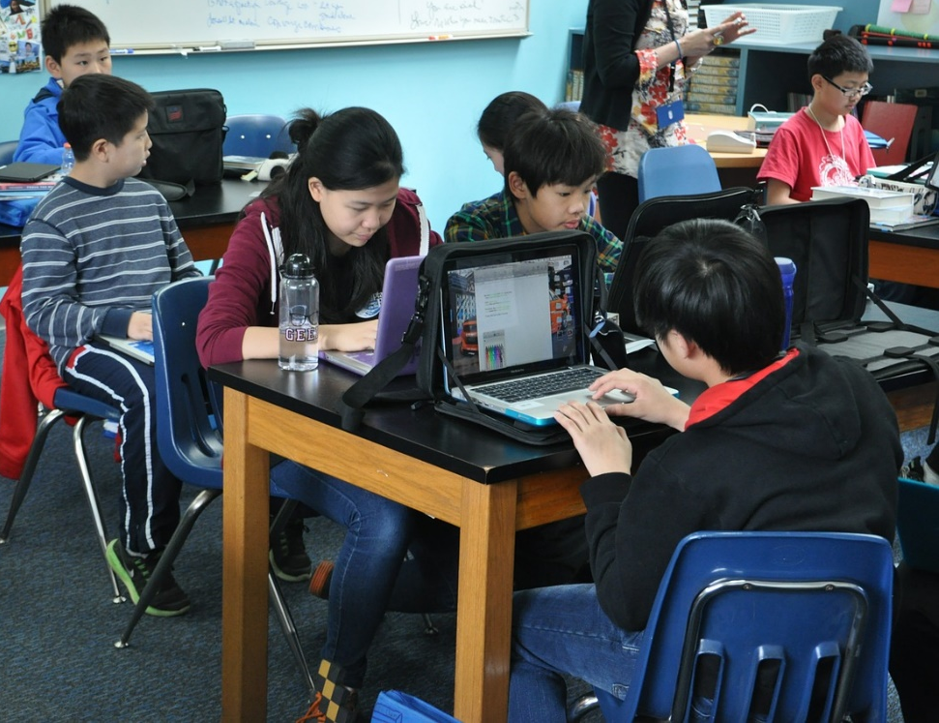
We all want to learn

Slide 16
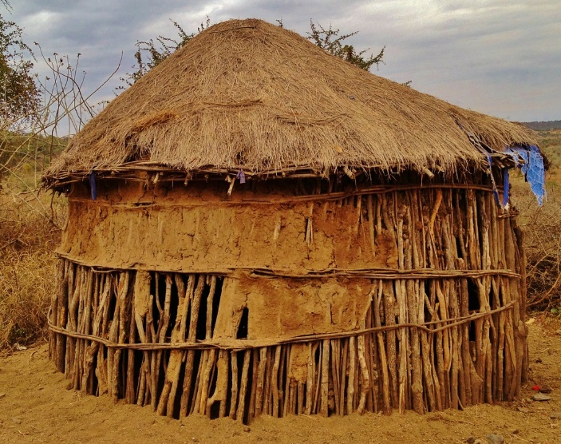
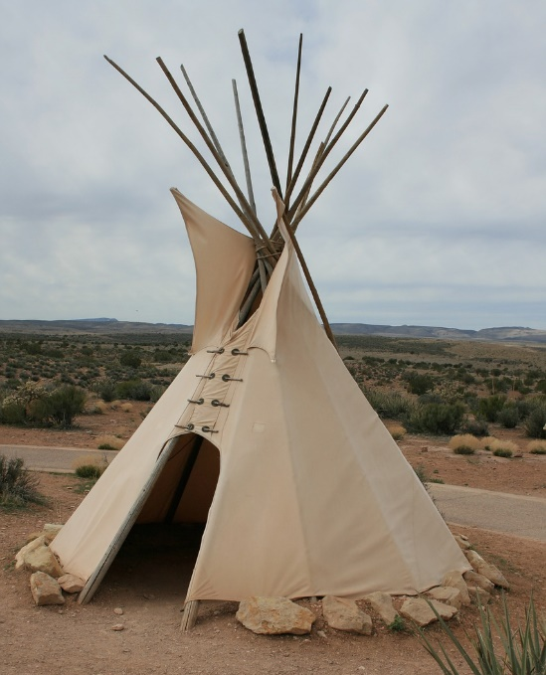
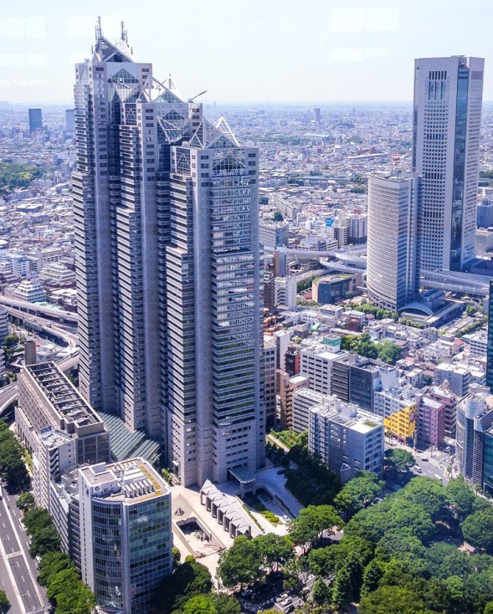
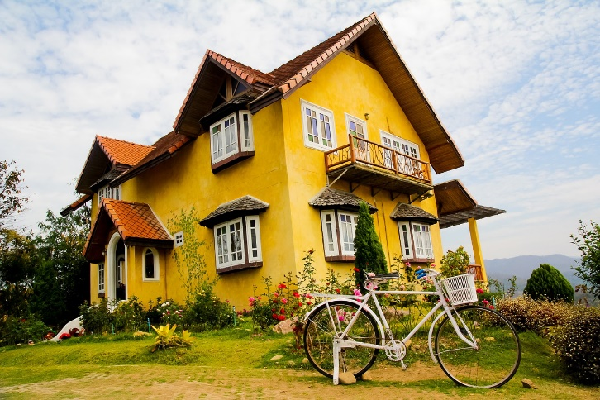
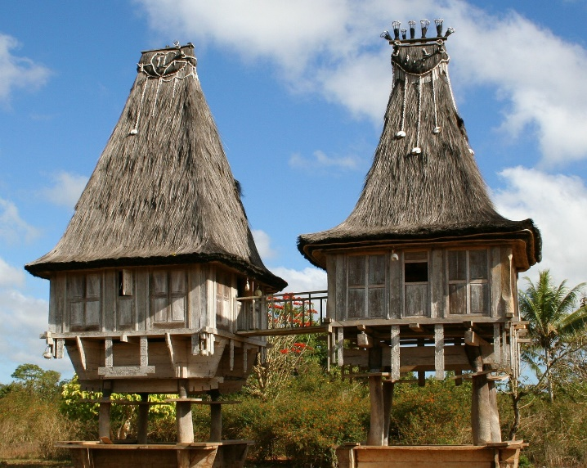
We all have houses
African hut
North American tee-pee
European detached house
Asian hut
Japanese skyscraper

Slide 17


