Slide 1

klasa III
moduł 11
BODY CARE
PI Synergia początkowej nauki języka obcego z edukacją wczesnoszkolną i technologiami informacyjno-komunikacyjnymi.
Projekt współfinansowany przez Europejski Fundusz Społeczny w ramach Programu Operacyjnego Kapitał Ludzki.
Priorytet III Wysoka jakość systemu oświaty, Działanie 3.3 Poprawa jakości kształcenia, Poddziałanie 3.3.4 Modernizacja treści i metod kształcenia – projekty konkursowe.

Slide 2
Your body is precious.
Take care of it.
Twoje ciało jest cenne.
Dbaj o nie.

Slide 3
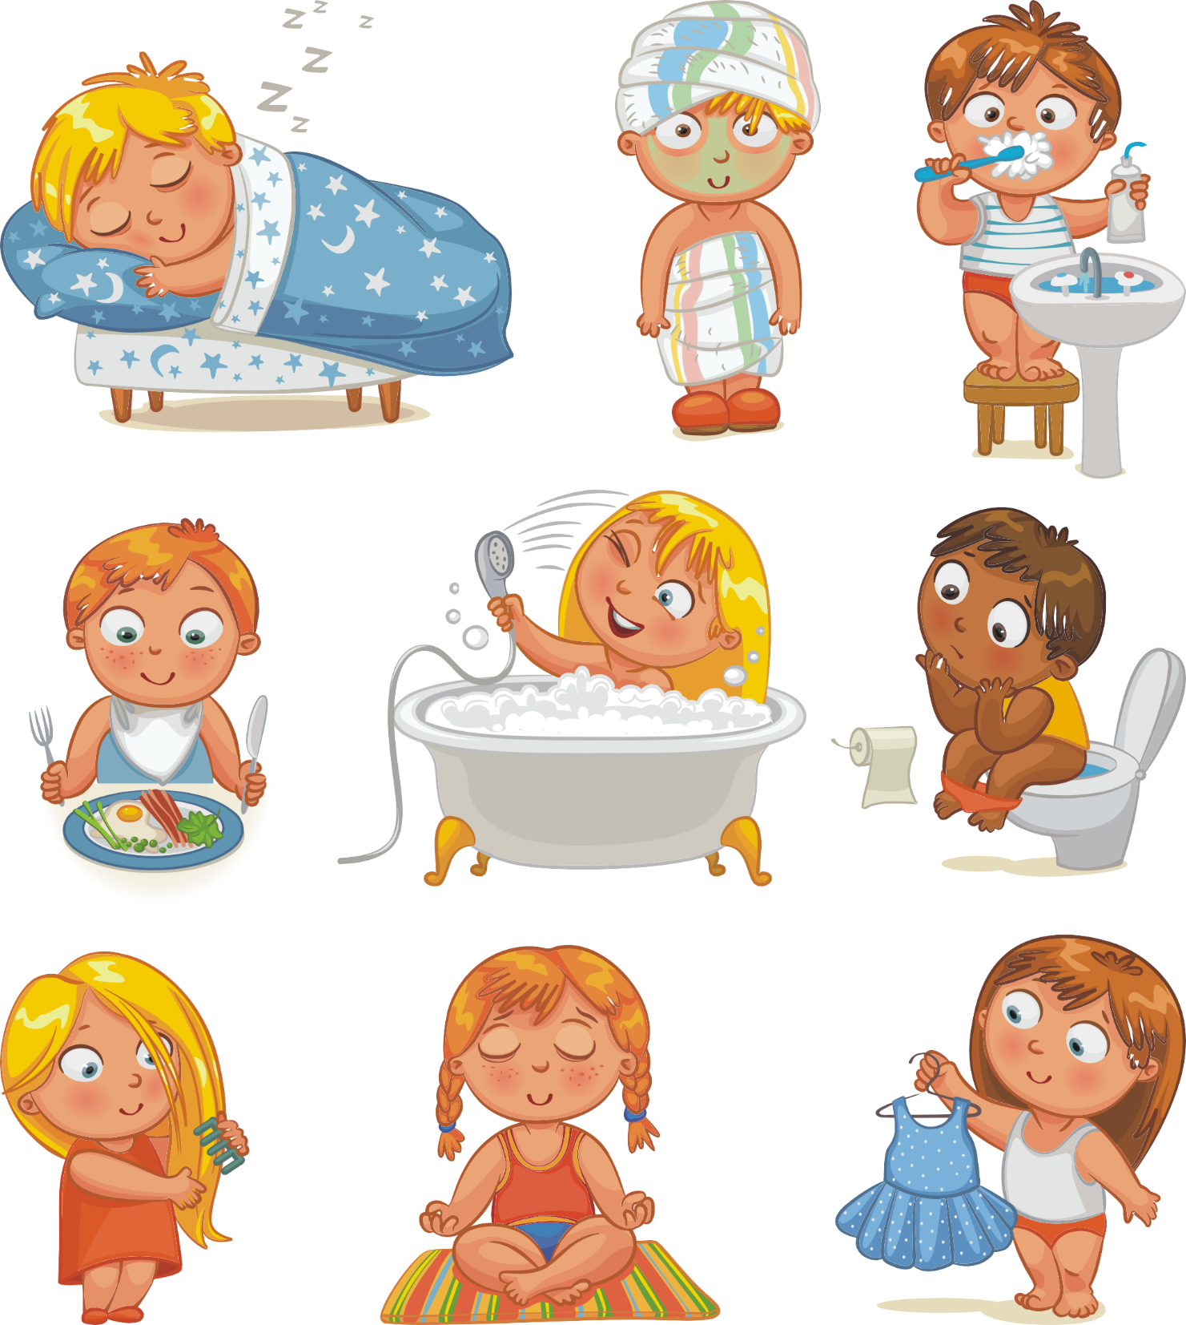


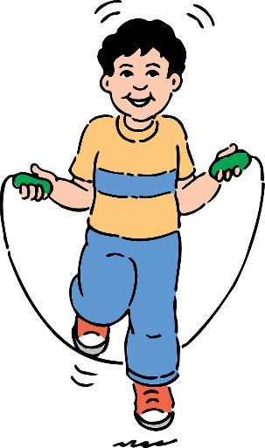
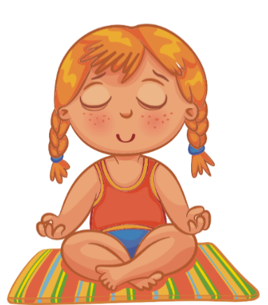
get sleep
take a bath
brush teeth
eat healthy meals
do exercise
rest

Slide 4



Personal hygiene
take a bath
brush teeth
use the toilet
get dressed
comb hair

Slide 5





getting enough sleep.
eatting healthy meals.
I stay
healthy by
brushing my teeth twice a day.
doing exercise.
getting rest.
taking a bath.

Slide 6
should/ shouldn’t
You eat fruit and vegetables.
should/ shouldn’t
You do exercise.
You eat too much sugar.
should/ shouldn’t
You take care of personal hygiene every day.
should/ shouldn’t
You rest.
should/ shouldn’t

Slide 7
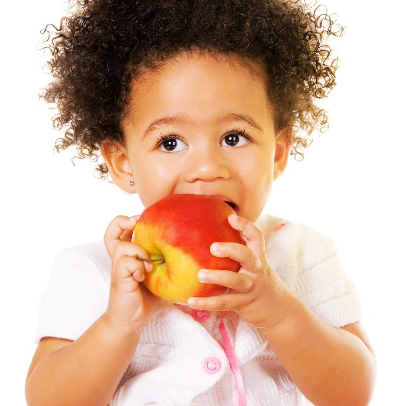
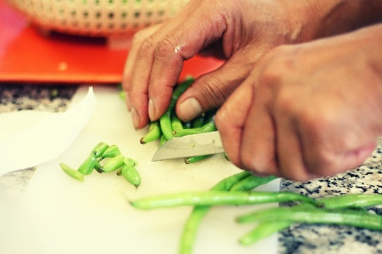
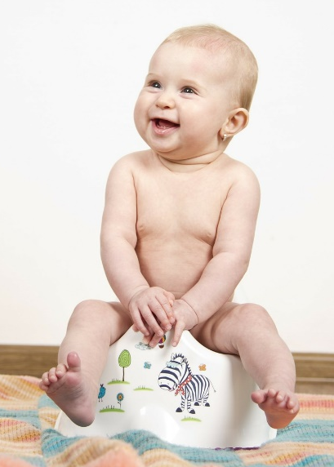
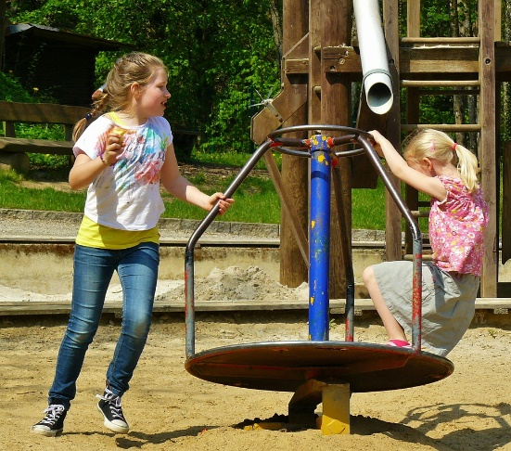
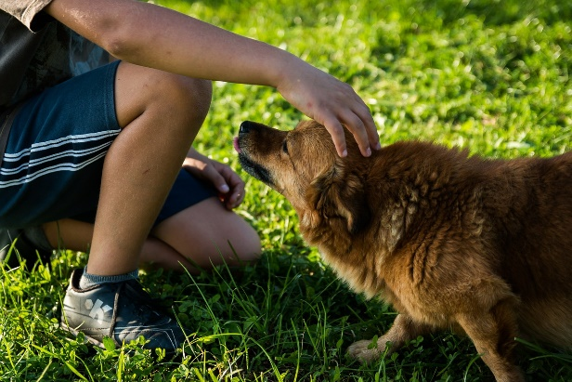
Wash your hands
Have you ever been sick? Germs (zarazki) make you sick.
Dirty hands spread germs. You must wash you hands:
BEFORE YOU:
cook meals.
touch and eat food.
AFTER YOU:
touch animals.
play.
use the toilet.

Slide 8





Before
Now
After

Slide 9
Hand washing
Look at your hands.
Are they dirty?
Make your hands dirty with a newspaper.
Wash your hands with cold water only.
Now wash your hands with soap and cold water.
Finally wash your hands with soap and warm water.
Which works best?
cold water
cold water + soap
warm water + soap
Washing hands with …………………………………………………
works best.

Slide 10




















Slide 11
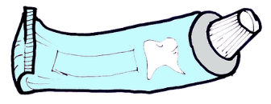



I use and to brush my teeth.
……………….. ………………………
I use to dry my body after a shower.
………………..
I use to blow my nose.
………………..
I use to wash my hands .
………………..

Slide 12

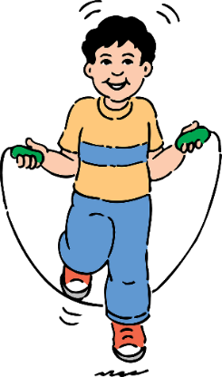
I clean my
t_ _th.
I brush my
h_ _ r.
I take care of my body
I do
_x _ rc _ s _.
I take a
b _ th.

Slide 13
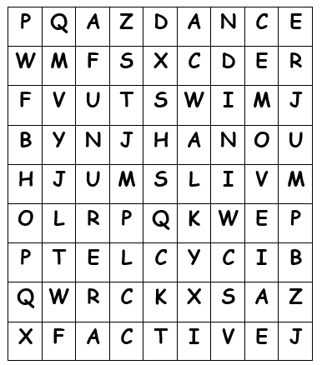
ACTIVE
JUMP
FUN
MOVE
RUN
WALK
DANCE
HOP
SWIM
BICYCLE
JACKS JUMP

