Slide 1

klasa III
moduł 10
AT THE DOCTOR’S
PI Synergia początkowej nauki języka obcego z edukacją wczesnoszkolną i technologiami informacyjno-komunikacyjnymi.
Projekt współfinansowany przez Europejski Fundusz Społeczny w ramach Programu Operacyjnego Kapitał Ludzki.
Priorytet III Wysoka jakość systemu oświaty, Działanie 3.3 Poprawa jakości kształcenia, Poddziałanie 3.3.4 Modernizacja treści i metod kształcenia – projekty konkursowe.

Slide 2
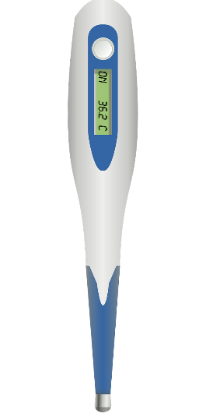
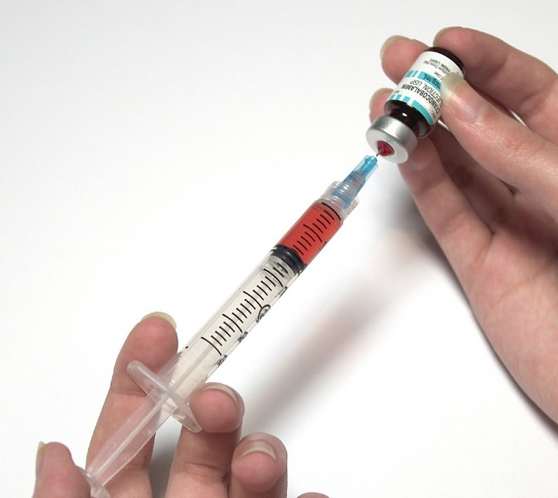
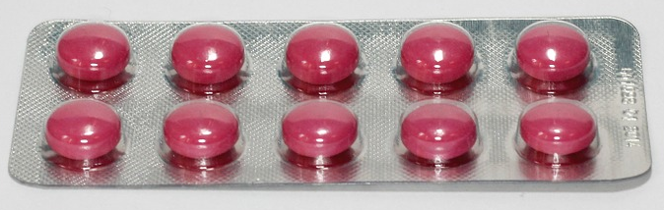

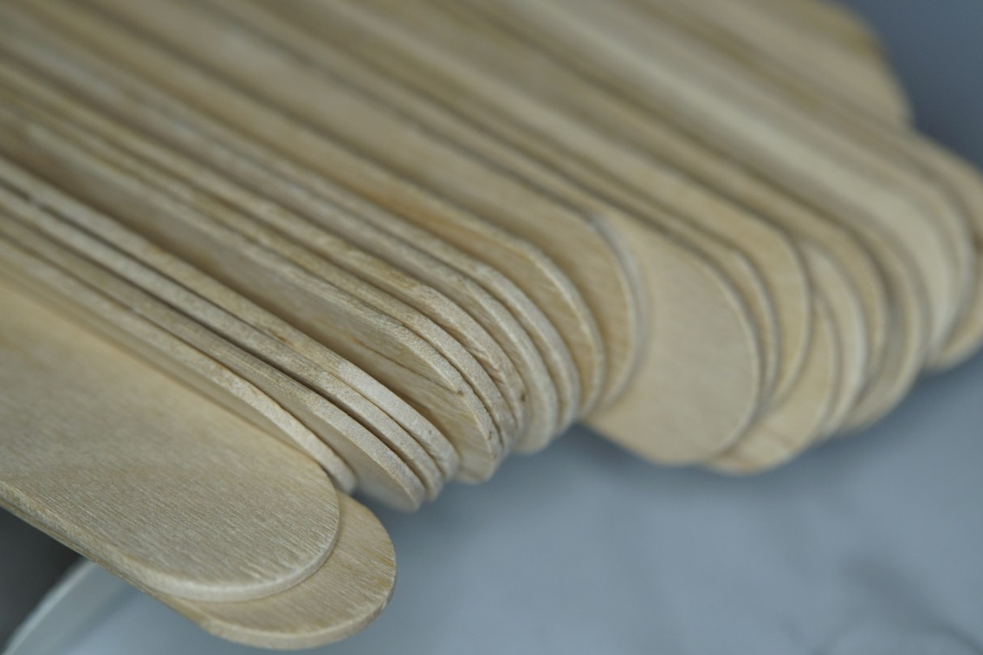

Slide 3



toothache
stomach ache
Aches
headache
backache

Slide 4
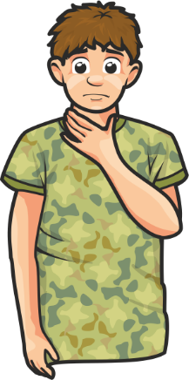
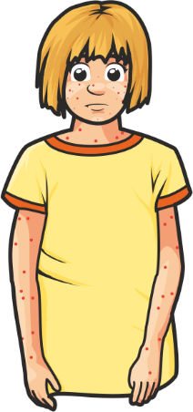
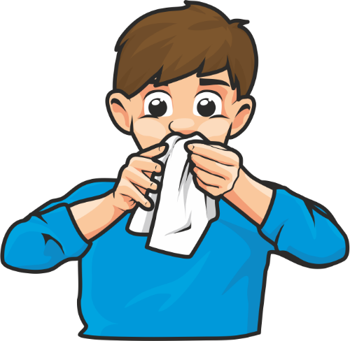
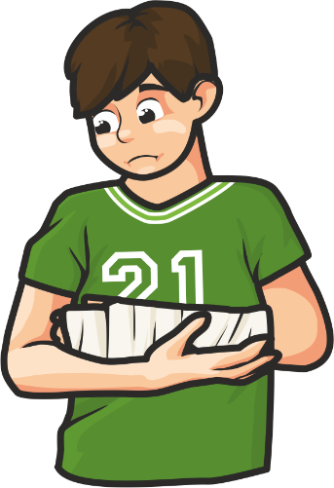
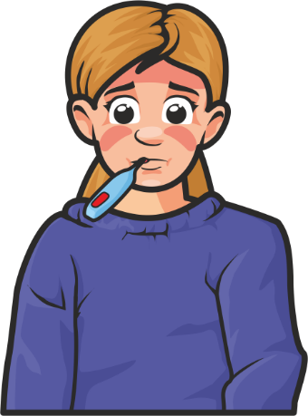

rash
runny nose
sore throat
Symptoms
broken arm
fever
cough

Slide 5





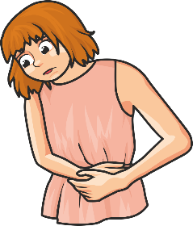



ACHES/BÓLE | SYMPTOMS/OBJAWY

Slide 6



I can’t move my arm.
I have a high fever.
I’m sneezing a lot.
I have a bad cough.
I vomited.
I have a terrible toothache.
I have a rash.
My back hurts.

Slide 7
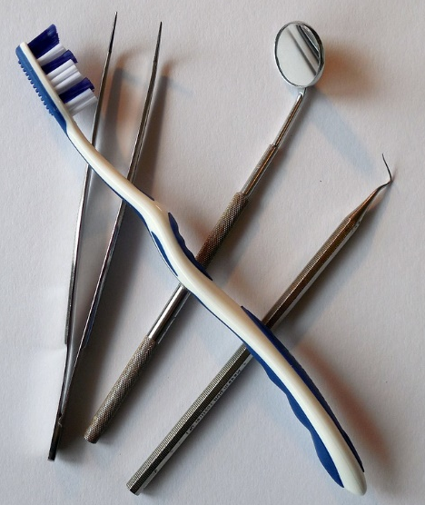
Which doctor am I?
a doctor who treats people’s teeth
a dentist

Slide 8
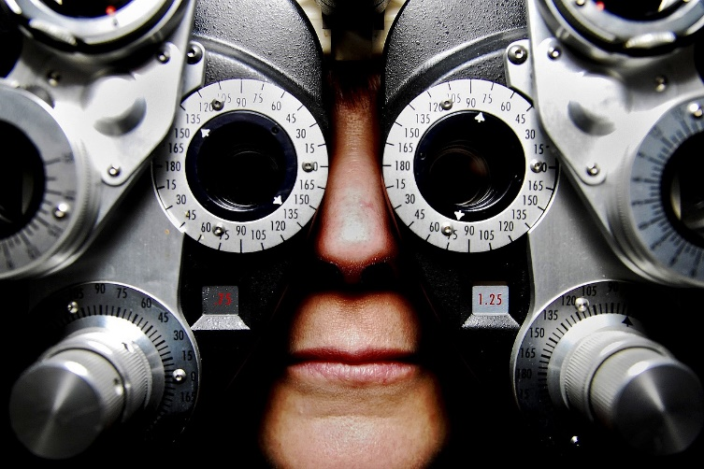
Which doctor am I?
a doctor who treats eye diseases and examines people’s eyes
an eye doctor

Slide 9
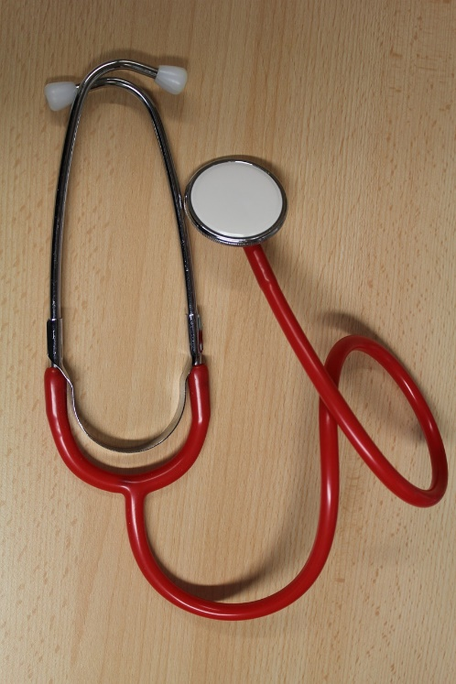
Which doctor am I?
a doctor who treats children
a paediatrician

Slide 10
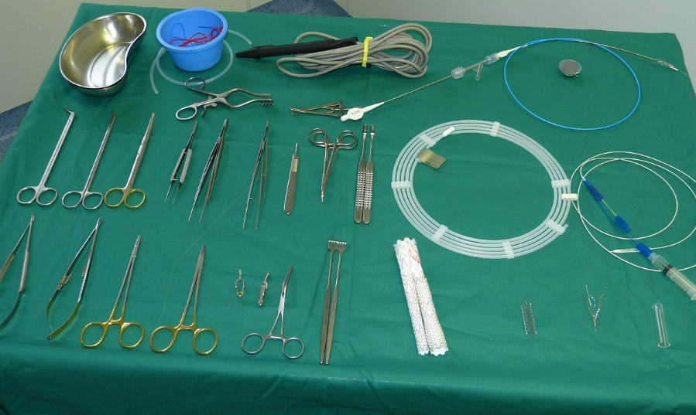
Which doctor am I?
a doctor who does medical operations
a surgeon

Slide 11
In the Clinic’s waiting room there are five patients to see
a dentist, three patients to see a surgeon, twelve patients to
see a paediatrician and half of the paediatrician’s patients to see an eye doctor. How many patients are waiting for their turn at the Clinic?
DENTIST
……………..
SURGEON
……………
PAEDIATRICIAN
………………
EYE DOCTOR …………………………………………………………………………….
Calculate/ Oblicz. ………………………………………………………….
Answer: There are …………………………………… patients waiting for their turn at the Clinic.

Slide 12
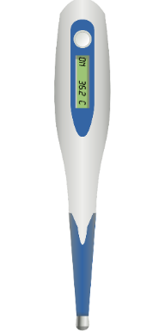




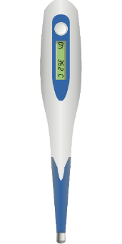

Slide 13
Patient’s Details
Name:
Surname:
Date of birth:
Symptoms:
Treatment

