Slide 1

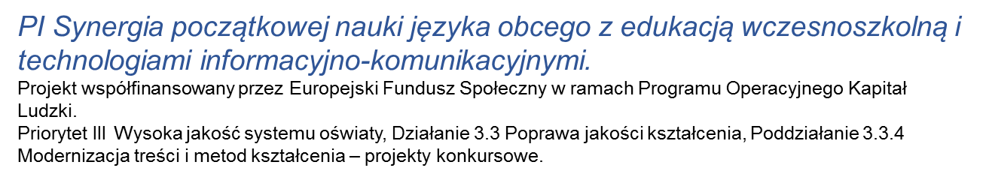
klasa III
Moduł 08
MY DUTIES

Slide 2
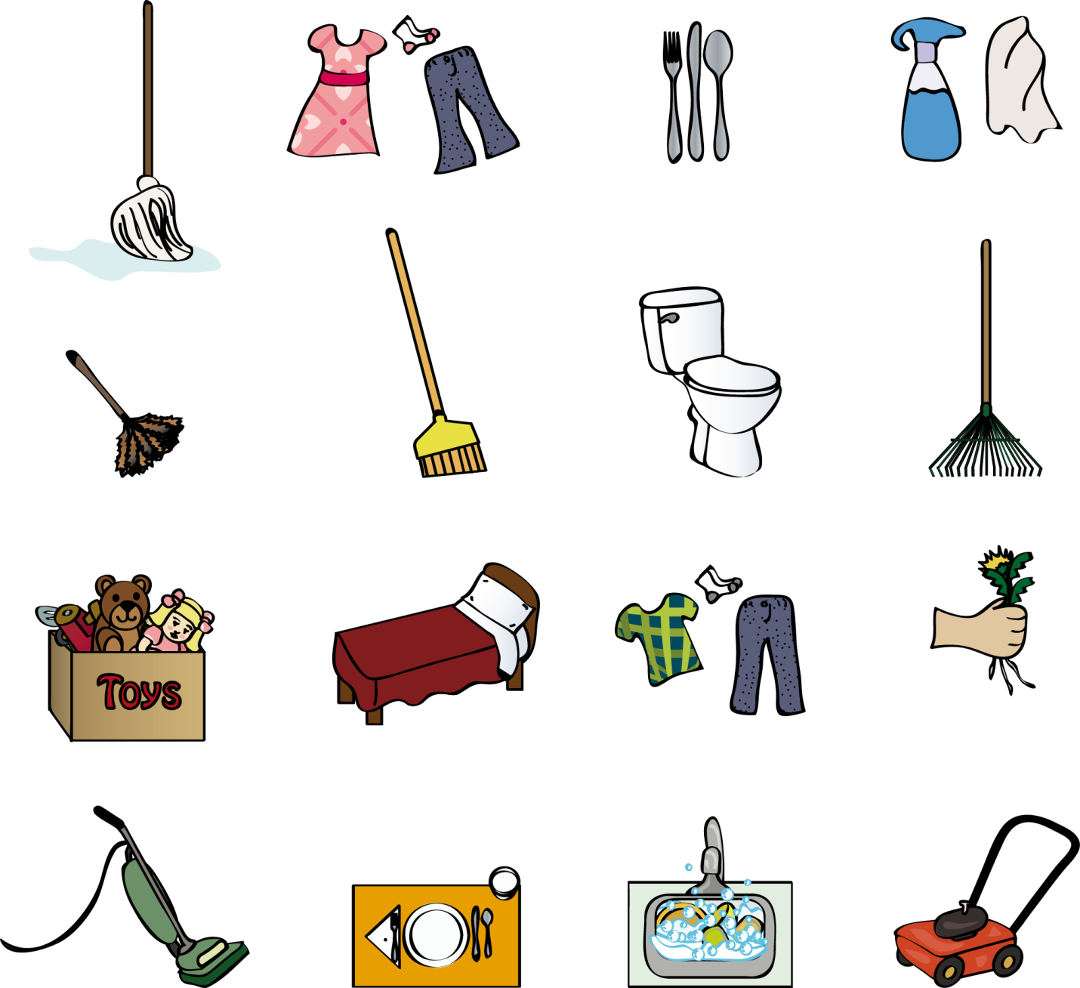

Slide 3


Slide 4
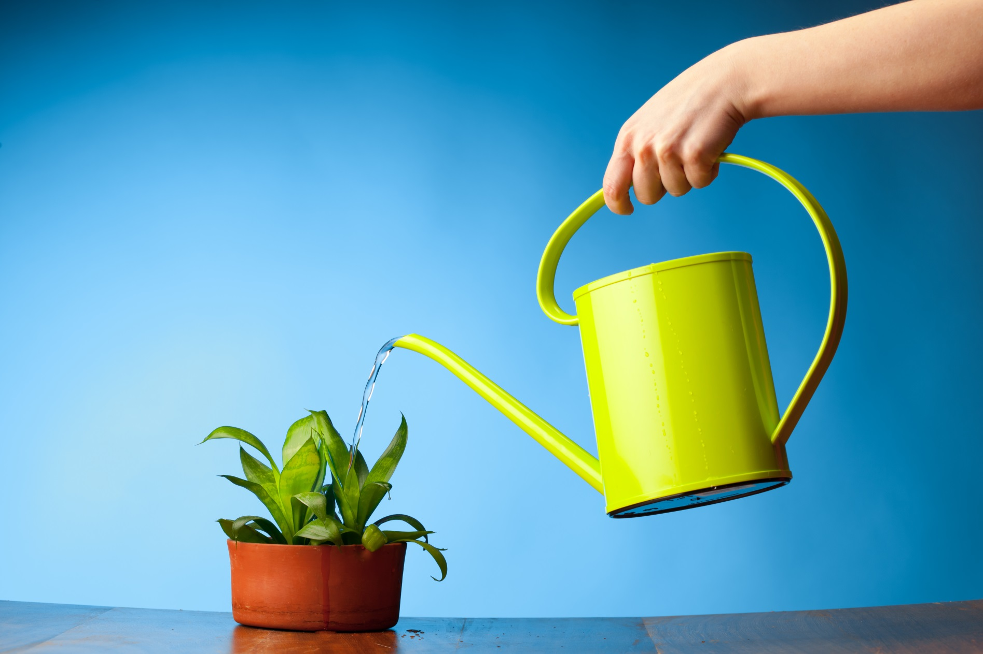

Slide 5
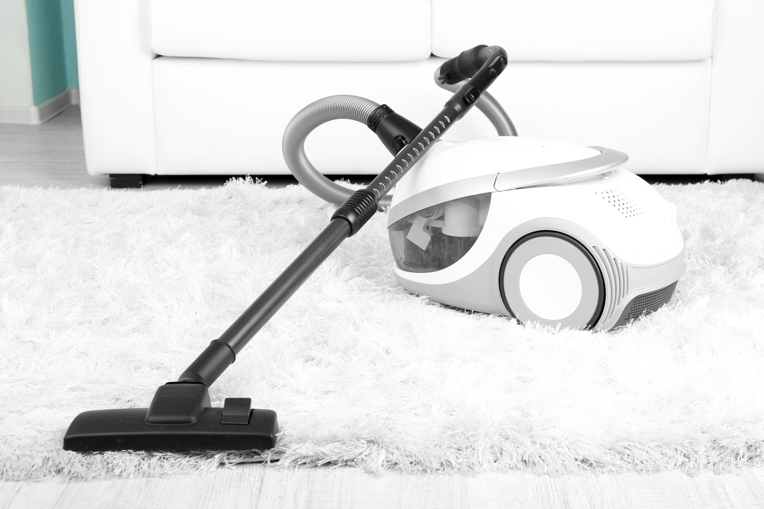

Slide 6
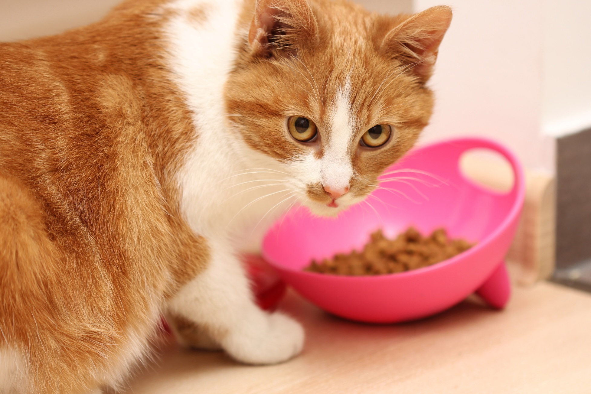

Slide 7
Take the rubbish out
Make the bed
Walk the dog
Water the plants
Mop the floor

Slide 8
Feed the cat
Do homework
Feed the parrot
Do shopping
Wash the dishes
Notes:
.

Slide 9
Duties at home
often
sometimes
never
every day
seldom

Slide 10
Duties at school
I like
I don’t like
I don’t mind
I love
I hate

Slide 11


