Slide 1

klasa II
moduł 1
HOLIDAY MEMORIES
PI Synergia początkowej nauki języka obcego z edukacją wczesnoszkolną i technologiami informacyjno-komunikacyjnymi.
Projekt współfinansowany przez Europejski Fundusz Społeczny w ramach Programu Operacyjnego Kapitał Ludzki.
Priorytet III Wysoka jakość systemu oświaty, Działanie 3.3 Poprawa jakości kształcenia, Poddziałanie 3.3.4 Modernizacja treści i metod kształcenia – projekty konkursowe.

Slide 2
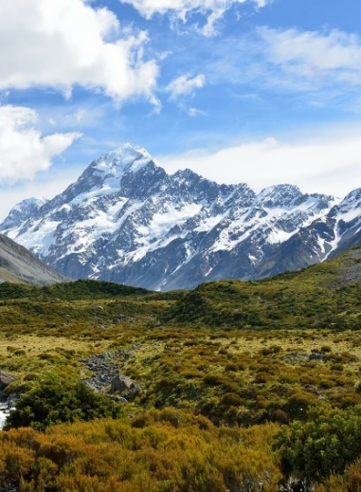
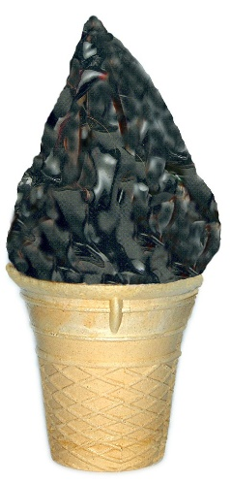
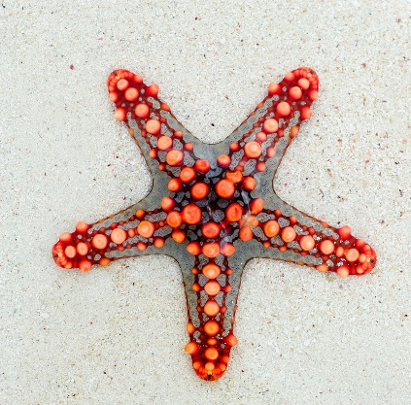
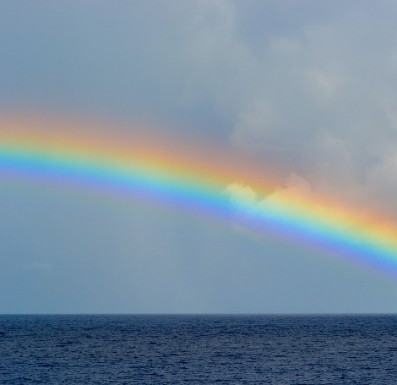
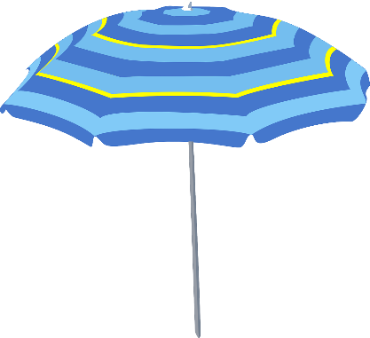
ICE
MEMORIES

Slide 3
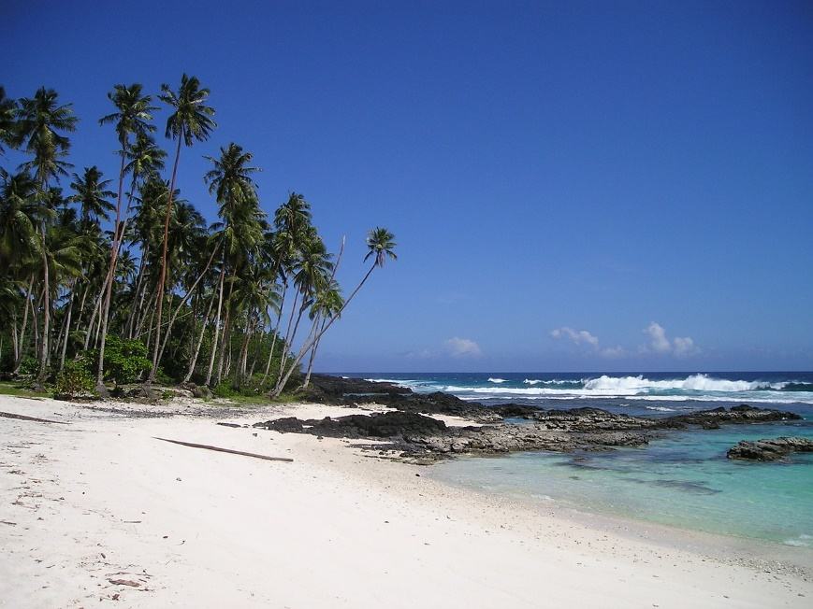
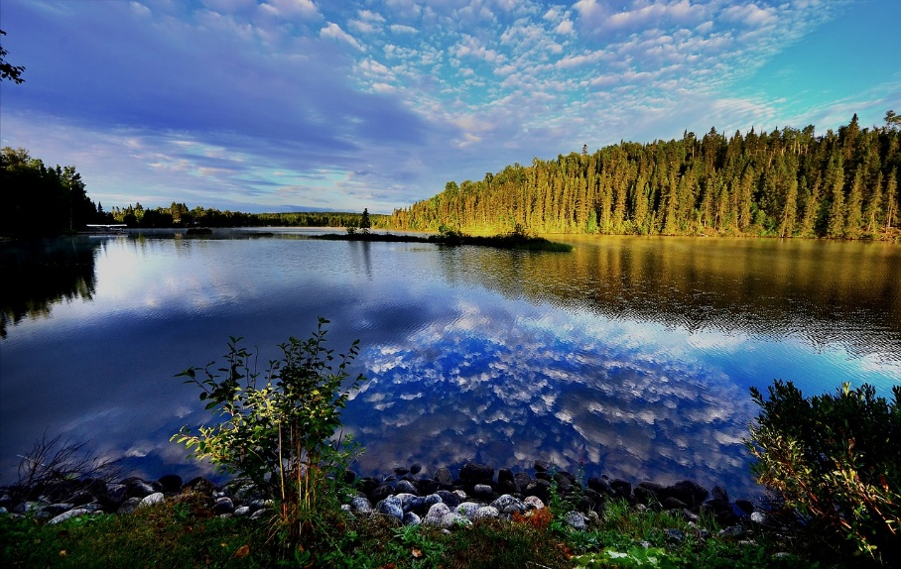

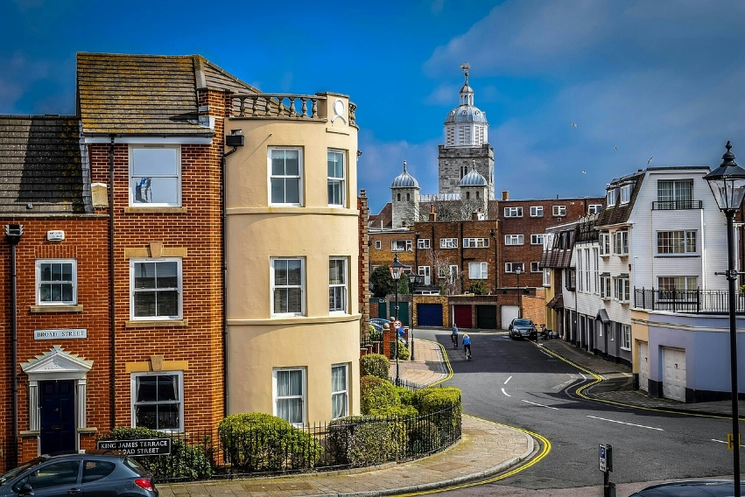
on the beach
Places
at the lake
in the mountains
in the city

Slide 4

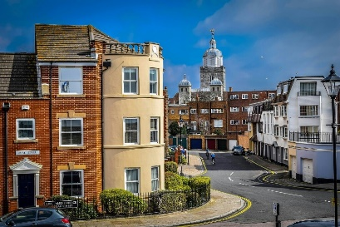
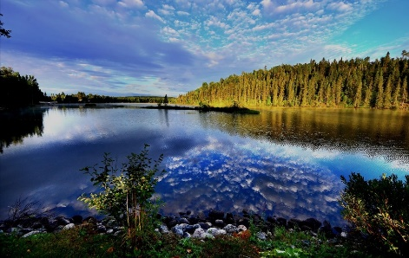

on the ……………………..
This summer I was
in the ……………………..
at the ……………………..
in the ……………………..

Slide 5
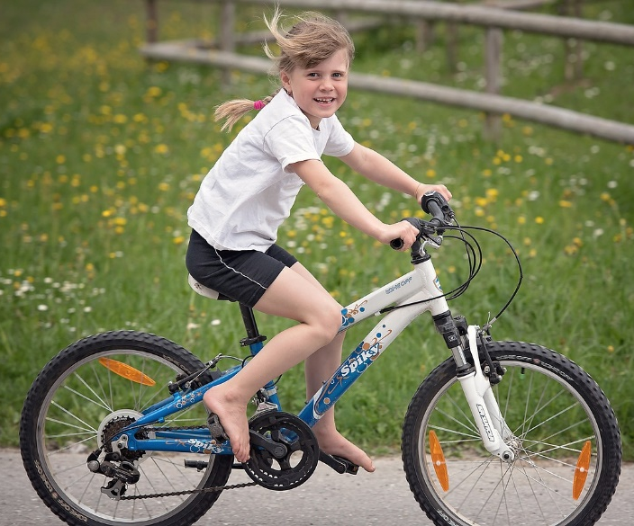
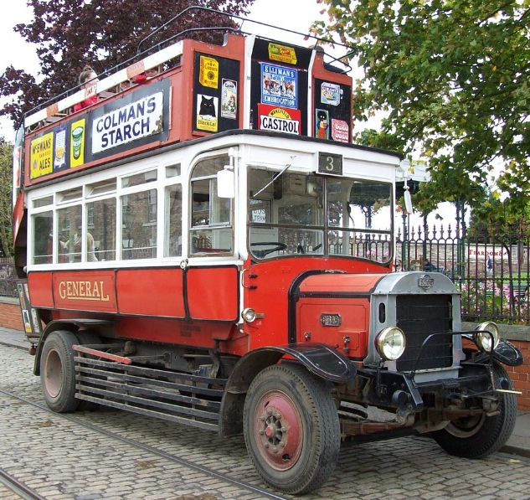
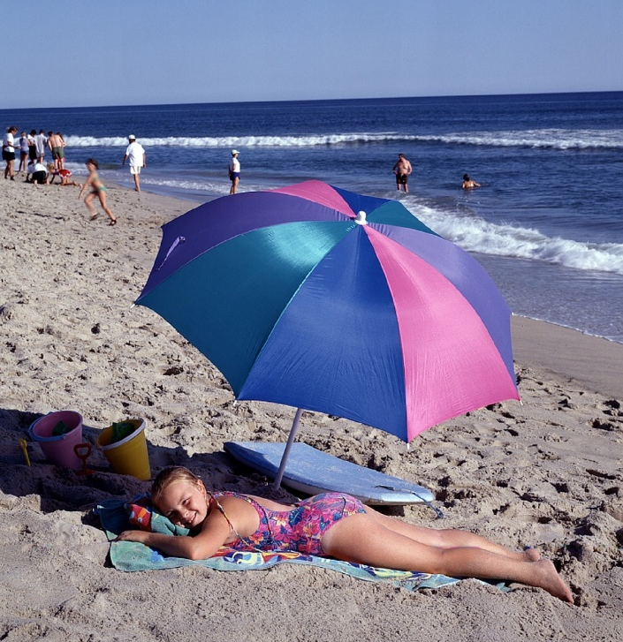
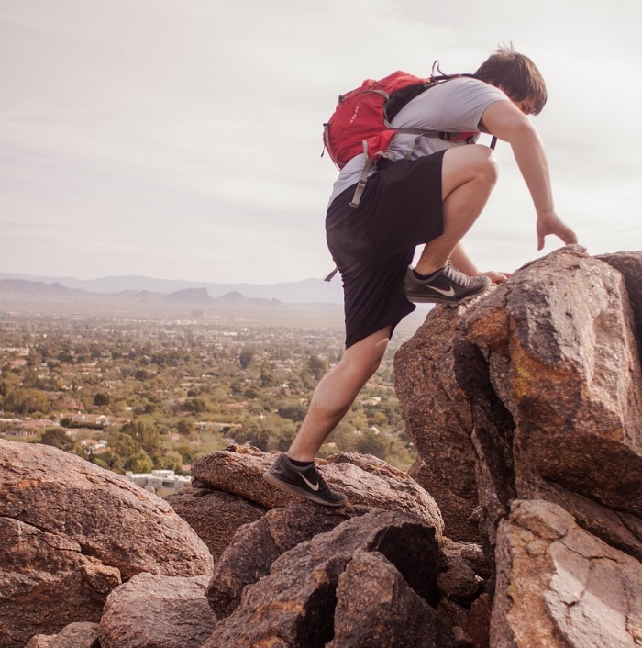
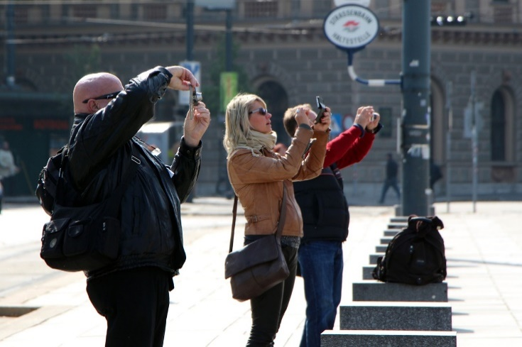
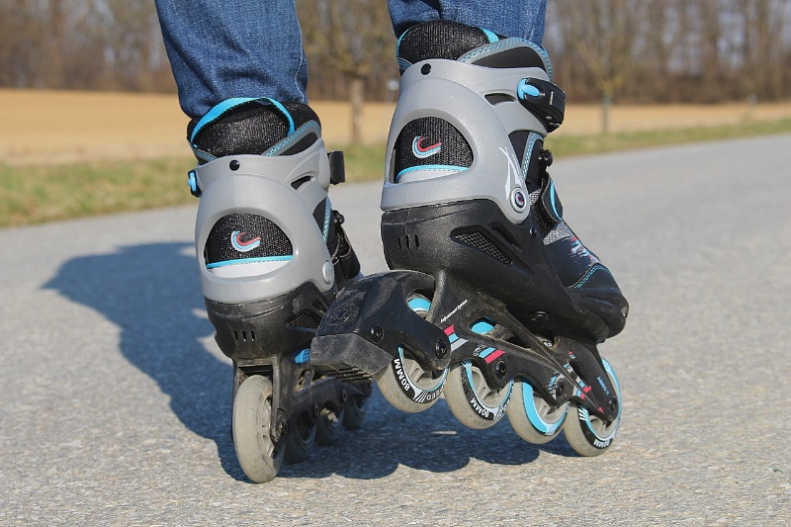
cycling
sightseeing
Activities
sunbathing
hiking
taking photos
rollerblading

Slide 6
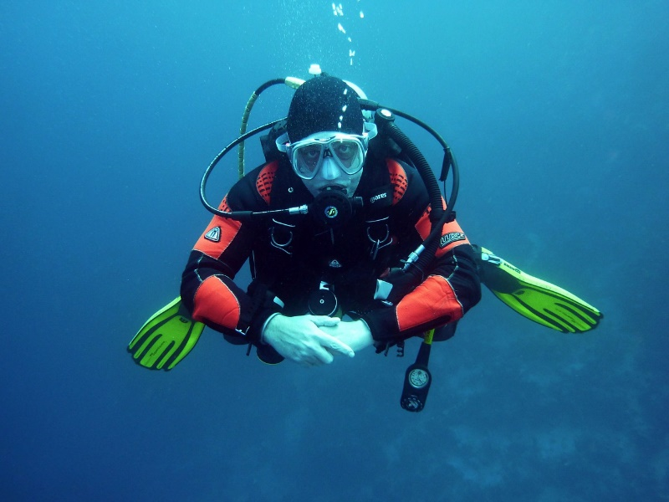
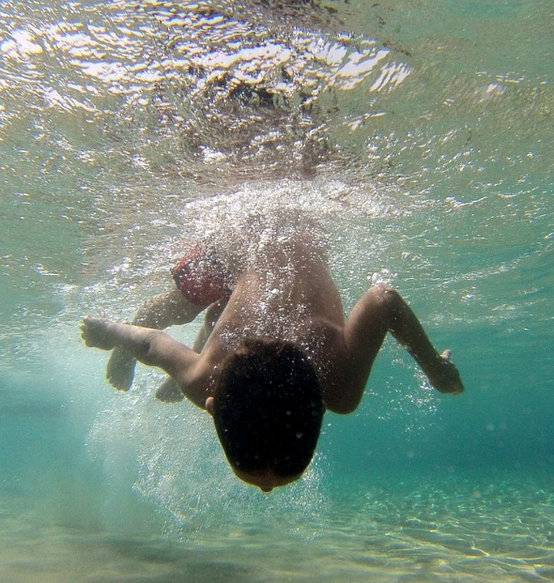
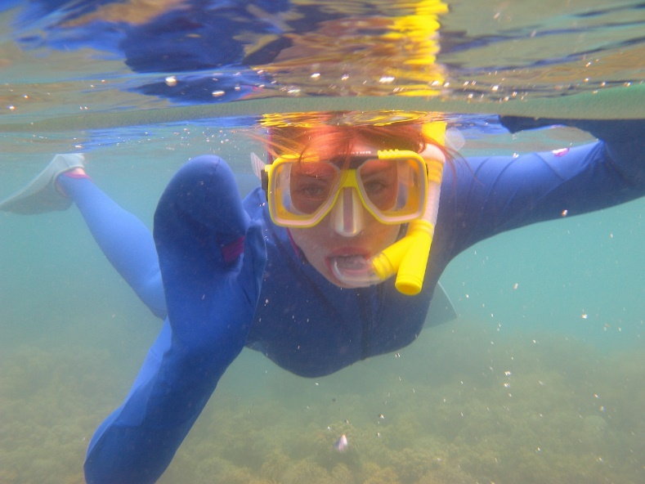
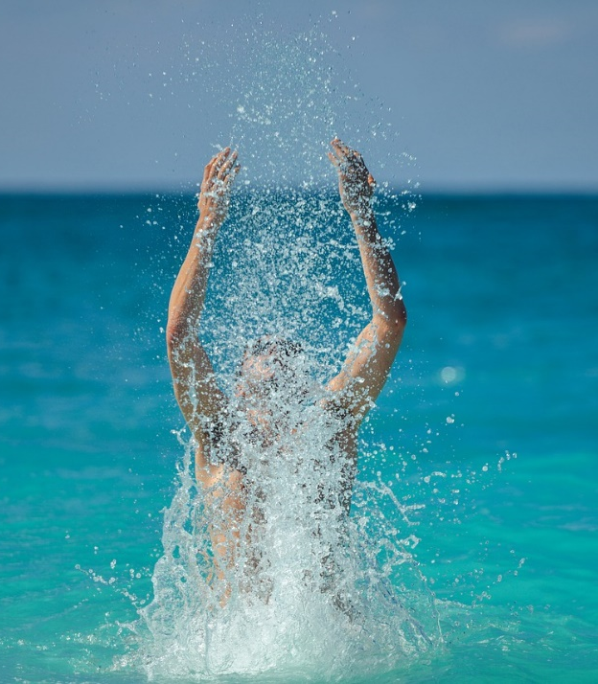
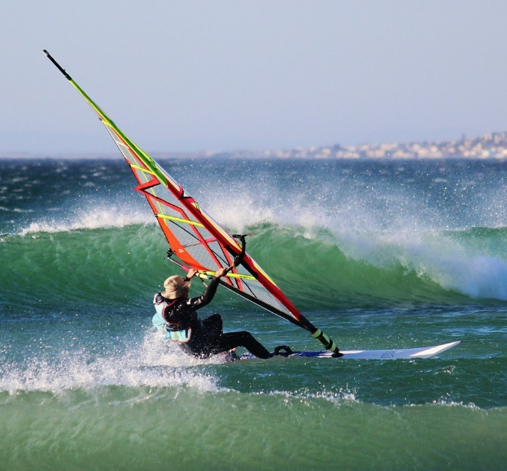
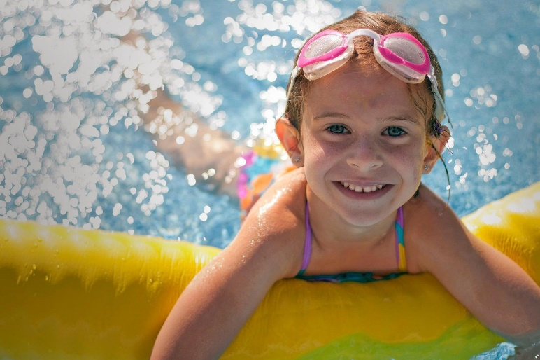
Water
activities
diving
snorkeling
kitesurfing
splashing
swimming

Slide 7
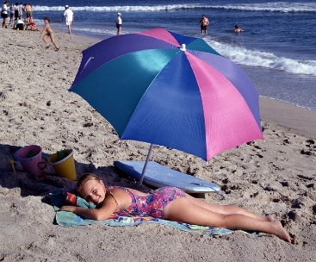




My favourite activity was

Slide 8
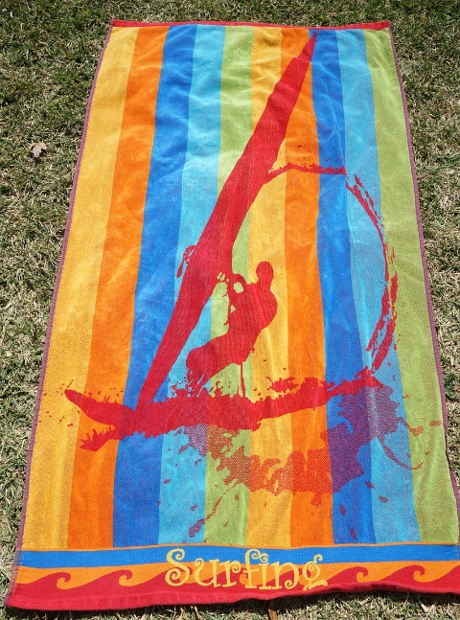
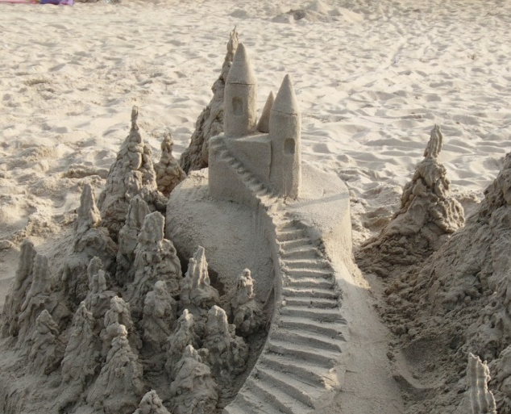
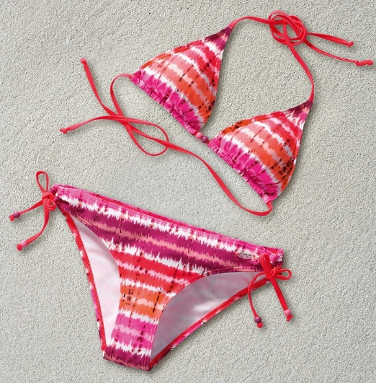
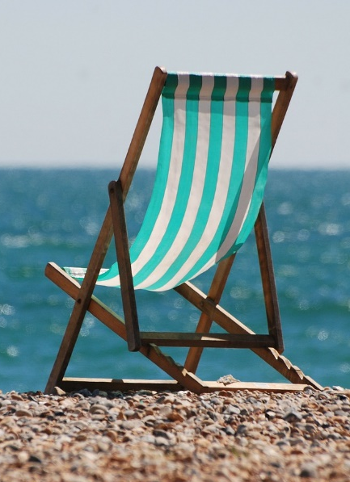
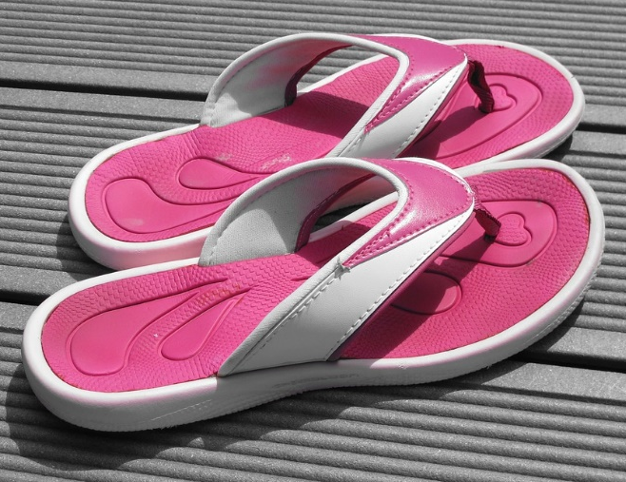
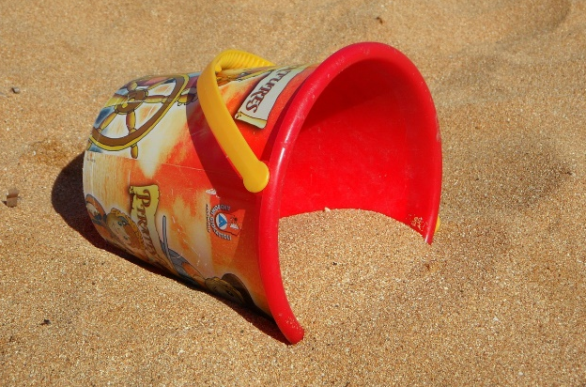

a sand castle
a swimsuit
a towel
On the beach
a bucket and
a shovel
flip flops
a deckchair

Slide 9
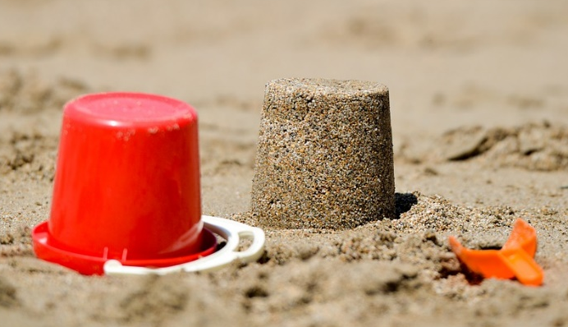
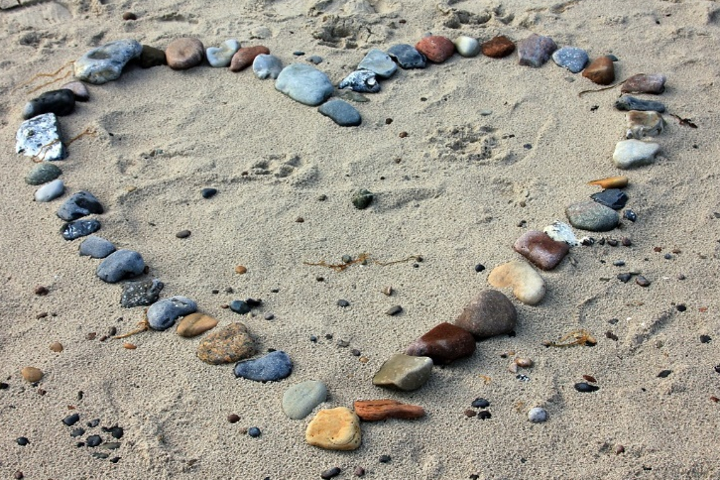
a sand castle.
This summer I made
a sand sculpture.
a heart from stones.

Slide 10
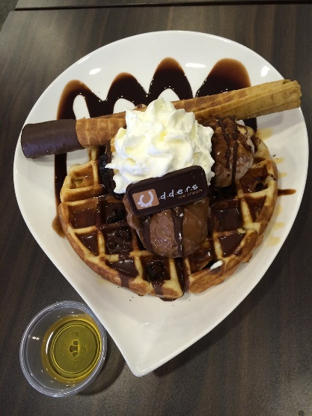
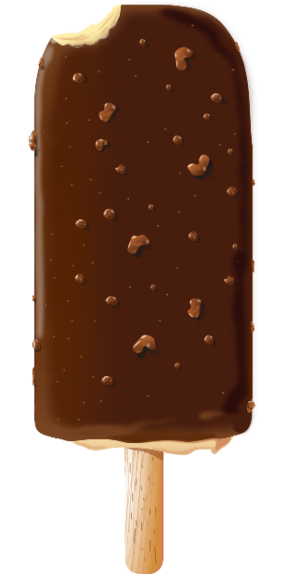
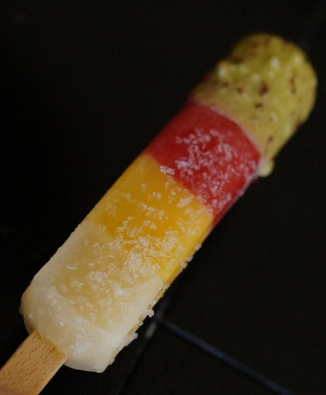
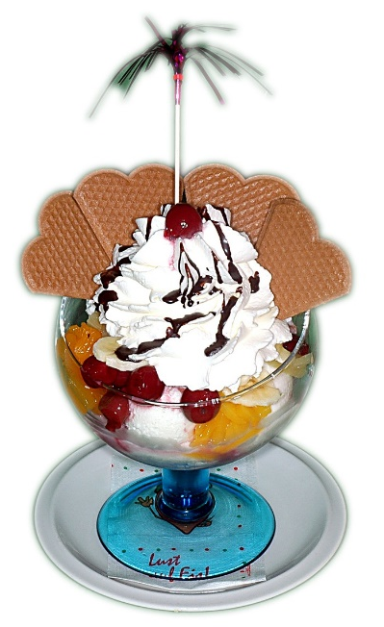
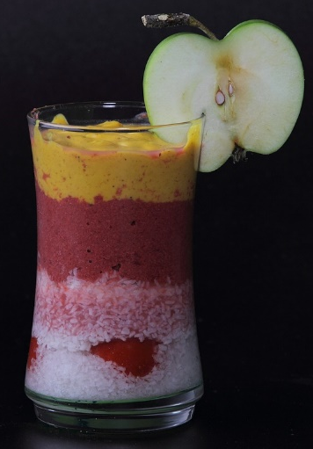
waffle
ice lolly
ice cream bar
Summer treats
sundae
smoothie

Slide 11




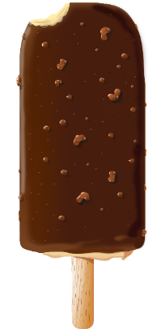
an ice lolly.
a sundae.
My favourite treat is
smoothie.
a waffle.
an ice cream bar.

Slide 12

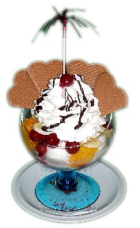






Odd one out
TREATS
ACTIVITIES
PLACES
WATER ACTIVITIES

Slide 13


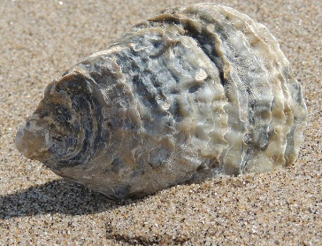
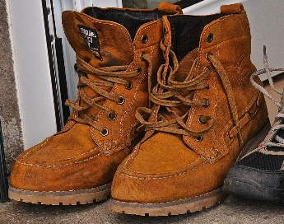

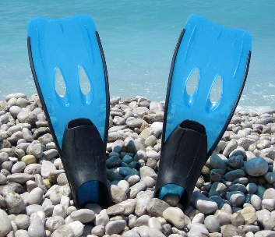

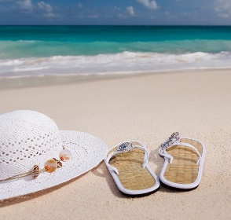



Odd one out
ON THE BEACH
AT THE LAKE
IN THE MOUNTAINS
IN THE CITY

Slide 14


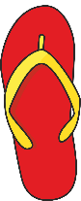








Summer I spy

Slide 15
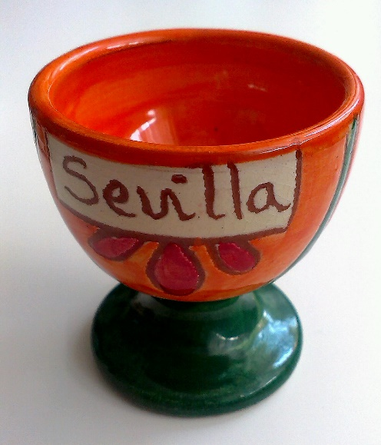
Souvenirs Quiz
This souvenir is from
a. Cracow
b. London
c. Sevilla
This city is in
a. Spain
b. Poland
This is an eggcup .
c. Germany

Slide 16
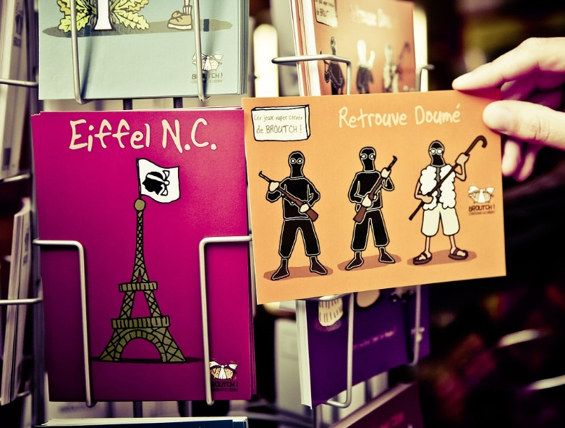
Souvenirs Quiz
These souvenirs are from
a. Paris
b. Hurgada
c. Sevilla
This city is in
a. Egypt
b. France
These are postcards.
c. Spain

Slide 17
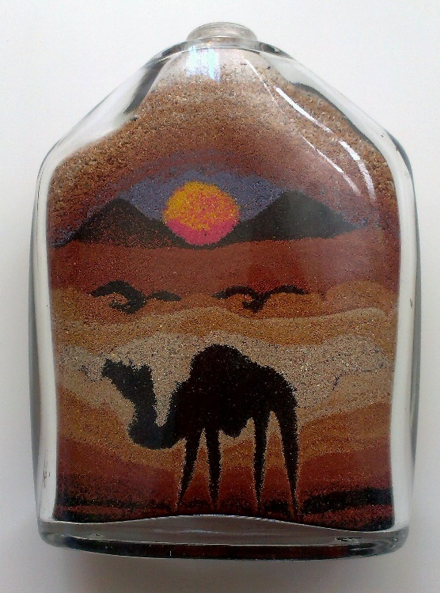
Souvenirs Quiz
This souvenir is from
a. London
b. Hurgada
c. Cracow
This city is in
a. Egypt
b. Spain
This is a sand picture in bottle .
c. England

Slide 18
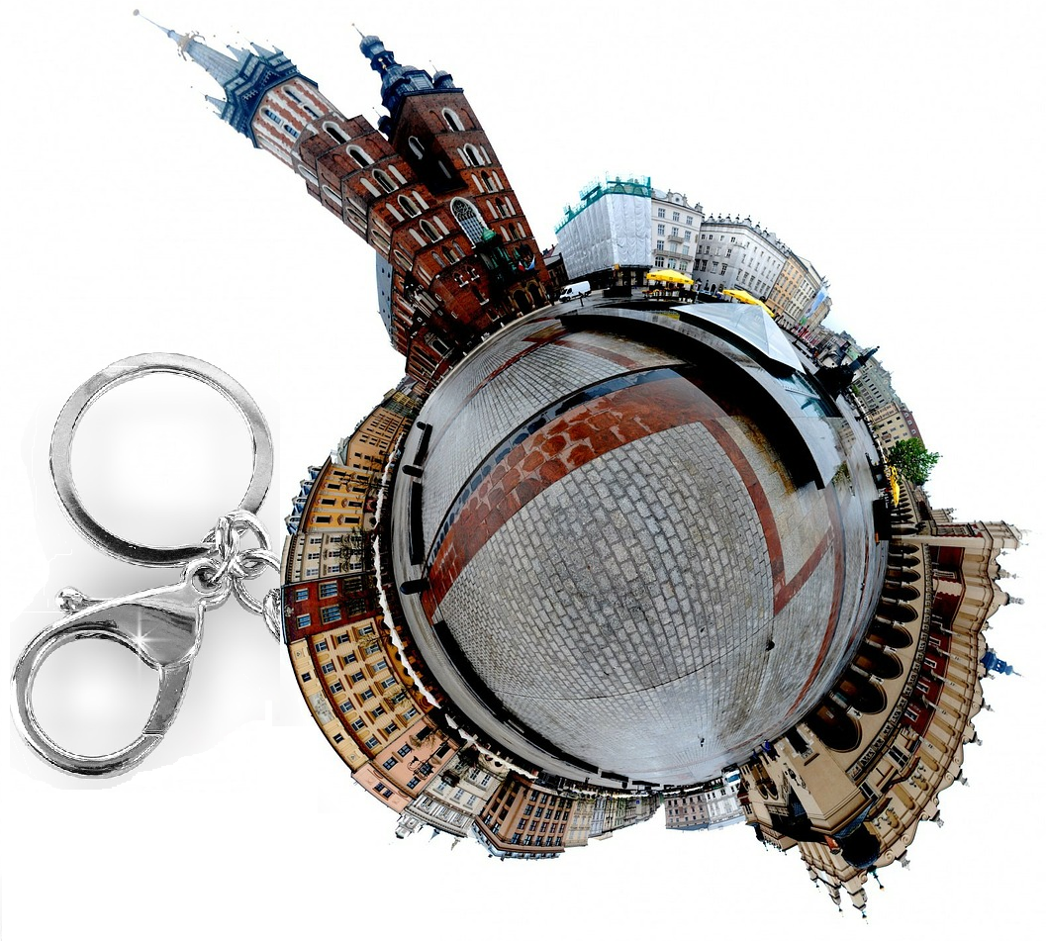
Souvenirs Quiz
This souvenir is from
a. London
b. Hurgada
c. Cracow
This city is in
a. Poland
b. Egypt
This is a keyring .
c. Spain

Slide 19
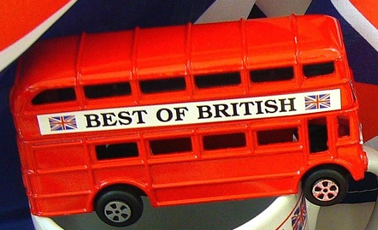
Souvenirs Quiz
This souvenir is from
a. Cracow
b. London
c. Sevilla
This city is in
a. Spain
b. Poland
This is a red bus.
c. England

Slide 20
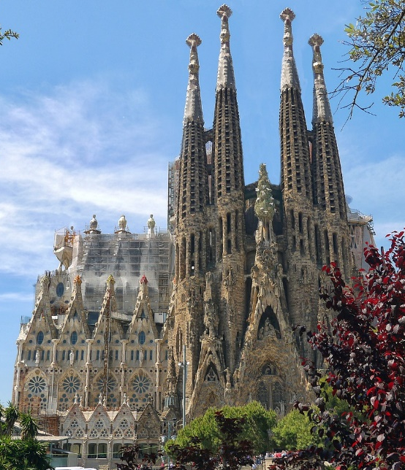
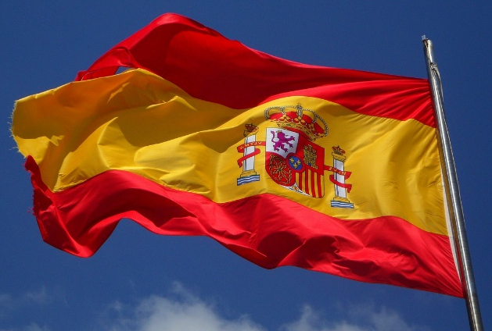






The Sphinx
Giewont peak
The Big Ben
The Sagrada Familia Temple

Slide 21




Creative corner

