Slide 1

klasa II
moduł 26
HELPFUL ANIMALS
PI Synergia początkowej nauki języka obcego z edukacją wczesnoszkolną i technologiami informacyjno-komunikacyjnymi.
Projekt współfinansowany przez Europejski Fundusz Społeczny w ramach Programu Operacyjnego Kapitał Ludzki.
Priorytet III Wysoka jakość systemu oświaty, Działanie 3.3 Poprawa jakości kształcenia, Poddziałanie 3.3.4 Modernizacja treści i metod kształcenia – projekty konkursowe.

Slide 2
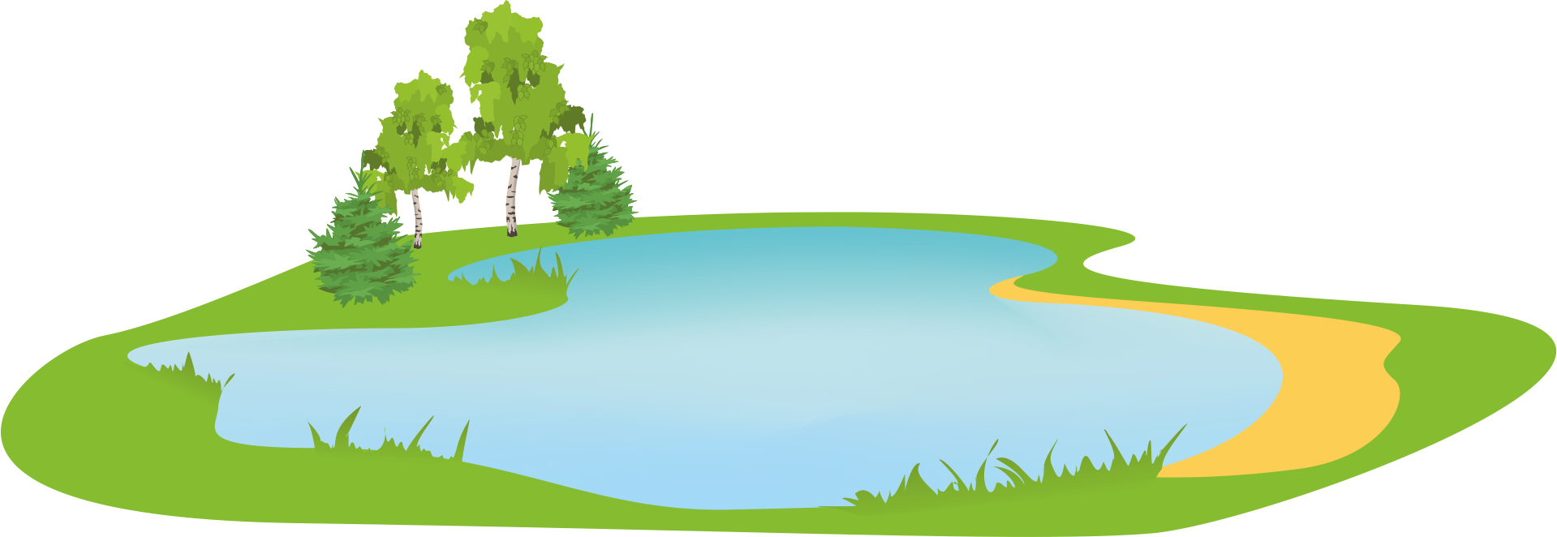
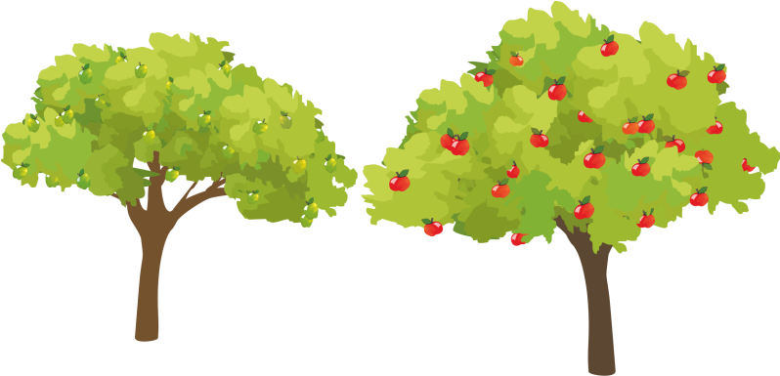
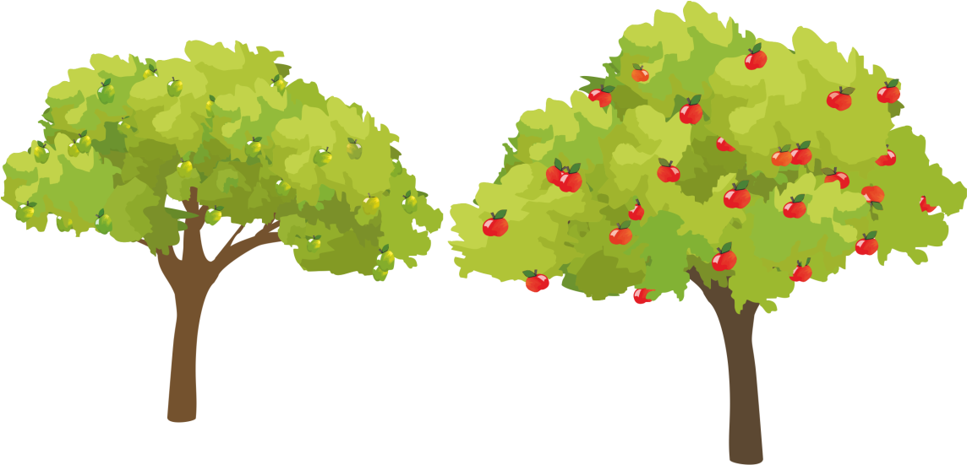


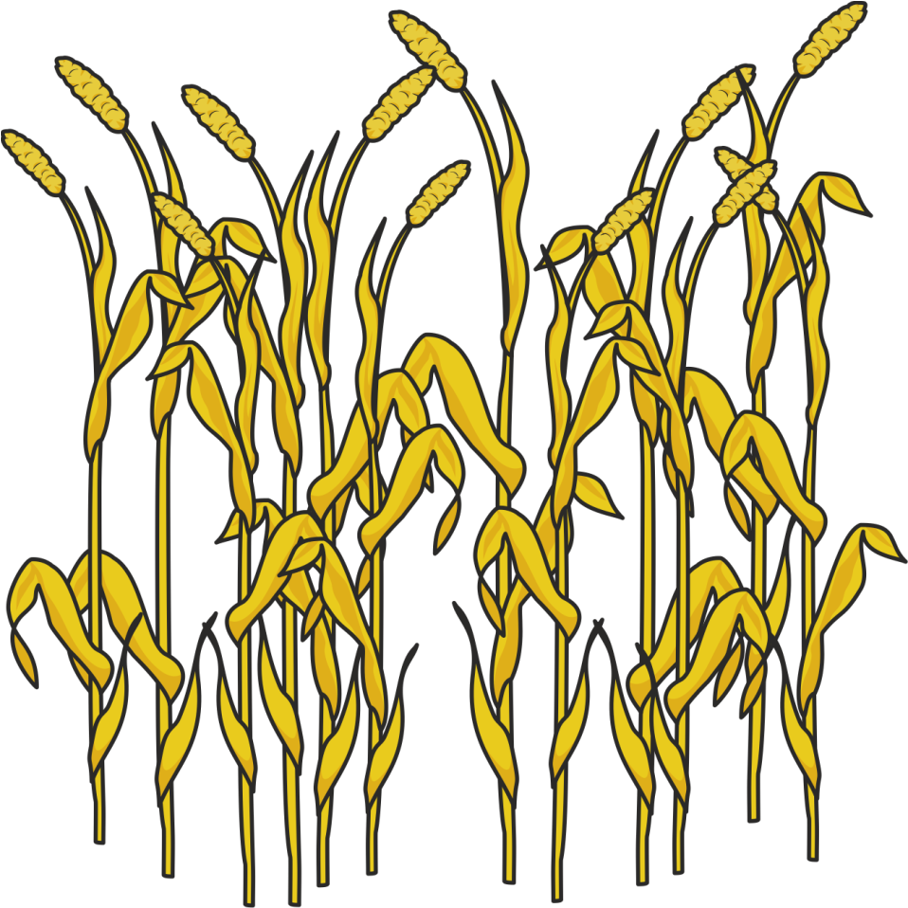


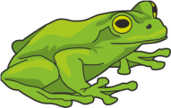


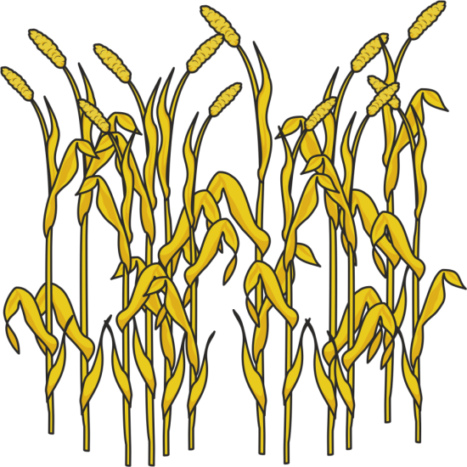
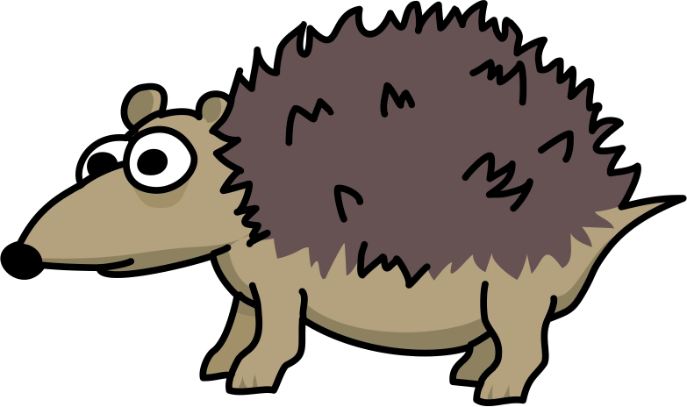
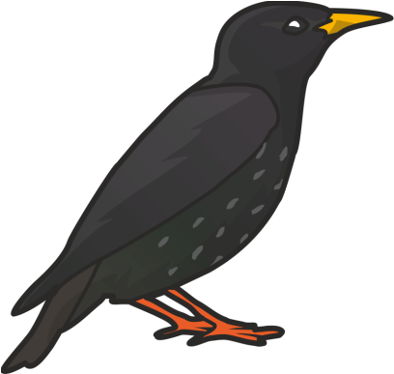
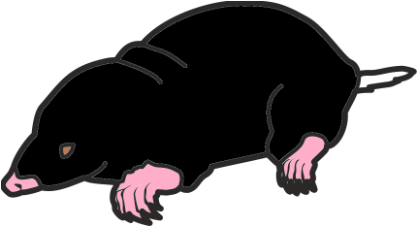


Slide 3

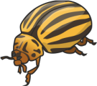




Slide 4
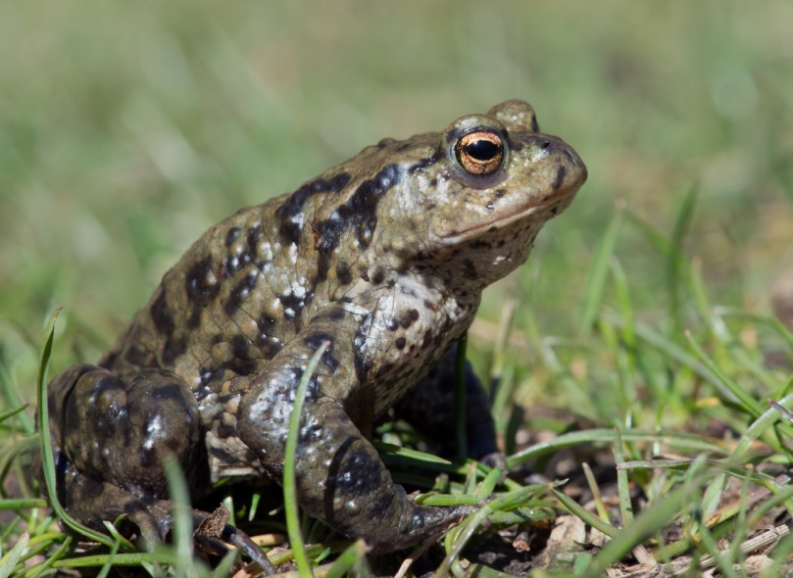
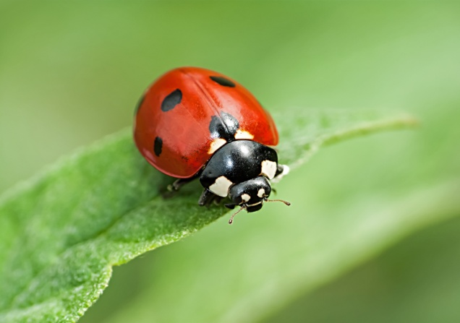
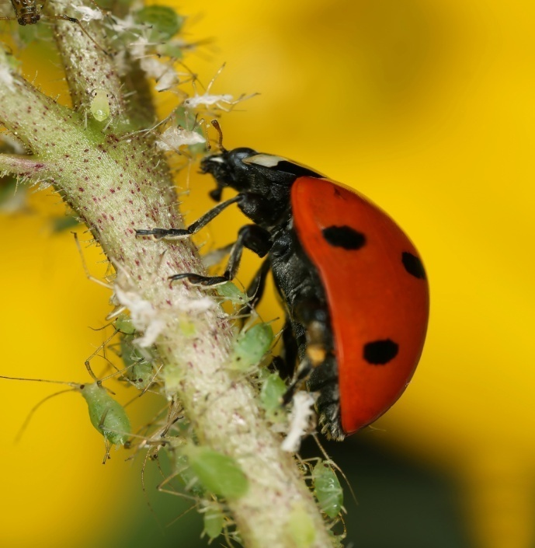
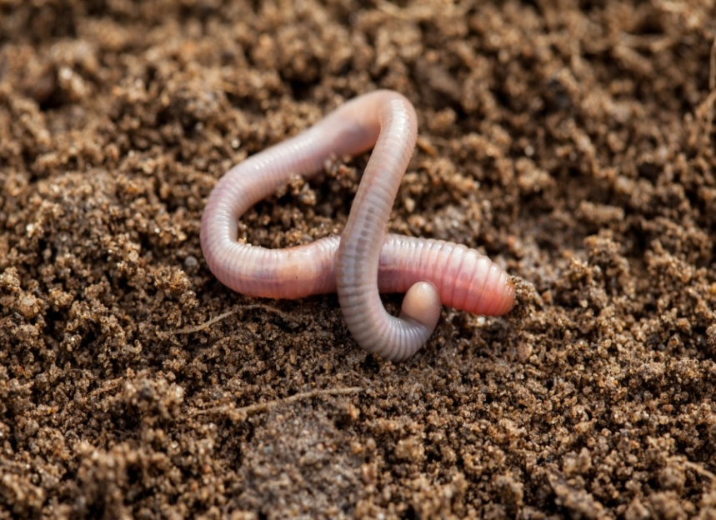
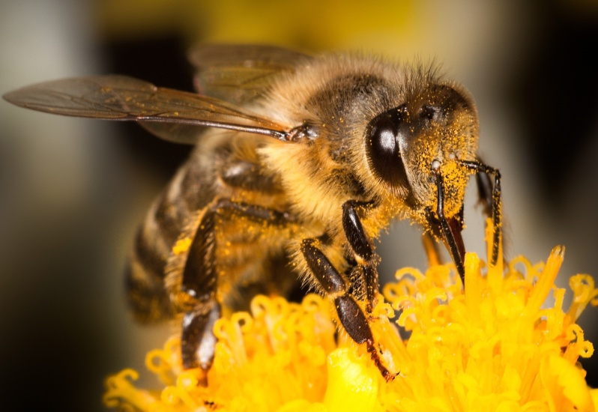
?
Toads eat different insects and snails.
Ladybirds eat greenflies.
Bees pollinate flowers
and make honey.
Earthworms loosen the soil.

Slide 5
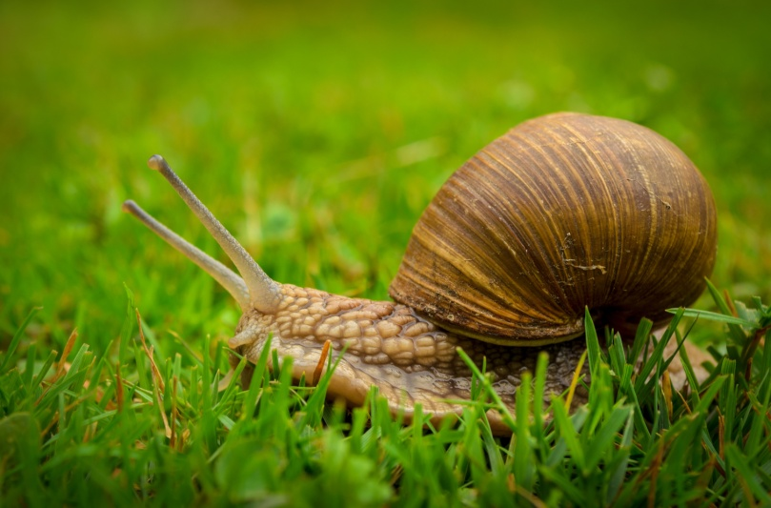
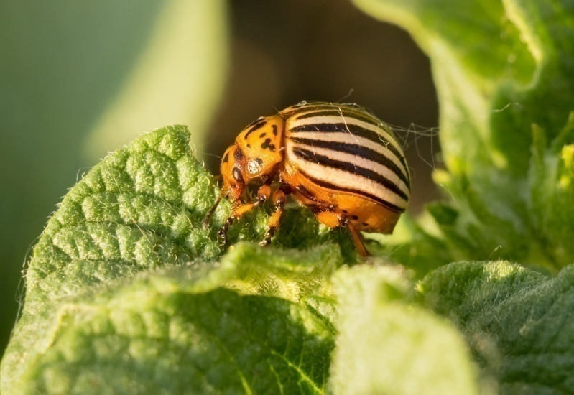
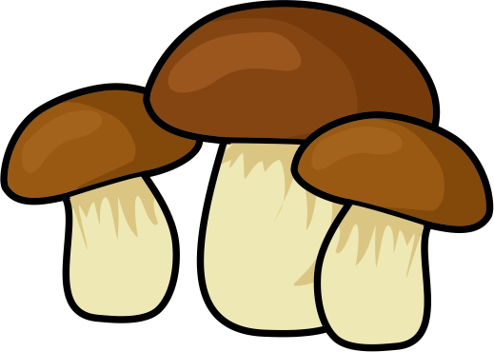

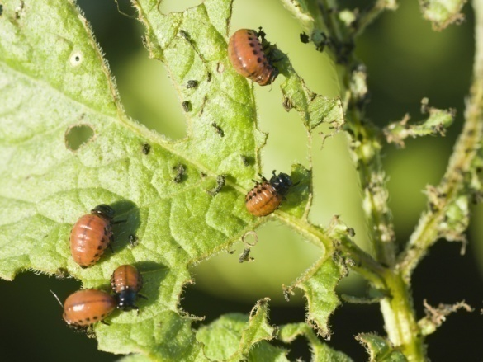
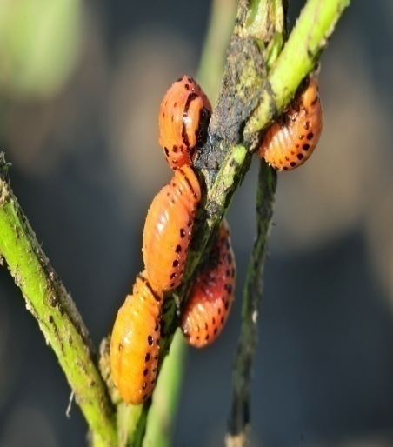
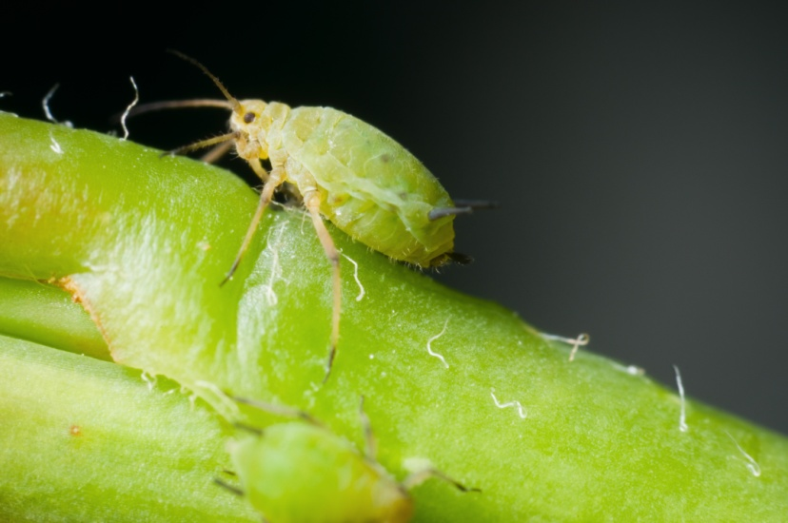
Snails eat mushrooms
and other plants.
Potato beetles eat potato leaves.
?
Greenflies eat different leaves and stems.

Slide 6
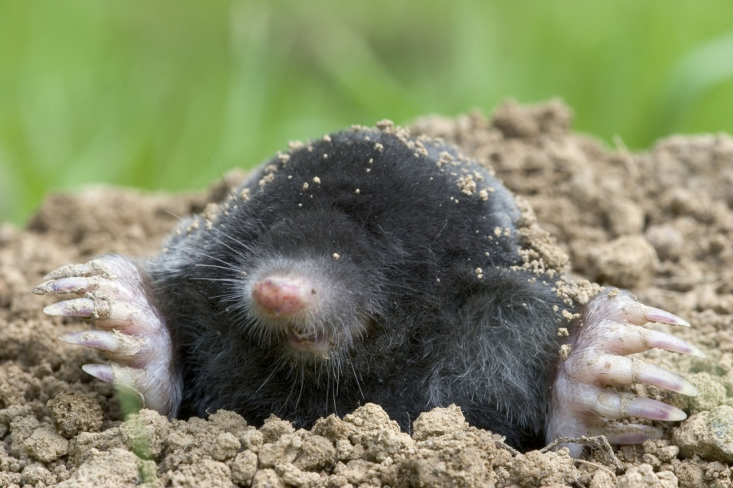
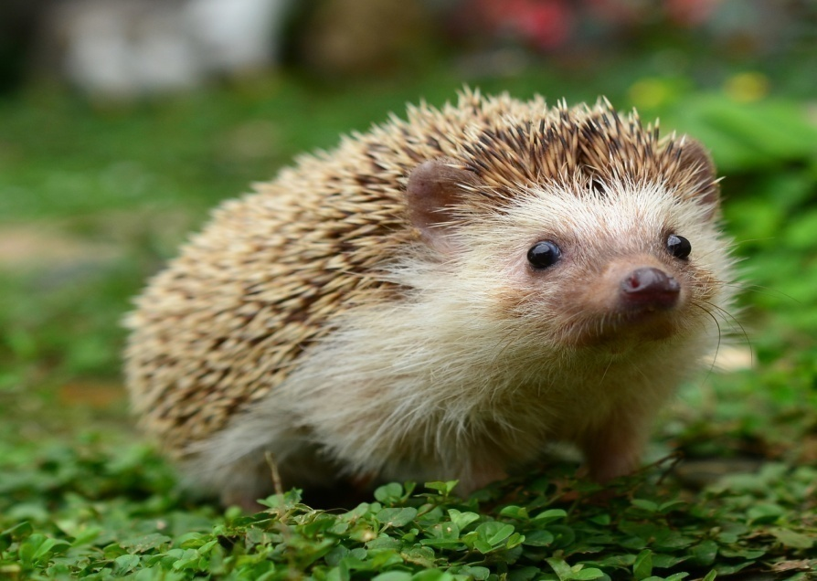
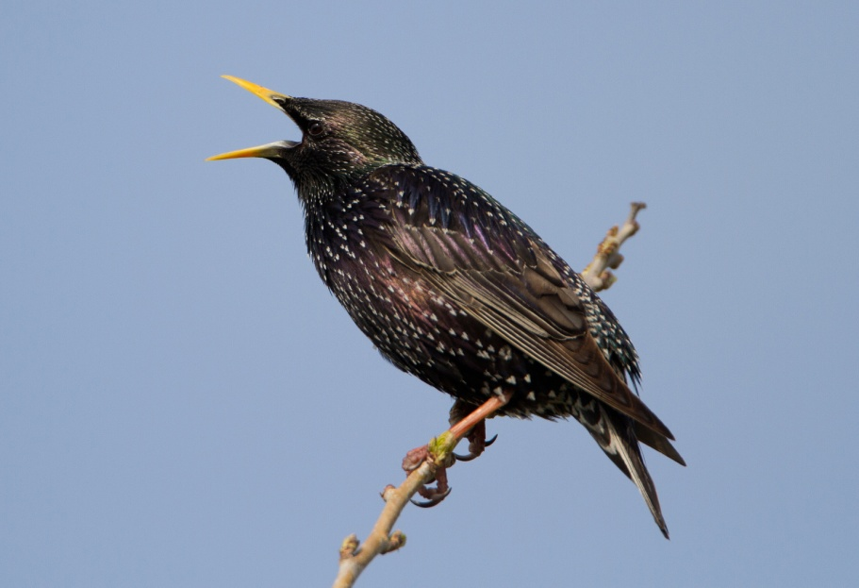
Moles loosen the soil but they also damage gardens.
Hedgehogs eat insects but they also eat earthworms.
?
Starlings eat insects but they
also eat fruit.

Slide 7
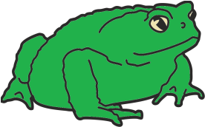
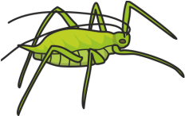
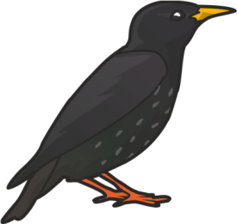
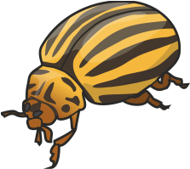
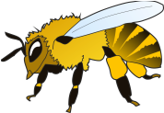

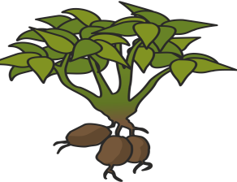
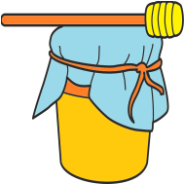
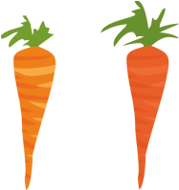
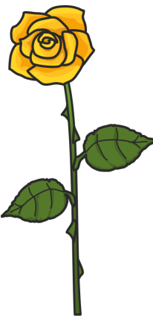
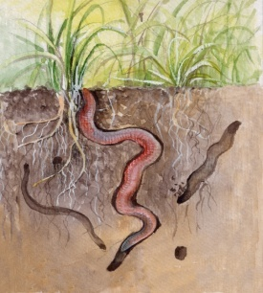




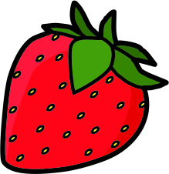
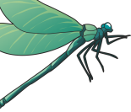

WHAT DO THEY EAT?
WHAT DO THEY DO / MAKE?

Slide 8
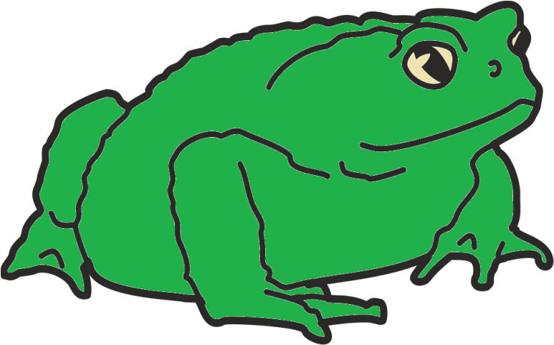
ladybird
bee
USEFUL
toad
earthworm

Slide 9
greenfly
snail
HARMFUL
potato beetle

Slide 10
hedgehog
USEFUL
and
HARMFUL
starling
mole

Slide 11
USEFUL
and
HARMFUL
USEFUL
HARMFUL

Slide 12
WHO AM I?
I can fly.
I like eating fruit.
I have got a beak.
I can jump.
I am green.
I like eating insects.

Slide 13
WHO AM I?
I can fly.
I am black and yellow.
I make honey.
I can crawl .
I am pink.
I live in the ground.

Slide 14

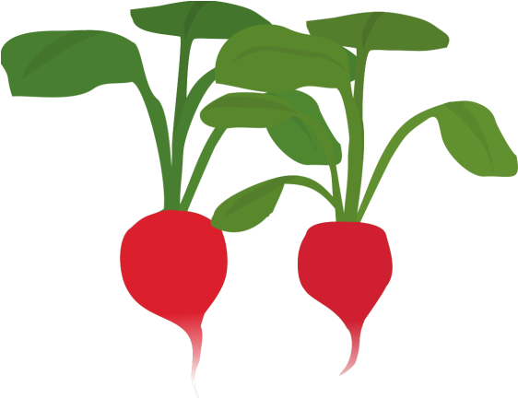


Slide 15
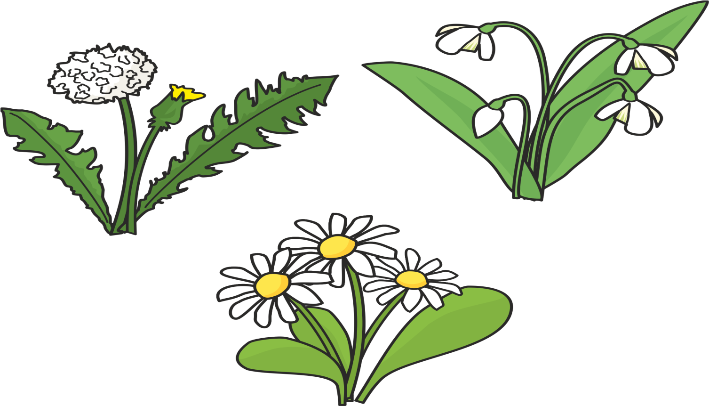
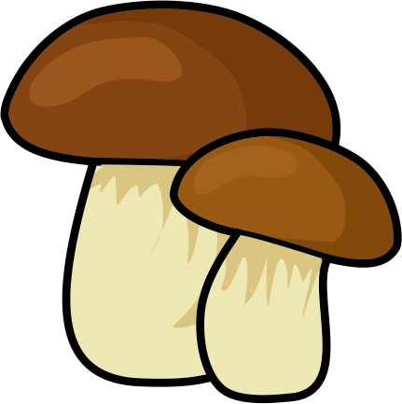

Slide 16
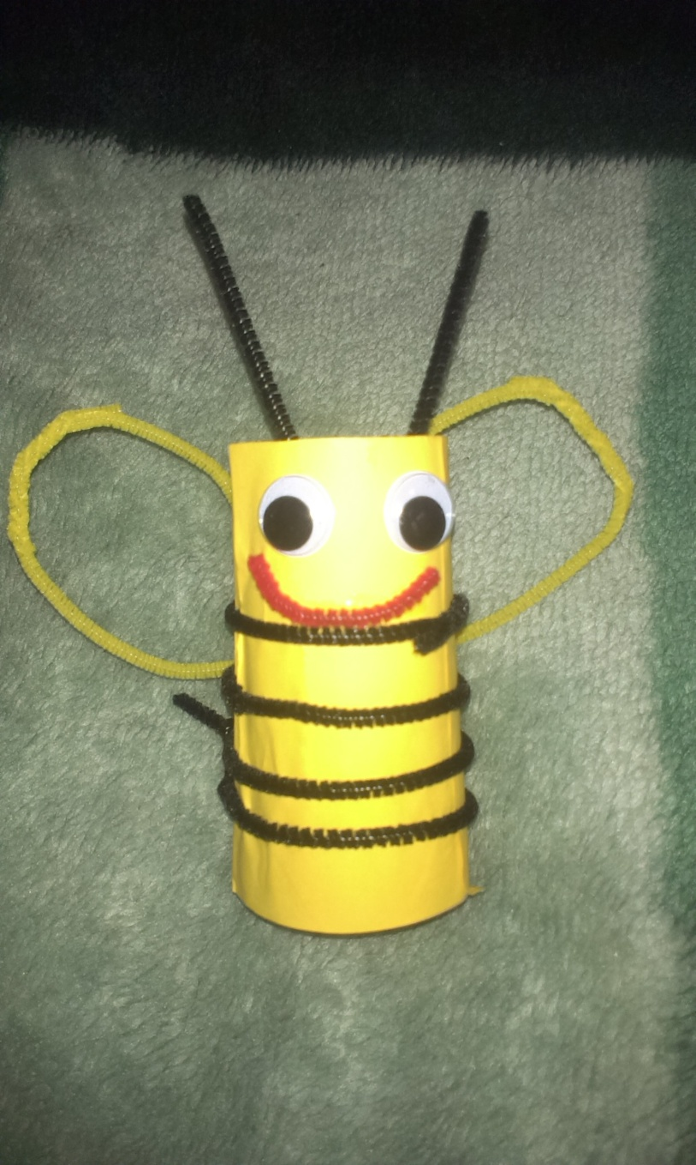
Happy meadow!
Use:
-empty roll of toilet paper
-coloured paper
-scissors
-glue
-creative, fluffy sticks
-plastic, mobile eyes
Make: ladybuds, bees, toads, birds and other animals.
Have a good time!

