Slide 1

klasa II
moduł 27
PEOPLE WHO HELP
PI Synergia początkowej nauki języka obcego z edukacją wczesnoszkolną i technologiami informacyjno-komunikacyjnymi.
Projekt współfinansowany przez Europejski Fundusz Społeczny w ramach Programu Operacyjnego Kapitał Ludzki.
Priorytet III Wysoka jakość systemu oświaty, Działanie 3.3 Poprawa jakości kształcenia, Poddziałanie 3.3.4 Modernizacja treści i metod kształcenia – projekty konkursowe.

Slide 2
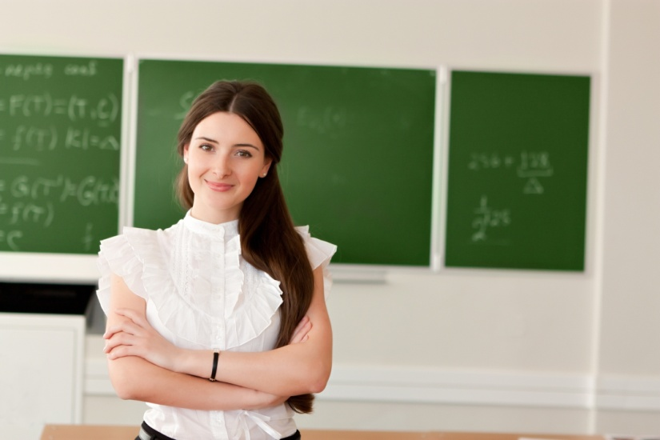
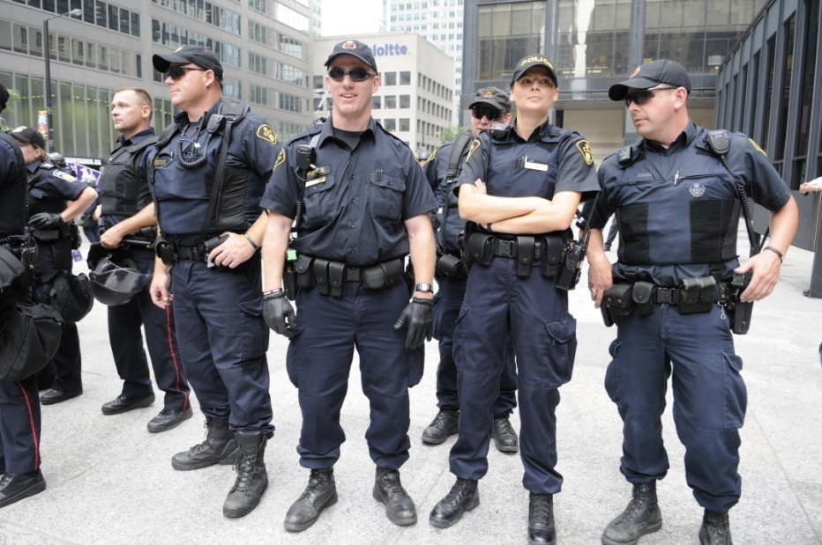
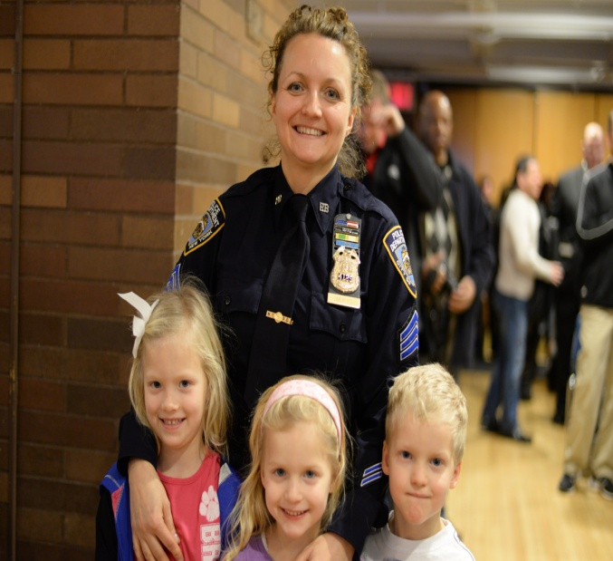
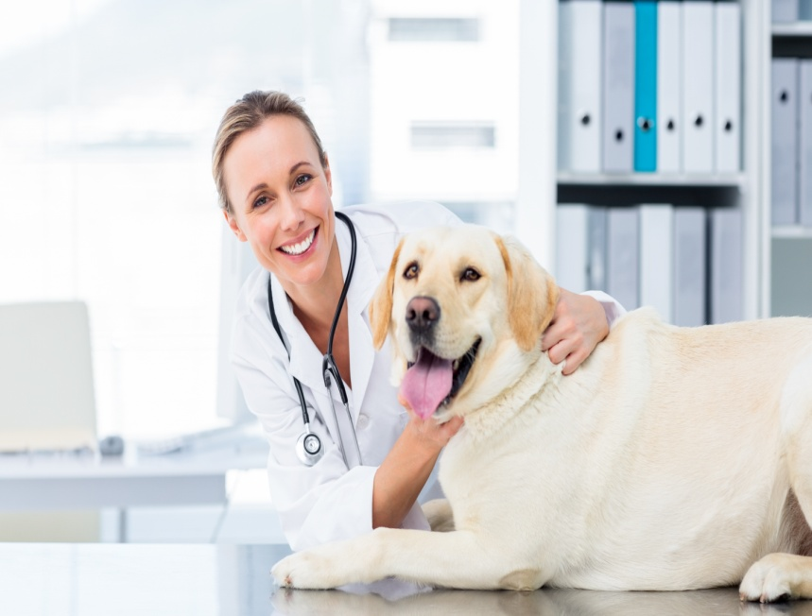

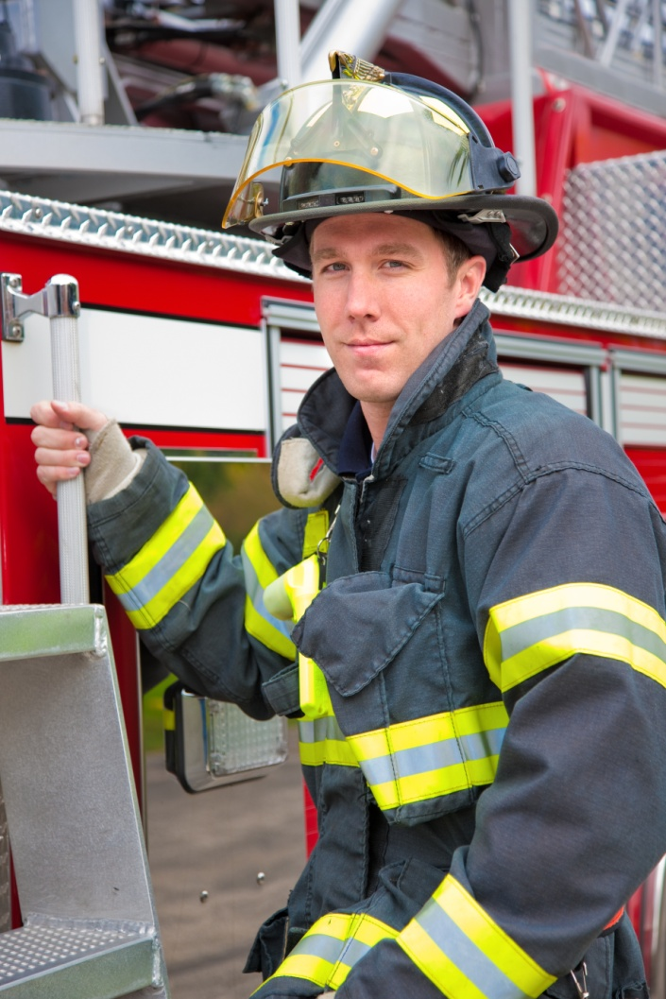
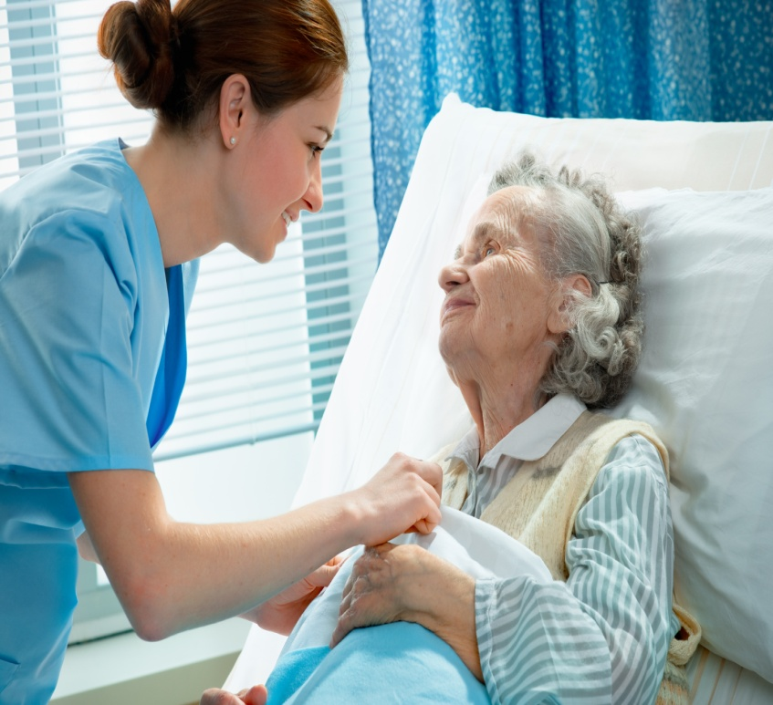
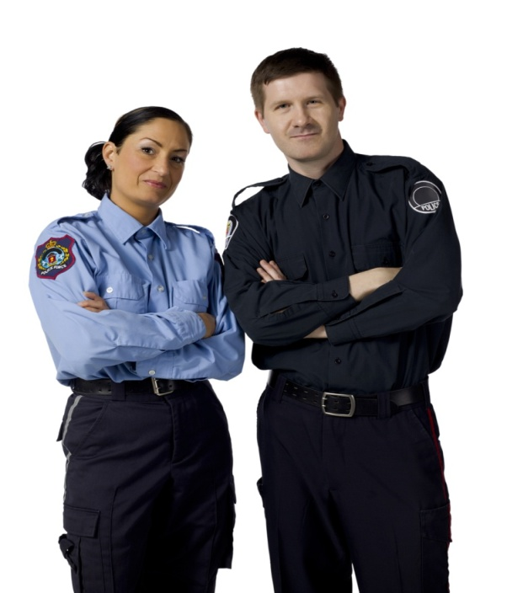

Slide 3

This is . He works .
He helps .
He wears a special .
Who is he?
Bob
at the fire station
people and animals
uniform
He is a firefighter.
This is . She works .
She helps .
She wears .
Who is she?
Ola
at school
children
?
?
?
?
?
casual clothes
She is a teacher.

Slide 4
This is . He works . He helps ill .
He wears a special .
Who is he?
Mark
in the hospital
people
uniform
He is a doctor.
?
?
?
?
?
This is . She works .
She looks after ill .
She wears .
Who is she?
Kate
in the hospital
people
a special uniform
She is a nurse.

Slide 5


This is .
She works .
She helps ill .
She wears a special .
Who is she?
Jane
in the veterinary clinic
animals
uniform
She is a vet.
?
?
?
?
?
This is with her colleague.
She works .
She helps .
She wears .
Who is she?
Lucy
at the police station
people
a special uniform
She is a police officer.

Slide 6
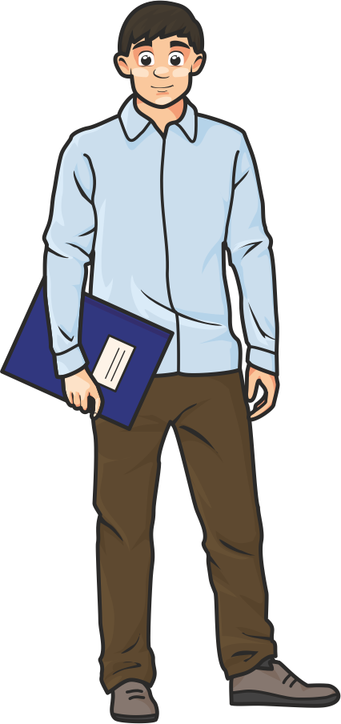
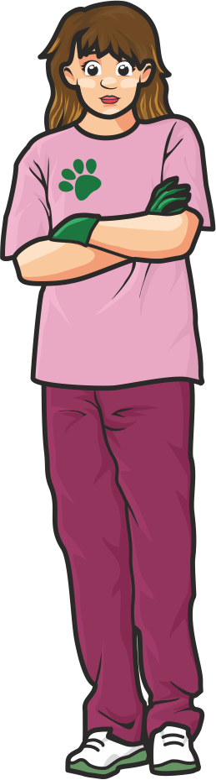
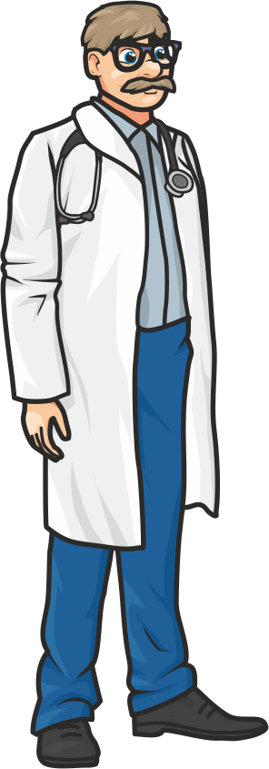
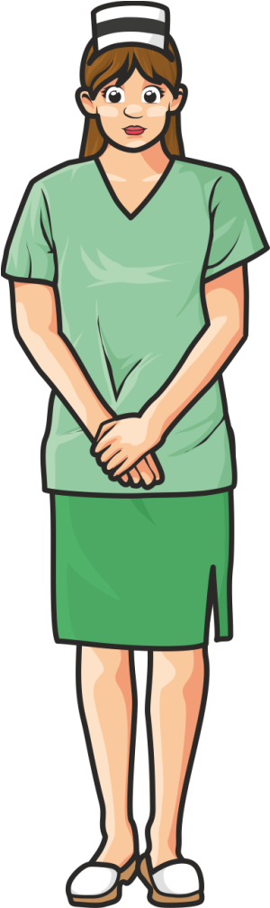
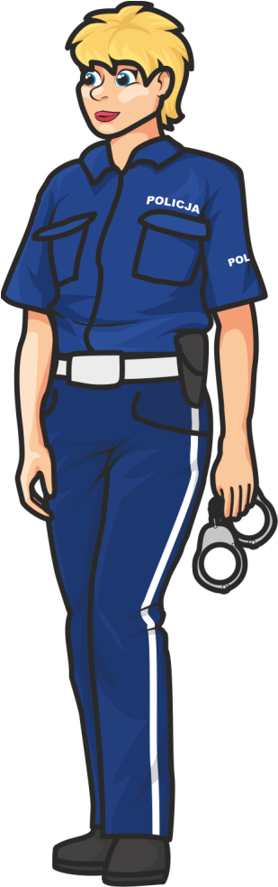
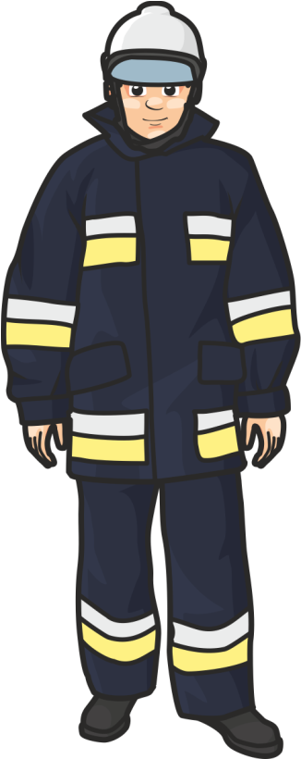
Who are they?
She is a police officer.
She is a vet.
She is a nurse.
He is a firefighter.
He is a teacher.
He is a doctor.

Slide 7


Slide 8
Who is missing?

Slide 9
Who is missing?

Slide 10
Who is missing?

Slide 11
kngfeokfdso
doctor
jhgdrosbtpro
kilbgfswtvdsaeee
nurse
Tult
kjuhhb
policeofficer
kjnhfsgetaoj
kjdnsbfi
firefighter
lkghysjaknhfn
dksneykdmhd
vet
jndlssjsjsjlsoqoj
kgfdxsyoihgu
jffggghjl
teacher

Slide 12


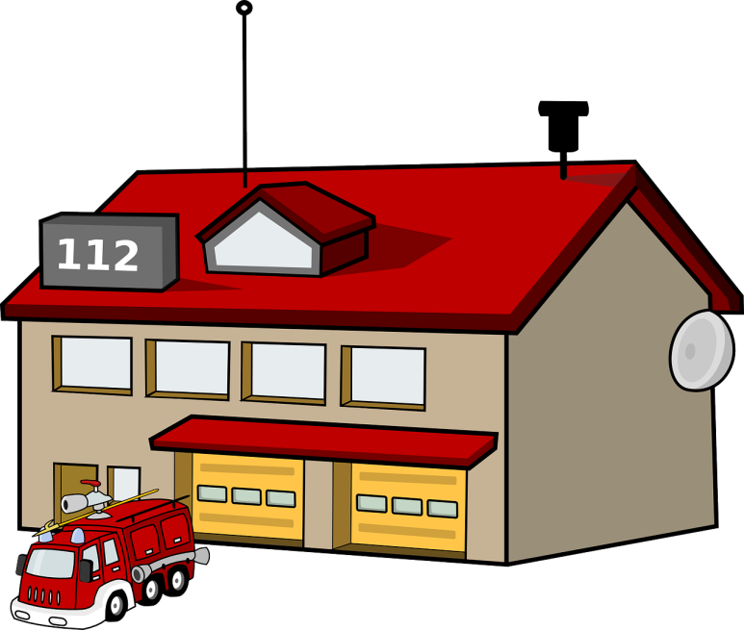


Who works there?

Slide 13
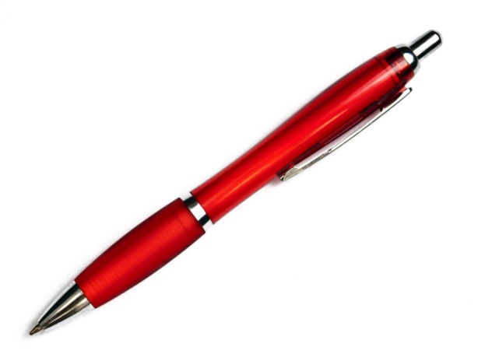

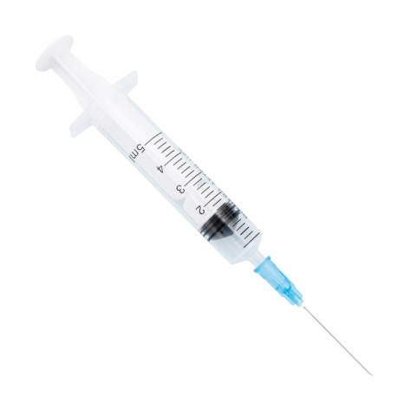

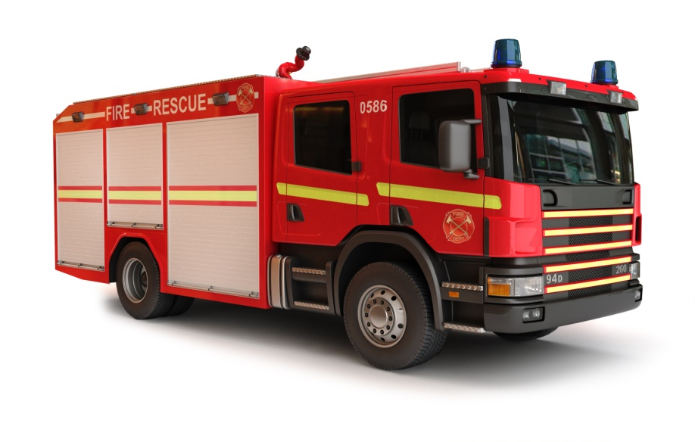
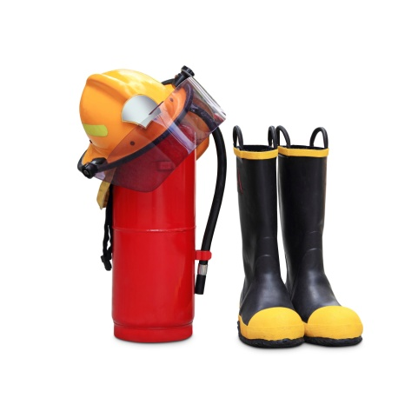
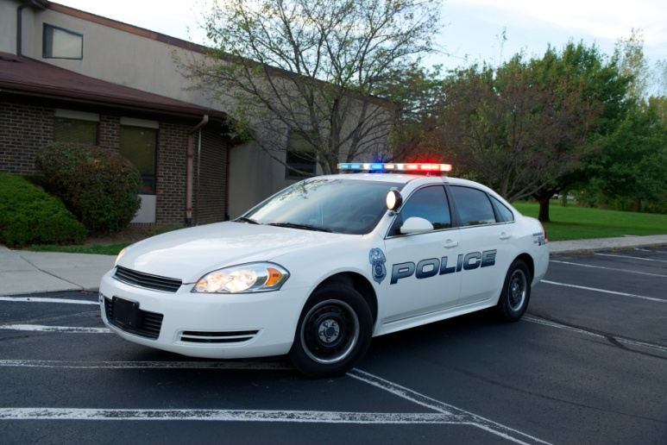
Whose is this?

Slide 14
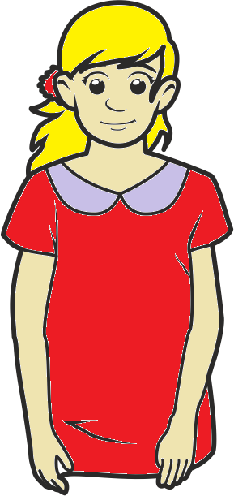
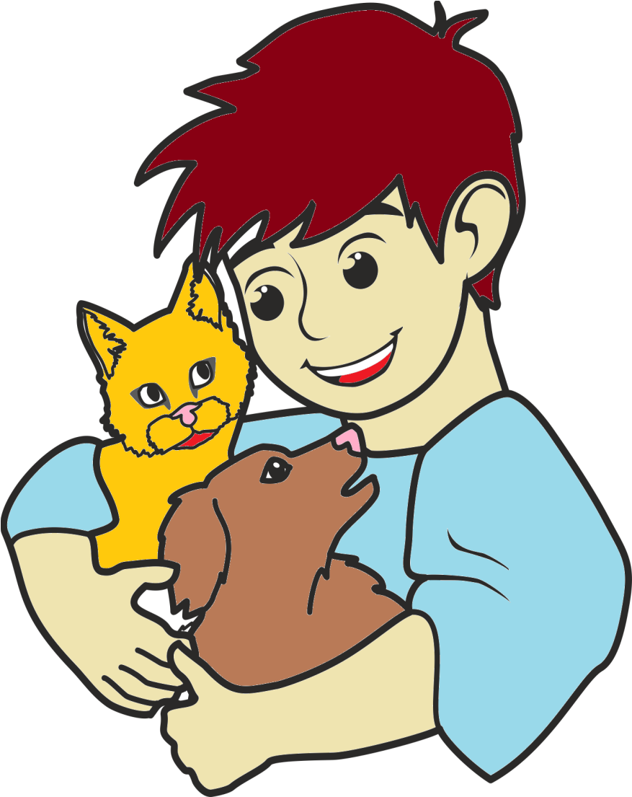

Hello!
I’m Ela.
I want to be ………………………..
a police officer.
a nurse.
a vet.
a teacher.
Hello!
I’m Olek.
I like animals.
I want to be ………………………..

Slide 15



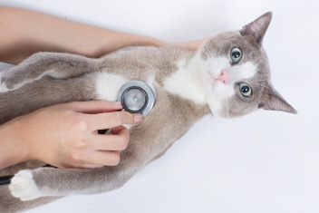

I want to be

Slide 16




Julka has a problem.
On Monday she wants to be a
On Tuesday he wants to be a
On Wednesday she wants to be a
On Thursday she wants to be a
On Friday she wants to be a
On Saturday she wants to be a
On Sunday she wants to be a

Slide 17
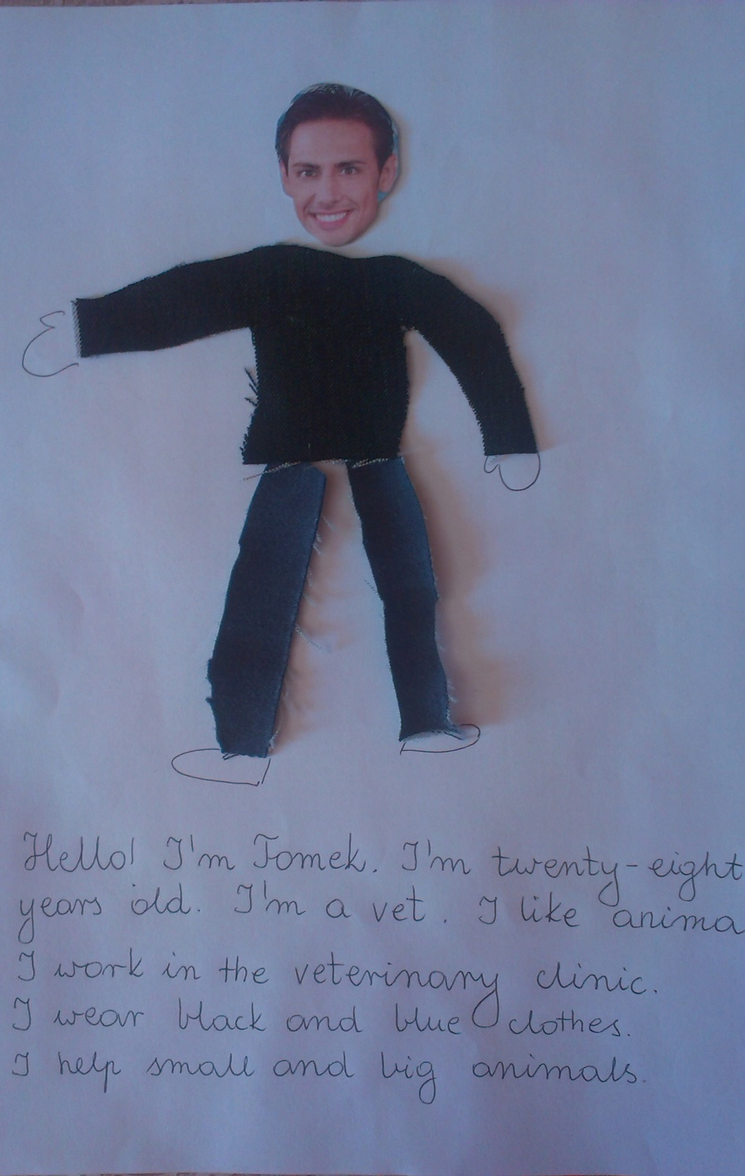
PROJECT
Think about your future job and design your uniform.
Prepare:
your photo
old magazines and materials
scissors
glue

