Slide 1

klasa II
moduł 23
FAMOUS SPORTS STARS
PI Synergia początkowej nauki języka obcego z edukacją wczesnoszkolną i technologiami informacyjno-komunikacyjnymi.
Projekt współfinansowany przez Europejski Fundusz Społeczny w ramach Programu Operacyjnego Kapitał Ludzki.
Priorytet III Wysoka jakość systemu oświaty, Działanie 3.3 Poprawa jakości kształcenia, Poddziałanie 3.3.4 Modernizacja treści i metod kształcenia – projekty konkursowe.

Slide 2
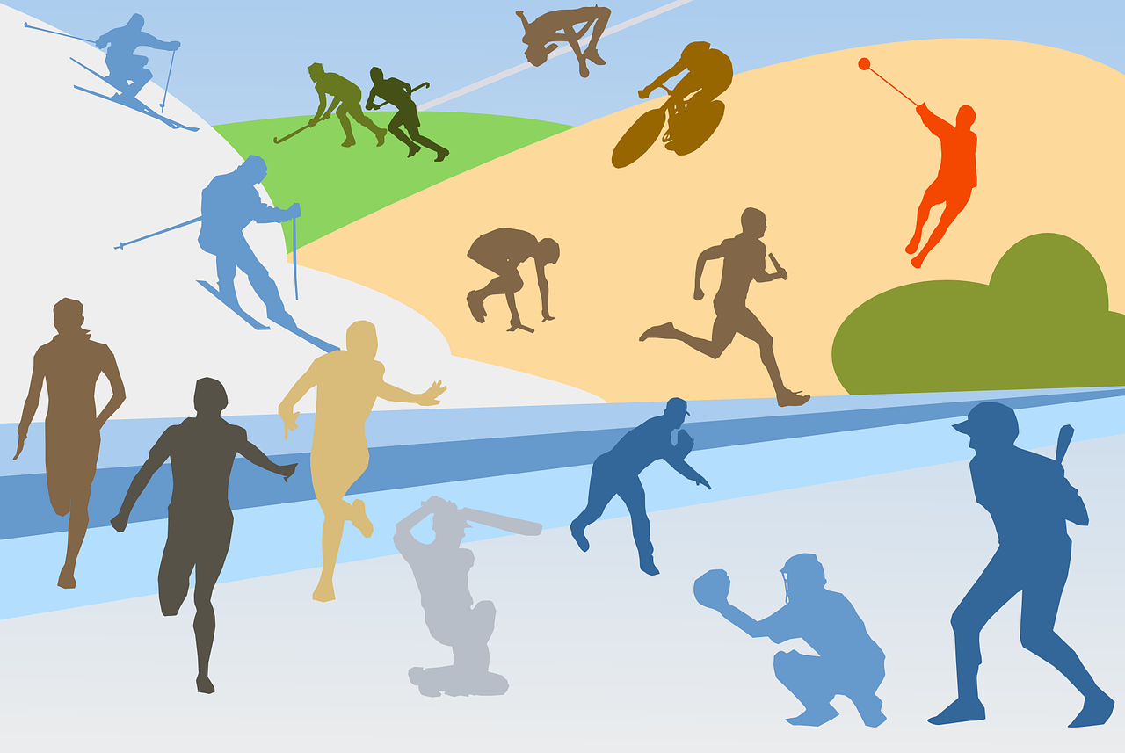

Slide 3
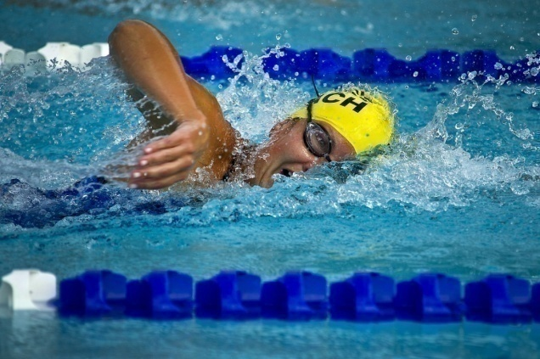
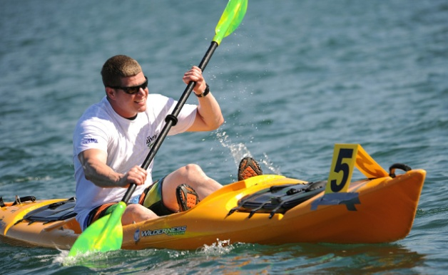
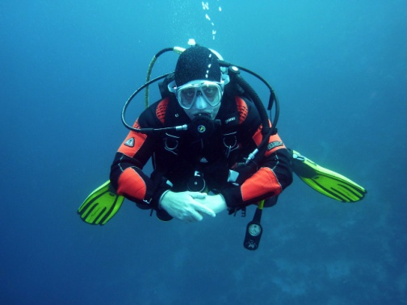

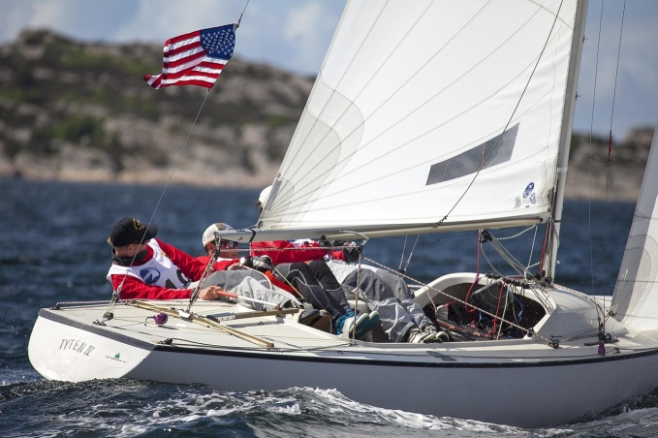
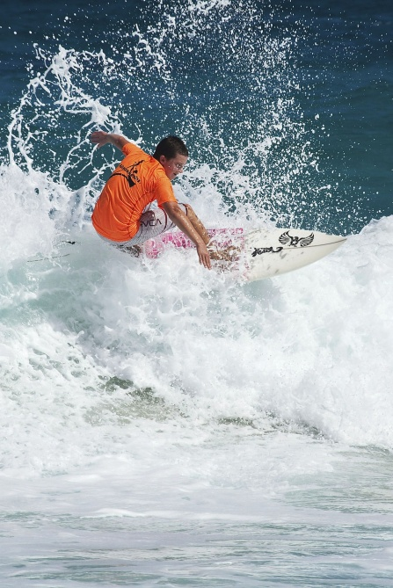
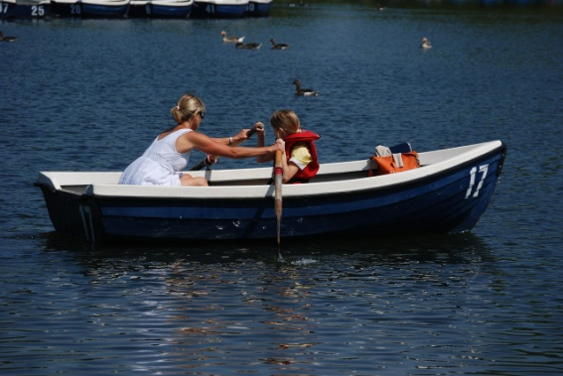
Water sports
SWIMMING
DIVING
CANOEING
WATER POLO
SAILING
ROWING
WINDSURFING

Slide 4







Slide 5
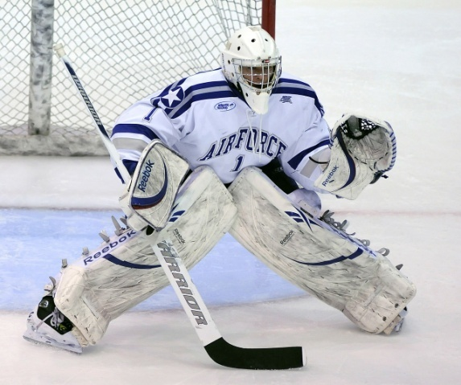
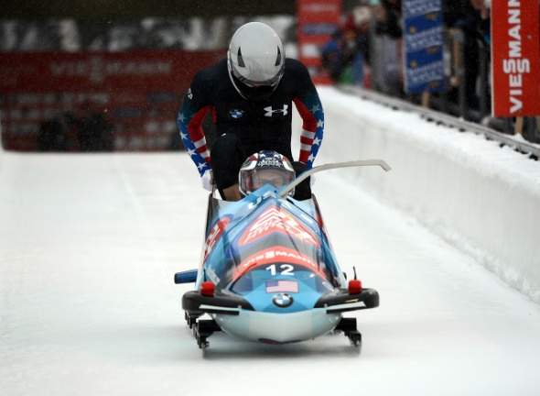
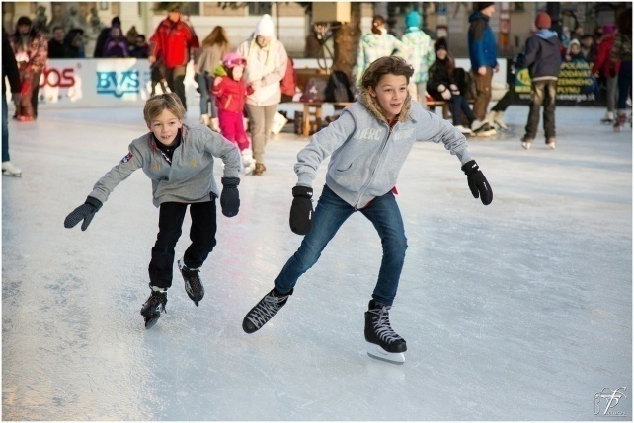
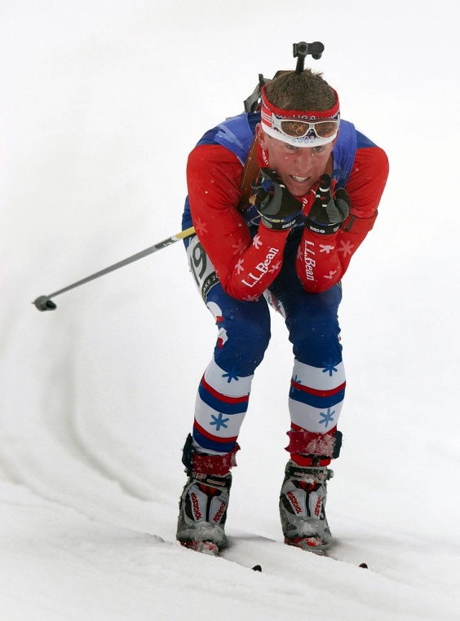
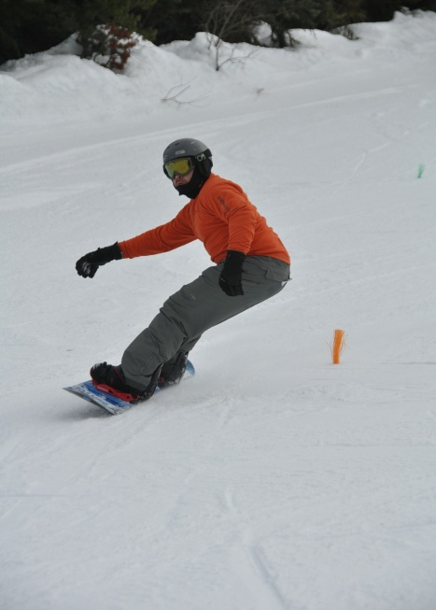

Winter sports
SLEDGING
ICE SKATING
ICE HOCKEY
SKI JUMPING
SKIING
SNOWBOARDING

Slide 6






Slide 7
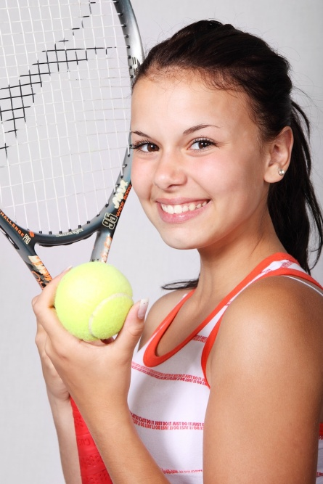
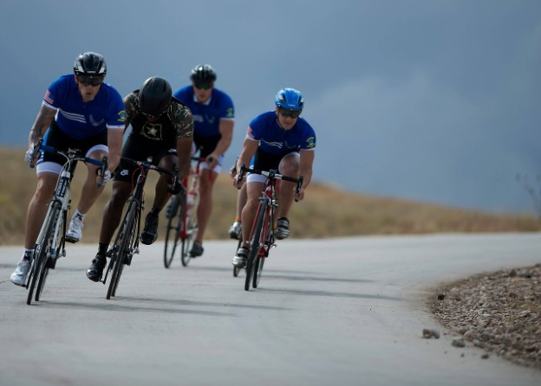
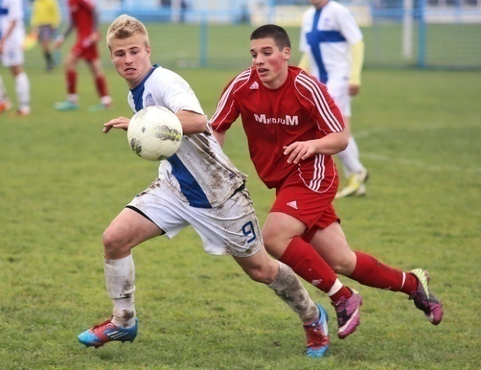
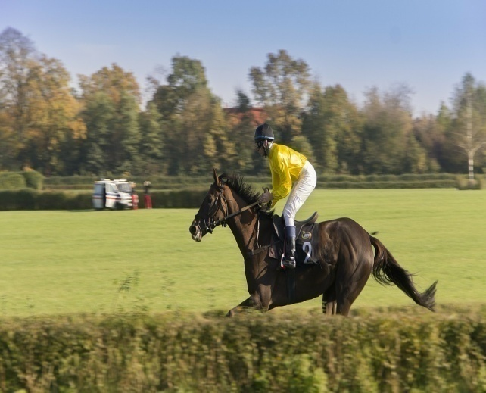
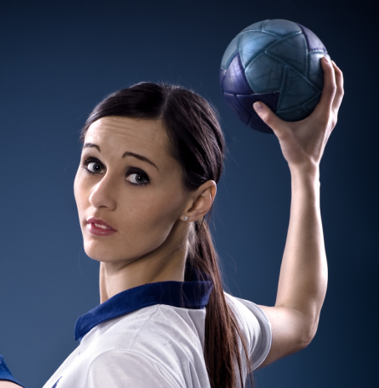
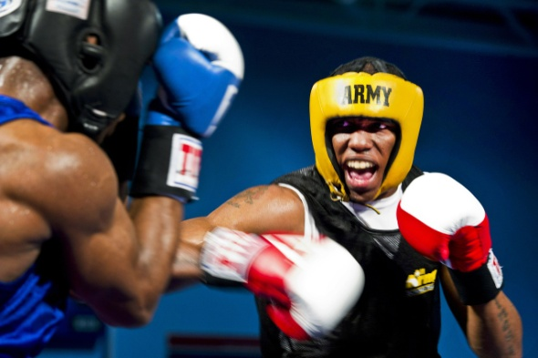
OTHER SPORTS
CYCLING
FOOTBALL
TENNIS
HORSE RIDING
HANDBALL
BOXING

Slide 8
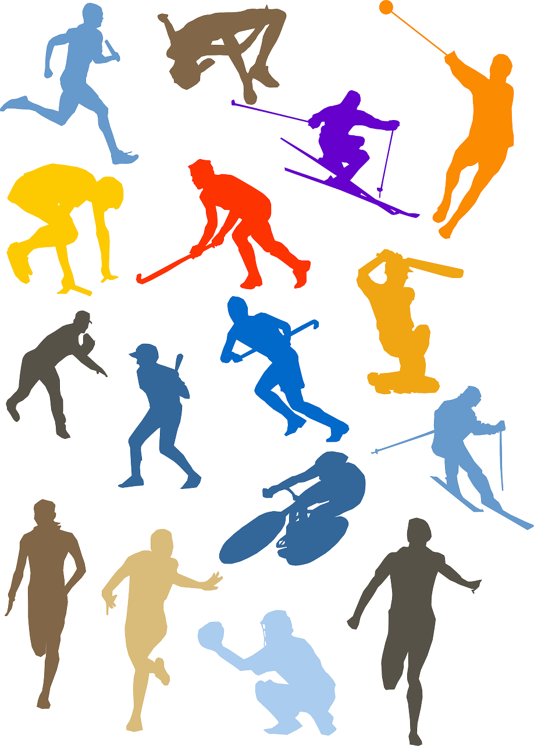






Slide 9
WATER SPORTS | WINTER SPORTS | OTHER SPORTS
TENNIS
ICE HOCKEY
SAILING
SWIMMING
CYCLING
BOXING
SKIING
WATER POLO
WINDSURFING
SNOWBOARDING
HANDBALL
ICE SKATING

Slide 10
Sławomir Szmal
Andrzej Gołota
Agnieszka Radwańska
Otylia Jędrzejczak
Mateusz Kusznierewicz
Robert Lewandowski
Justyna Kowalczyk
Kamil Stoch

Slide 11
Agnieszka
Radwańska
Otylia Jędrzejczak
Justyna
Kowalczyk
can
play handball.
swim.
play tennis.
sail.
ski.

Slide 12
Andrzej Gołota
Mateusz
Kusznierewicz
Robert Lewandowski
is good at
playing football.
boxing.
sailing.
cycling.
winsurfing.
skiing.

Slide 13
tennis
sailing
swimming
ski jumping
boxing
skiing
football
handball

Slide 14
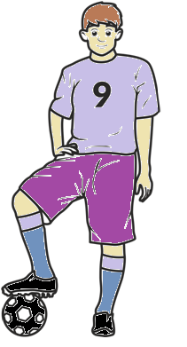
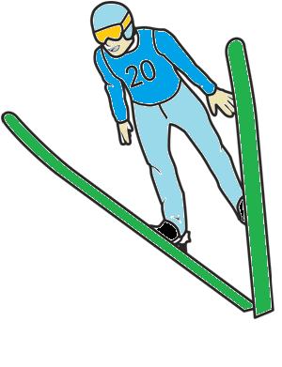
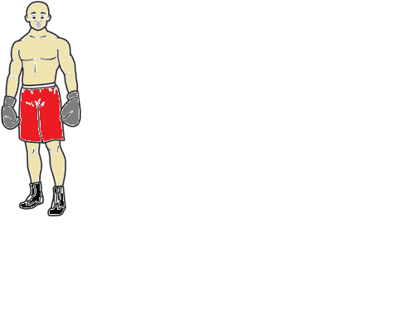
Hello!
I’m a football player.
I have to eat about 5000 calories a day.
I eat five meals a day.
I eat lots of vegetables and fruit.
I never eat a lot of sweets.
Hello!
I’m a boxer.
I have to eat about 5000 calories a day.
I eat 7 meals a day.
I eat lots of dairy products .
I sometimes eat sweets.
Hello!
I’m a ski jumper.
I have to eat about 1500 calories a day.
I eat four meals a day.
I eat lots of vegetables.
I never eat sweets.

Slide 15
Exercise 1
There are 32 sportsmen. Half of them will take part in cycling events. Eight of them will take part in a tennis tournament.
How many sportsmen will take part in a handball match?
Fill in the diagram.
Name of game

