Slide 1

klasa II
moduł 21
INVENTIONS
PI Synergia początkowej nauki języka obcego z edukacją wczesnoszkolną i technologiami informacyjno-komunikacyjnymi.
Projekt współfinansowany przez Europejski Fundusz Społeczny w ramach Programu Operacyjnego Kapitał Ludzki.
Priorytet III Wysoka jakość systemu oświaty, Działanie 3.3 Poprawa jakości kształcenia, Poddziałanie 3.3.4 Modernizacja treści i metod kształcenia – projekty konkursowe.

Slide 2
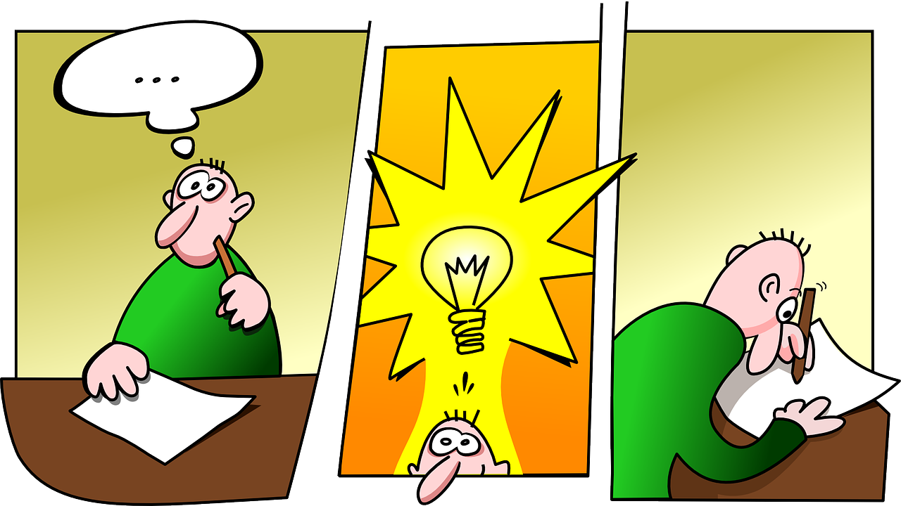

Slide 3
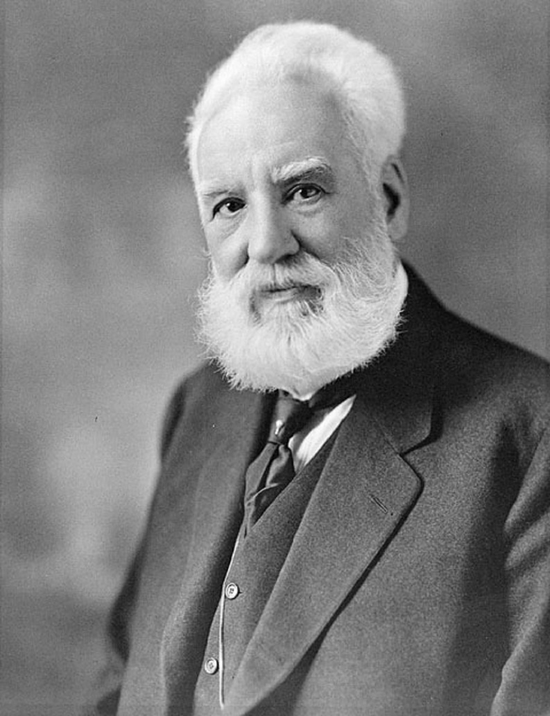
Ktoś, kto projektuje lub wymyśla nowe rzeczy.
Inventor
(wynalazca)
Alexander Graham Bell

Slide 4
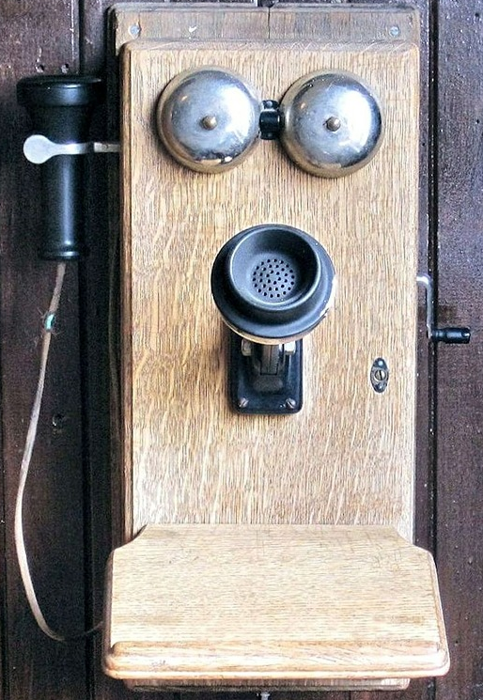
Coś, co zostało zaprojektowane lub wymyślone po raz pierwszy.
Invention
(wynalazek)
Telephone

Slide 5
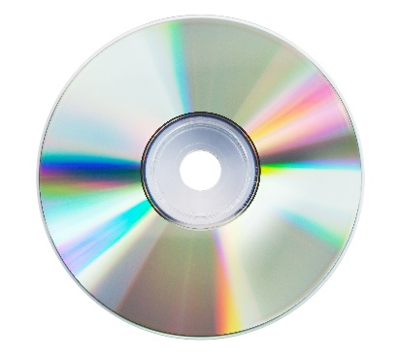
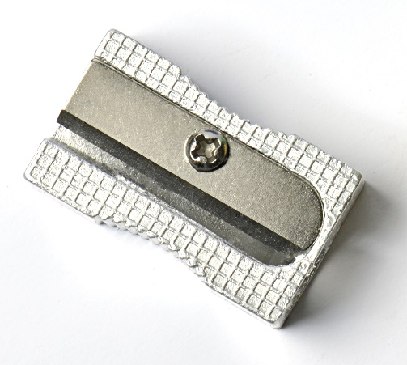
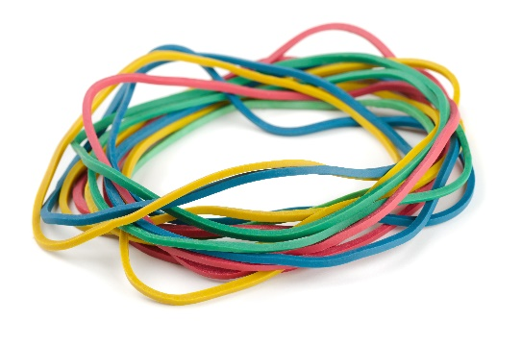
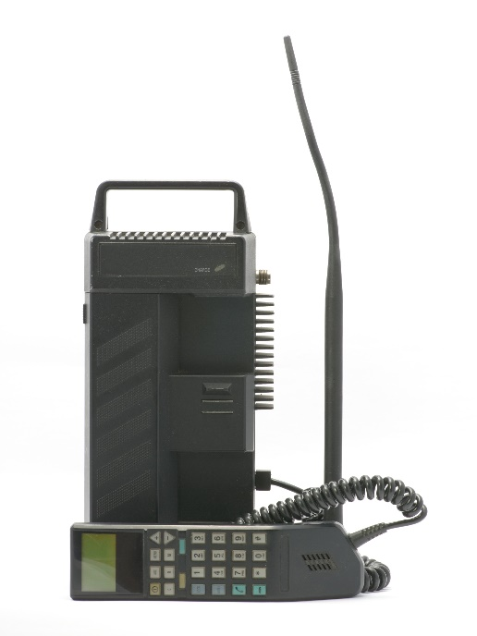
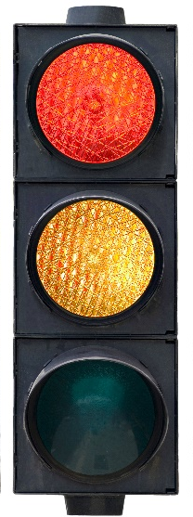
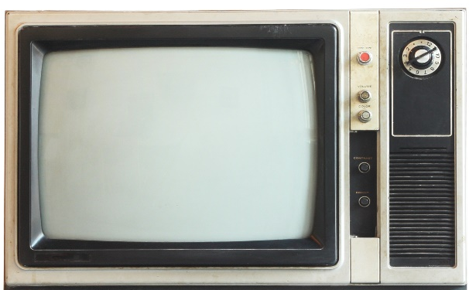
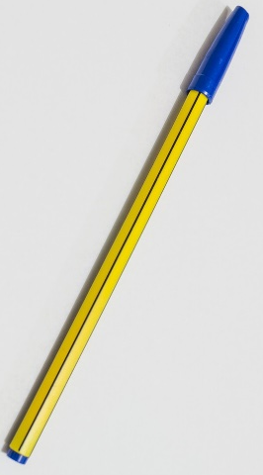

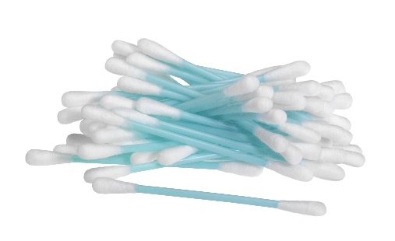
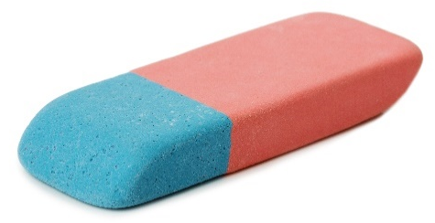
a CD
rubber bands
a sharpener
a cell phone
a traffic light
a TV
a pen
Post- it stickers
cotton swabs
a rubber

Slide 6
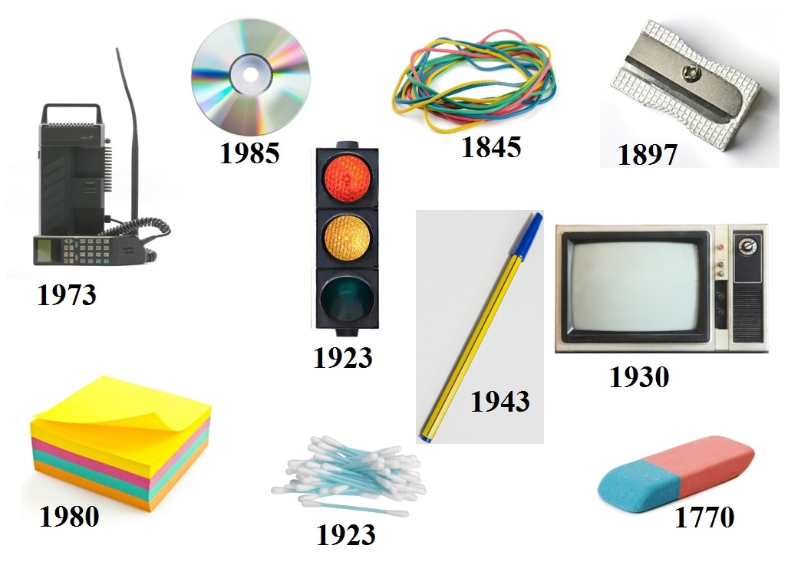

Slide 7
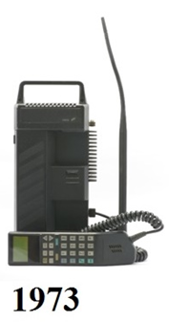
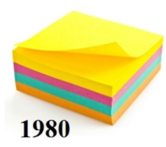
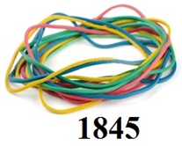
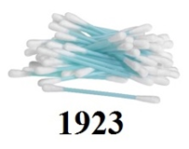
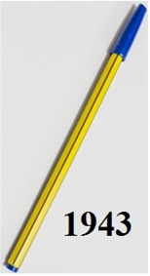

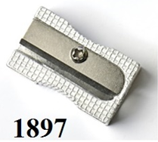
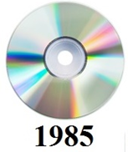
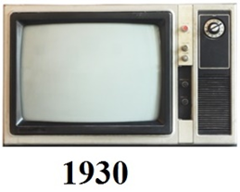
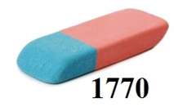
Timeline
2015

Slide 8
Inventions Quiz
This thing was invented by
a. Martin Cooper
b. Garrett Morgan
c. Philo Taylor Farnsworth
This thing was invented in
a. 1930
b. 1923
This is ………………....…………… .
We usually use it …………………………………………………………………....................... .
c. 1985

Slide 9
Inventions Quiz
This thing was invented by
a. Leo Gersenzang
b. James T. Russel
c. Martin Cooper
This thing was invented in
a. 1973
b. 1770
This is ………………....…………… .
We usually use it …………………………………………………………………....................... .
c. 1897

Slide 10
Inventions Quiz
This thing was invented by
a. Stephen Perry
b. Laszlo Biro
c. Arthur Fry & Spencer Silver
This thing was invented in
a. 1980
b. 1943
These are …………....…………… .
We usually use those …………………………………………………………………....................... .
c. 1845

Slide 11
Inventions Quiz
This thing was invented by
a. Philo Taylor Farnsworth
b. James T. Russell
c. Joseph Priestley
This thing was invented in
a. 1770
b. 1930
This is ………………....…………… .
We usually use it …………………………………………………………………....................... .
c. 1943

Slide 12
Inventions Quiz
This thing was invented by
a. Martin Cooper
b. John Lee Love
c. Arthur Fry & Spencer Silver
This thing was invented in
a. 1980
b. 1897
These are …………....…………… .
We usually use those …………………………………………………………………....................... .
c. 1985

Slide 13
Inventions Quiz
This thing was invented by
a. Garrett Morgan
b. John Lee Love
c. Laszlo Biro
This thing was invented in
a. 1923
b. 1845
This is ………………....…………… .
We usually use it …………………………………………………………………....................... .
c. 1897

Slide 14
Inventions Quiz
This thing was invented by
a. Leo Gersenzang
b. Joseph Priestley
c. Stephen Perry
This thing was invented in
a. 1973
b. 1923
These are …………....…………… .
We usually use those …………………………………………………………………....................... .
c. 1943

Slide 15

Inventions Quiz
This thing was invented by
a. Martin Cooper
b. Leo Gersenzang
c. Laszlo Biro
This thing was invented in
a. 1923
b.1943
This is ………………....…………… .
We usually use it …………………………………………………………………....................... .
c. 1930

Slide 16

Inventions Quiz
This thing was invented by
a. Stephen Perry
b. Joseph Priestley
c. Arthur Fry & Spencer Silver
This thing was invented in
a. 1770
b. 1845
This is ………………....…………… .
We usually use it …………………………………………………………………....................... .
c. 1897

Slide 17
Inventions Quiz
This thing was invented by
a. Laszlo Biro
b.Johne Lee Love
c. James T. Russell
This thing was invented in
a. 1985
b. 1930
This is ………………....…………… .
We usually use it …………………………………………………………………....................... .
c. 1945

Slide 18
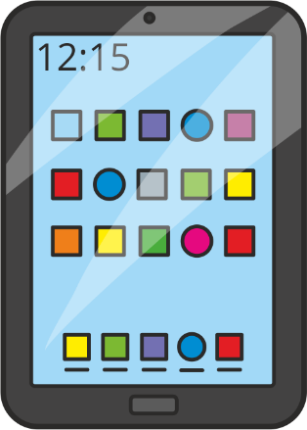


Invention’s Evolution
a computer a laptop a pad

Slide 19


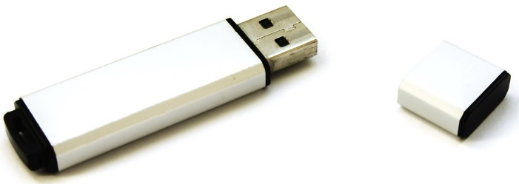
Invention’s Evolution
a floppy disk a CD pendrive

Slide 20
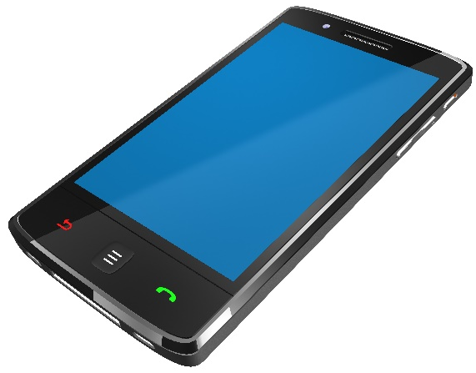
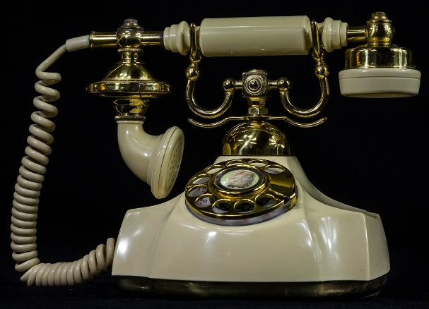
Invention’s Evolution
a telephone a cell phone a smartphone

Slide 21


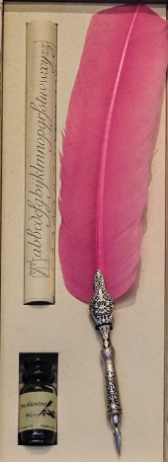

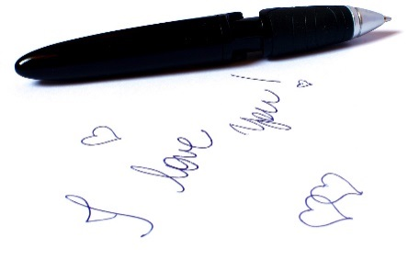
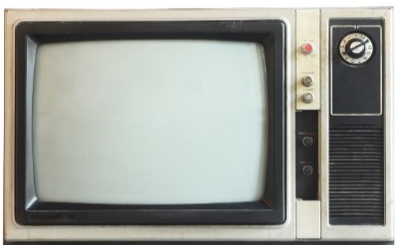


Then | Now

