Slide 1

klasa II
moduł 12
I FEEL
PI Synergia początkowej nauki języka obcego z edukacją wczesnoszkolną i technologiami informacyjno-komunikacyjnymi.
Projekt współfinansowany przez Europejski Fundusz Społeczny w ramach Programu Operacyjnego Kapitał Ludzki.
Priorytet III Wysoka jakość systemu oświaty, Działanie 3.3 Poprawa jakości kształcenia, Poddziałanie 3.3.4 Modernizacja treści i metod kształcenia – projekty konkursowe.

Slide 2

EMOTIONS
WHAT DOES IT MEAN?

Slide 3
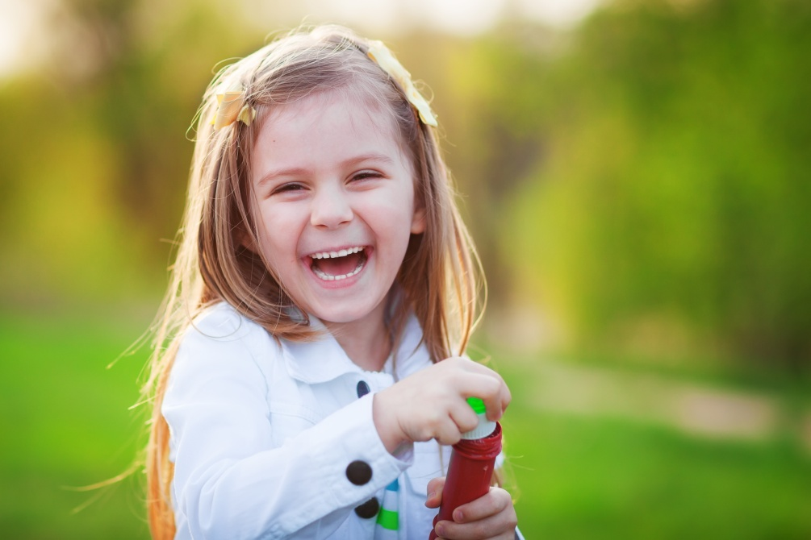
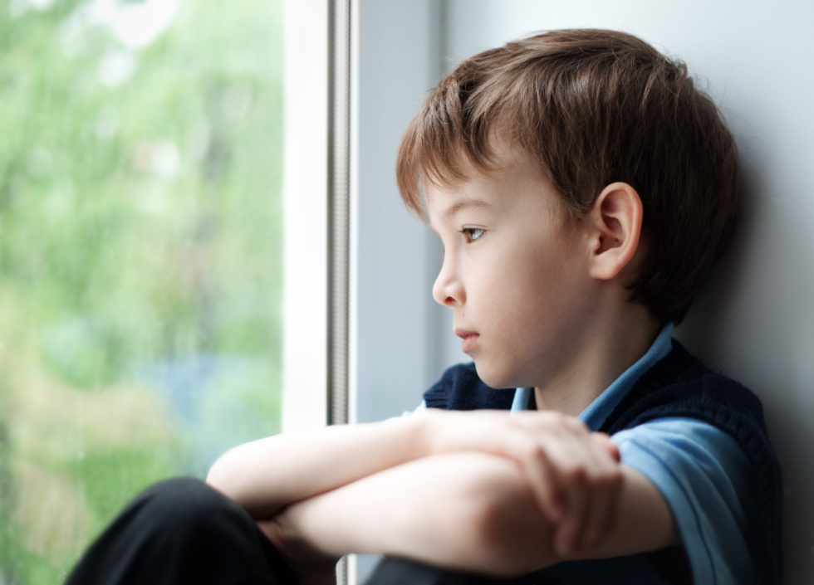
HOW CAN PEOPLE FEEL?
She is happy.
He is sad.

Slide 4
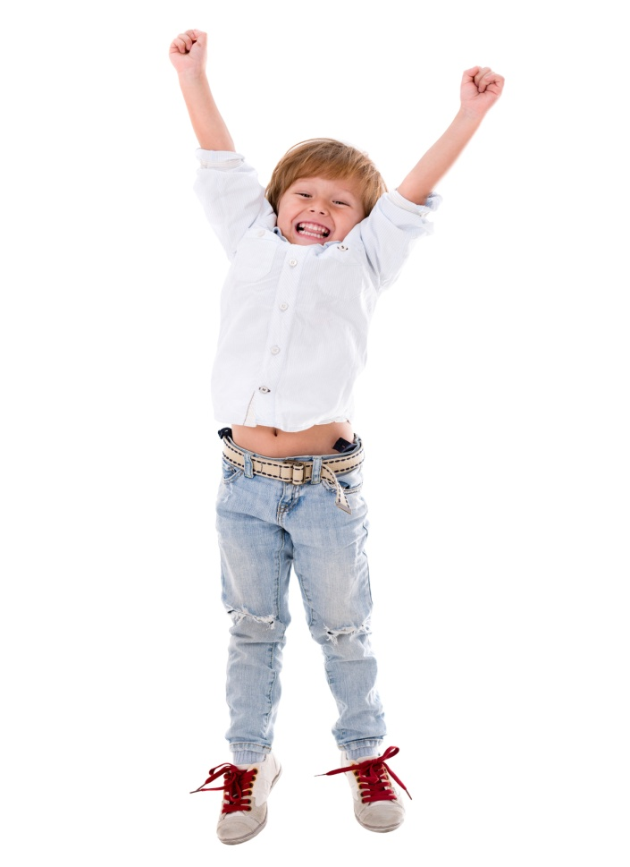
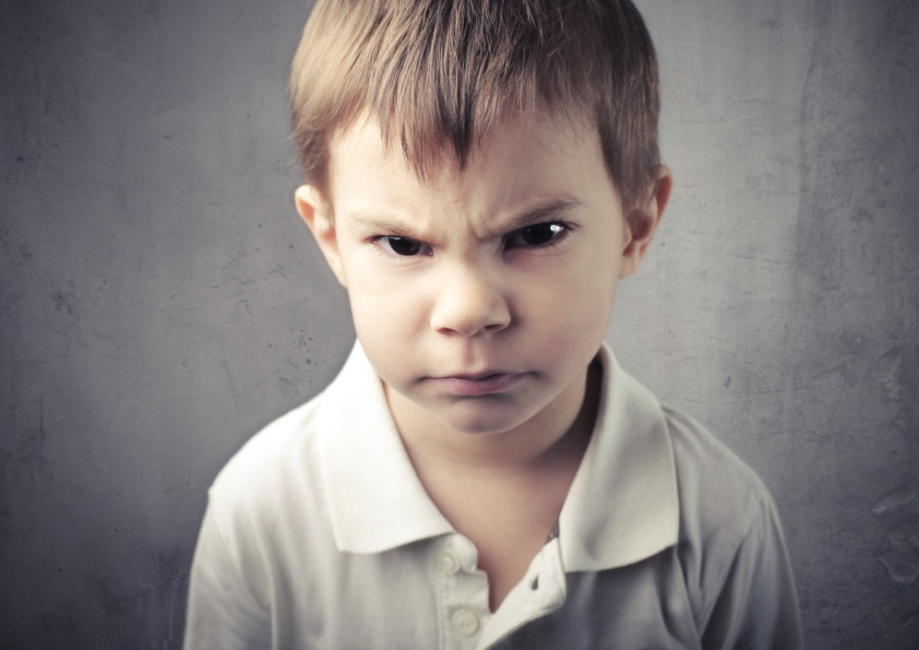
HOW CAN PEOPLE FEEL?
He is angry.
He is excited.

Slide 5

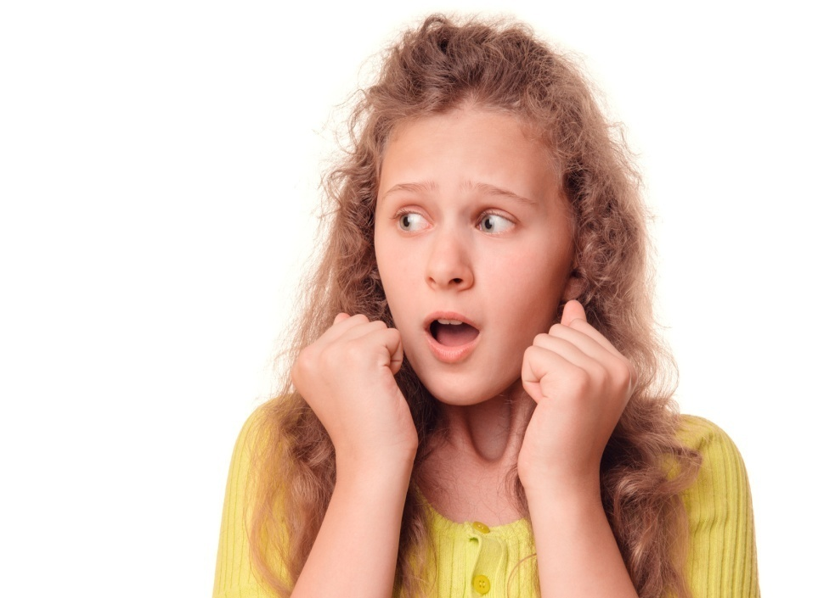
HOW CAN PEOPLE FEEL?
She is scared.
She is ashamed

Slide 6

I’m angry.
I’m sad.

Slide 7
I’m scared.
I’m sad.

Slide 8
I’m excited.
I’m scared.

Slide 9
I’m sad.
I’m ashamed.

Slide 10
I’m excited.
I’m scared.

Slide 11
I’m happy.
I’m scared.

Slide 12
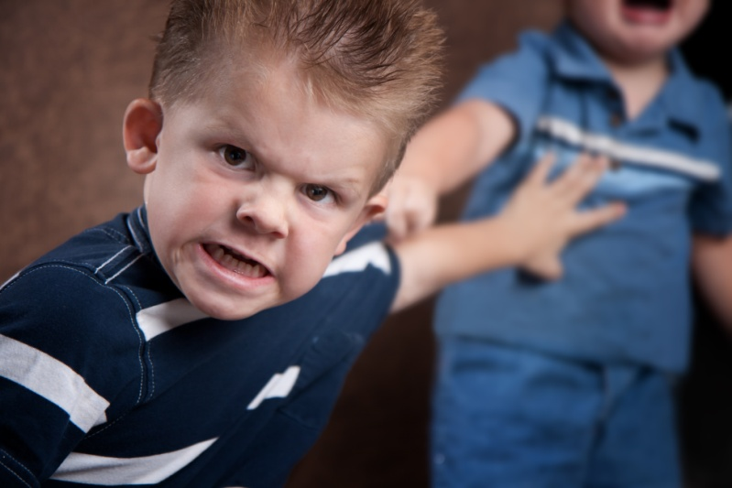
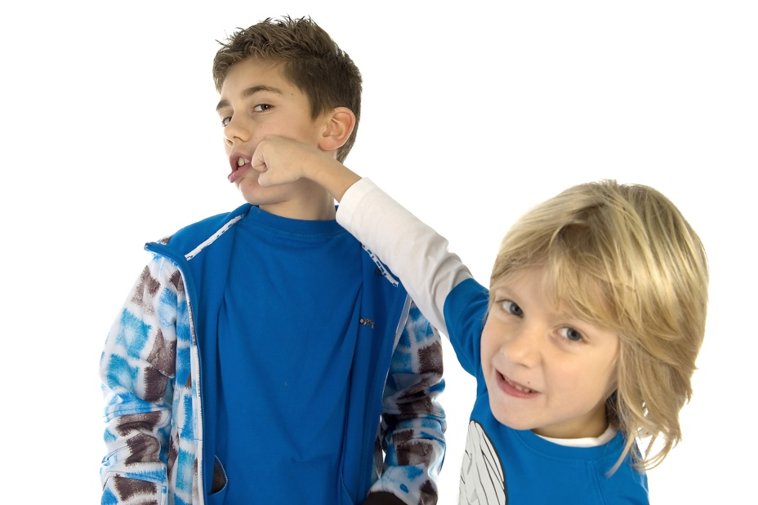
How do they feel?
He is pushing his friend.
He is hitting his friend.
PUSH
HIT
excited
happy
scared
ashamed
angry
sad

Slide 13
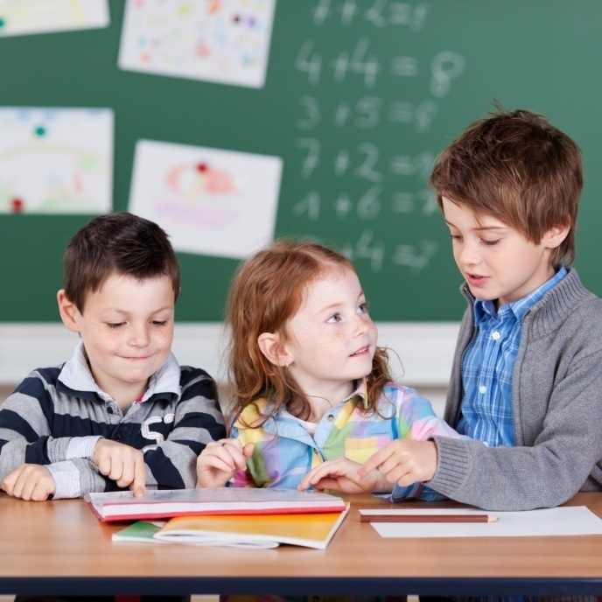
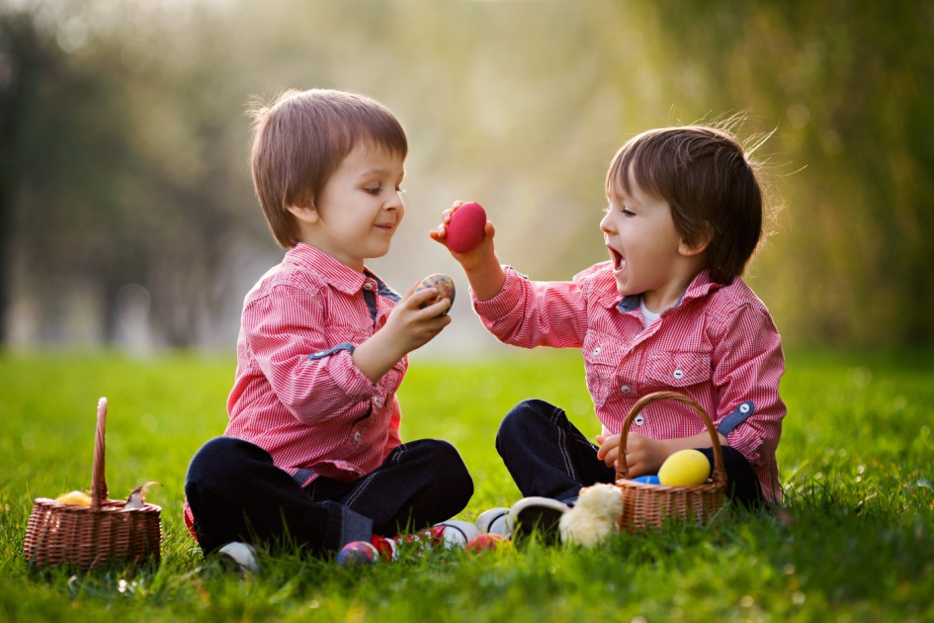
How do they feel?
He is sharing with his friend.
They are working together.
WORK TOGETHER
SHARE WITH
excited
happy
scared
ashamed
angry
sad

Slide 14


How do they feel?
He is lending a book.
She is helping her friend.
LEND
HELP
excited
happy
scared
ashamed
angry
sad

Slide 15
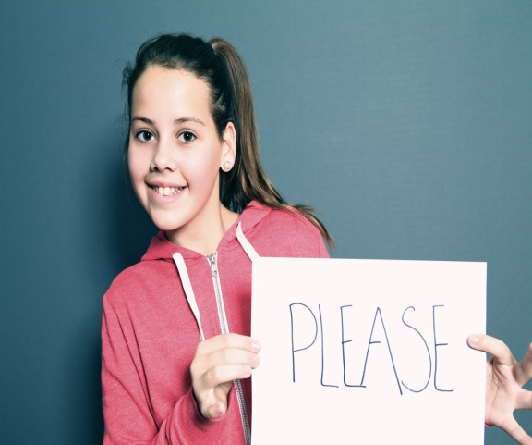
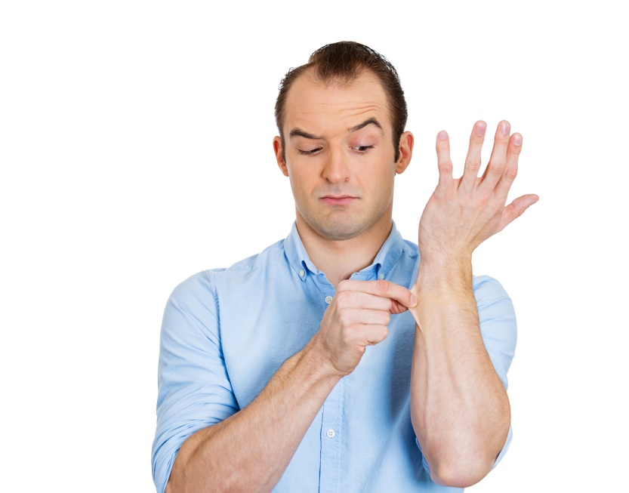

How do they feel?
He is pinching.
They are saying please an thank you.
PINCH
SAY PLEASE AND THANK YOU
excited
happy
scared
ashamed
angry
sad

Slide 16
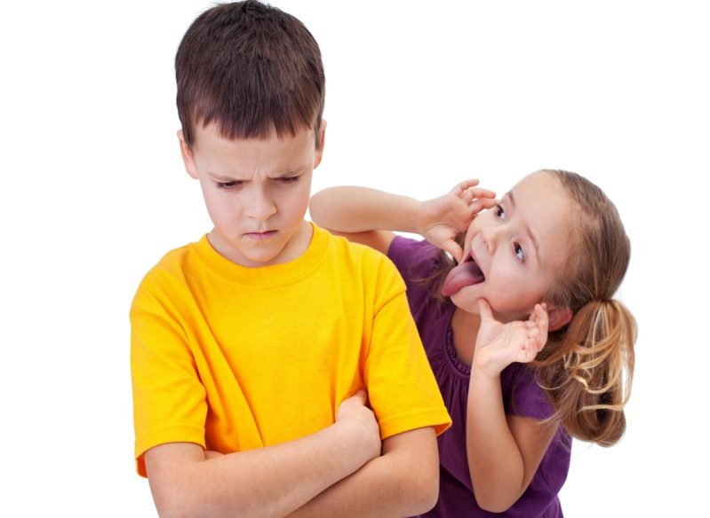
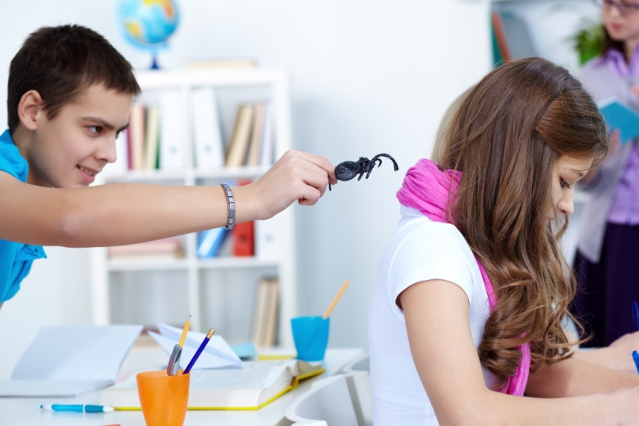
How do they feel?
He is playing tricks on his friend .
She is laughing at her friend.
LAUGH
PLAY TRICKS ON
excited
happy
scared
ashamed
angry
sad

Slide 17


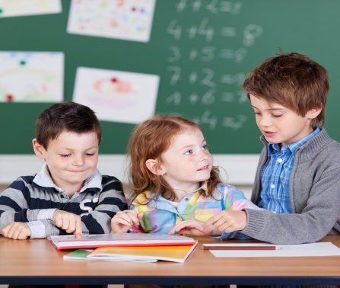
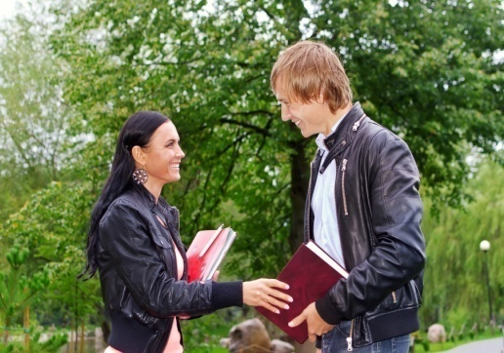

WORK
TOGETHER
LEND
SHARE WITH
SAY THANK YOU
HELP

Slide 18





PINCH
PUSH
HIT
LAUGH
PLAY TRICKS ON

Slide 19
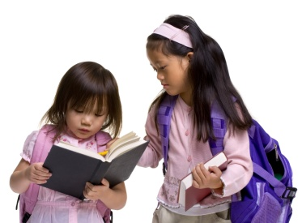




DO!
DON’T

Slide 20
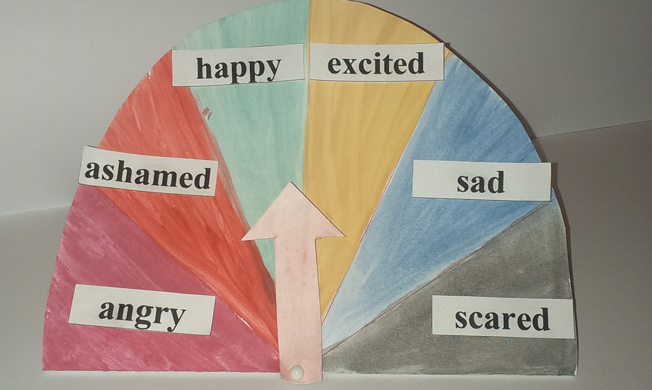
CREATIVE CORNER

