Slide 1







CHALLENGES OF TEACHER EDUCATION
IN POLAND
Project Bilingual education. MA in teaching English to young learners as a second and foreign language co-financed by the European Union under the European Social Fund
Prof. Małgorzata Żytko
University of Warsaw
Faculty of Education
e-mail: mzytko@uw.edu.pl

Slide 2
Project Bilingual education. MA in teaching English to young learners as a second and foreign language co-financed by the European Union under the European Social Fund
Overview of the presentation
1. Teachers’ models of teaching
2. Teacher profession-challenges
3. Possible solutions.

Slide 3
Project Bilingual education. MA in teaching English to young learners as a second and foreign language co-financed by the European Union under the European Social Fund
Teachers’ models of teaching
Skillful follower
Open to dialogue with students
Reflective practitioner
Transformation protagonist G.Evert (1993), M. Lewartowska- Zychowicz (2009)

Slide 4
Adapts to imposed school reality
Thoroughly carries out given tasks
Follows well established goals and methods
Perceives students as object of implementing procedures and expecting results
Cog in a machine
Project Bilingual education. MA in teaching English to young learners as a second and foreign language co-financed by the European Union under the European Social Fund
Skillful follower

Slide 5
Project Bilingual education. MA in teaching English to young learners as a second and foreign language co-financed by the European Union under the European Social Fund
Open to dialogue with students
Interprets knowledge with students
Resigns from his/her only truth
Creates opportunity to think and waits for students’ ideas
Looks for challenging educational situation
H.G. Gadamer (1980)

Slide 6
Project Bilingual education. MA in teaching English to young learners as a second and foreign language co-financed by the European Union under the European Social Fund
Reflective practitioner
Analyses and evaluates his/her educational experience
Is ready to modify his/her action and draw conclusions
Stimulates students to work independently and be successful
Is able to perceive educational tradition in critical way
Is able to be a partner to students
          D.A. Schön (1983)

Slide 7
Project Bilingual education. MA in teaching English to young learners as a second and foreign language co-financed by the European Union under the European Social Fund
TRANSFORMATION PROTAGONIST
Actively participates in education and promotes democratic values
Ready to react to negative phenomena
Prepares students to be critical reviewers
Perceives school as basis for change
H. A.Giroux (1983)

Slide 8
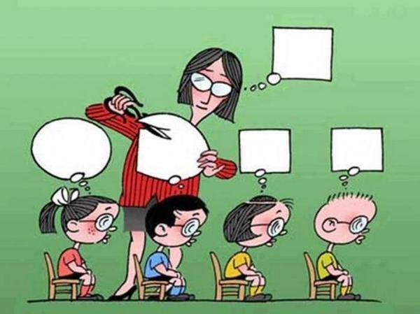
Which model of teacher identity is most popular at school?

Slide 9
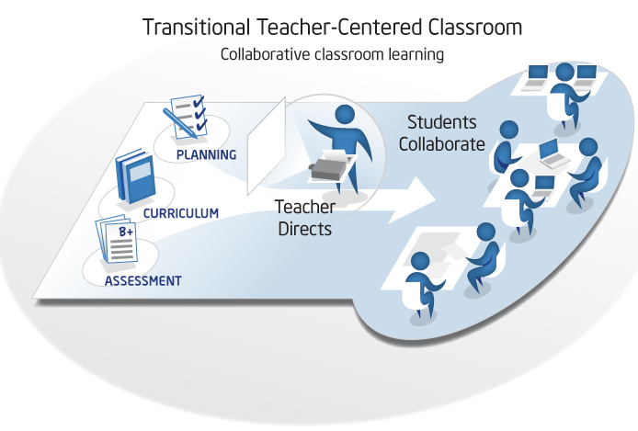

Slide 10
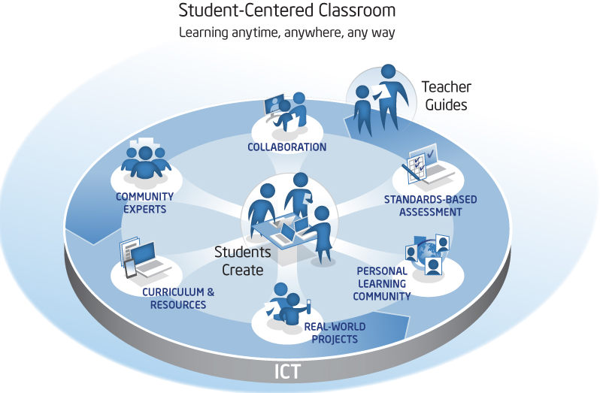
Which model of teacher identity is expected by modern democratic state?

Slide 11
Project Bilingual education. MA in teaching English to young learners as a second and foreign language co-financed by the European Union under the European Social Fund
UNIVERSITY LEVEL EDUCATION
Two-tier study
Bachelor’s degree
Master’s degre
Teachers who hold a higher education diploma (Bachelor’s or Master’s degree) represent 97% of all teachers working (with vast majority - 92%, holding a Master’s degree).

Slide 12
Project Bilingual education. MA in teaching English to young learners as a second and foreign language co-financed by the European Union under the European Social Fund
TEACHER EDUCATION STANDARDS
are formulated in the new regulation by Ministry of Science and Higher Education of 2012 on training standards for the teaching profession.

Slide 13
Project Bilingual education. MA in teaching English to young learners as a second and foreign language co-financed by the European Union under the European Social Fund
MAIN PROBLEMS
Rise in number of students during the last decade
( doubled compared with pre-1999)
New phenomenon – wider access but lower quality
Unexpected results:
– devaluation of higher education
- difficulty in finding a job for graduates

Slide 14
Theory and practice in teacher education
The new trend to increase the role of practical training
Closer link between university and school,
Stronger tie with school teachers as tutors of students
Emphasis put on team work and cooperation between teachers, pupils, parents, local community

Slide 15
Project Bilingual education. MA in teaching English to young learners as a second and foreign language co-financed by the European Union under the European Social Fund
Career path
Pursuant to the Teachers’ Charter teachers can obtain the following professional promotion grades:
a trainee teacher
a contract teacher
an appointed teacher
a chartered teacher

Slide 16
Project Bilingual education. MA in teaching English to young learners as a second and foreign language co-financed by the European Union under the European Social Fund
Teaching profession –challenges
  Low social and financial status
  Bureaucratic control
  Hierarchical system
  Accountability (curriculum, syllabus, students’ grades, exams)

Slide 17
Project Bilingual education. MA in teaching English to young learners as a second and foreign language co-financed by the European Union under the European Social Fund
Teaching profession –challenges
Lack of autonomy
Lack of trust between the various stakeholders of the educational process: teachers, students, parents, educational authorities.

Slide 18
Project Bilingual education. MA in teaching English to young learners as a second and foreign language co-financed by the European Union under the European Social Fund
Possible solutions
Inspiring teachers (pre-service and in-service) with new ideas and concepts
Long - term support for the interested teachers, regular contact with experts and mentors
Establishing cooperation between school teachers

Slide 19
Project Bilingual education. MA in teaching English to young learners as a second and foreign language co-financed by the European Union under the European Social Fund
Supporting critical thinking about educational tradition and model
Stimulating cooperation, encouraging teachers’ own ideas
Transforming school into learning institution, not only for students but also for teachers and parents,

Slide 20
Project Bilingual education. MA in teaching English to young learners as a second and foreign language co-financed by the European Union under the European Social Fund
THANK YOU FOR YOUR ATTENTION

